Slide 1
Cover option 4
Jo Astley
University of Derby
Embedding the NERUPI framework in your APP
24 May 2022

Slide 2
Main body option 1 white background
NERUPI and the APP
Why NERUPI then (the first round)?
Why NERUPI now?
Next steps for Derby

Slide 3
Main body option 1 white background
Why NERUPI? -Then
February 2018
OfS, APPs and NERUPI
Theory of Change and a theory/evidence based framework
Informing practice, strategy and APPs
Responding to policy and the requirements of network members

Slide 4
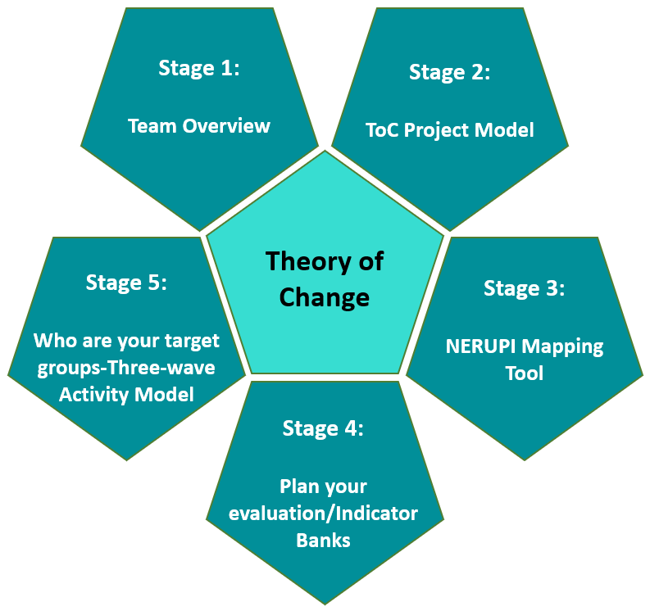
Main body option 1 white background
UoD Theory of Change 5 stage model

Slide 5
Main body option 1 white background
And now – ‘variations’, rewrites and practice
Evaluation remains his ‘highest priority’ (2022)
The development of an ‘eco-system of evidence-based practice’ (2022)
Expectation that ‘review and enquiry’ against APP activity is approached ‘like any academic endeavour and area of study’ (2022)
John Blake TASO Conference 2022
John Blake TASO Conference 2022

Slide 6
Main body option 1 white background
And now – ‘variations’, rewrites and practice
Focus on schools and on attainment
‘Marking our own homework’ (2022)
TASO
NERUPI - ‘Intermediate’ middle ground – evidencing the steps to achieving increased attainment
John Blake TASO Conference 2022

Slide 7
Main body option 1 white background
Next steps for Derby
Await the new APP guidance and work on our variations submission
But in the mean time………….

Slide 8
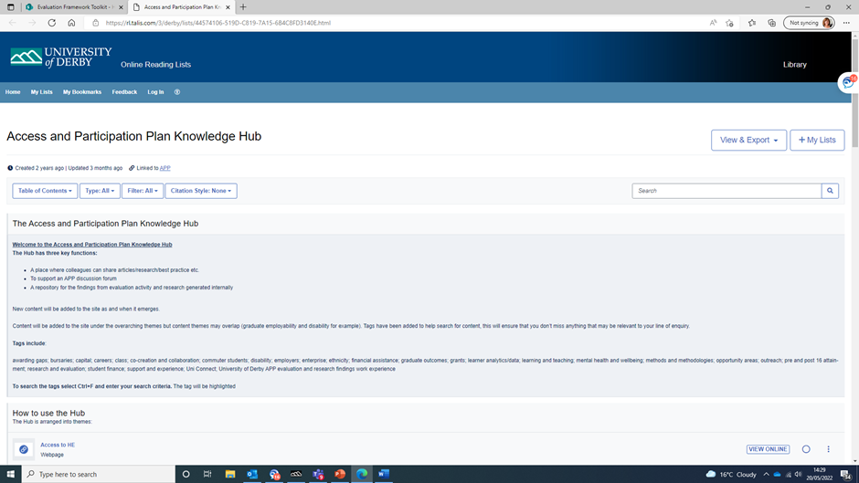
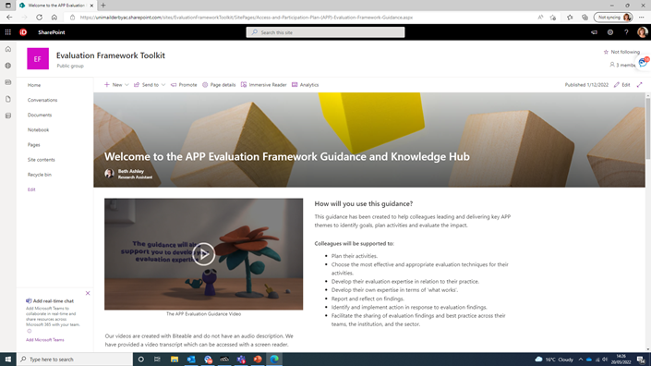
Main body option 1 white background
Next steps for Derby
Focus on intermediate outcomes that lead to attainment
continue to build our evidence bank to inform SMs and our delivery
Increase colleagues engagement with our APP evaluation/guidance/Knowledge Hub and NERUPI
Make the most of everything that NERUPI has to offer

Slide 9
Thank you and contact details
University of Derby, Kedleston Road, Derby, DE22 1GB
T +44 (0)1332 591044 E opendays@derby.ac.uk

