Slide 1

Collaborative Outreach to Support Student Choice
Rebecca Harland – Monitoring and Evaluation Officer

Slide 2
Overview
Local Context
The NERUPI Framework and Student Choice
The ‘Mock Open Day’: A Collaborative Intervention
Evaluation

Slide 3
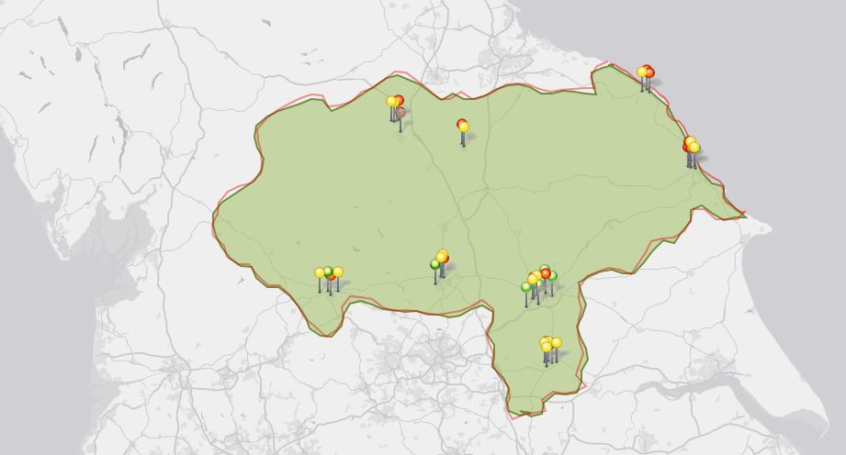
NCOP York & North Yorkshire (FutureHY)
10 Target Wards
3 Universities
6 FE Colleges with HE
Over 3,000 square miles!
Partner Institutions
Schools
Community
Activity
Notes:
Data shows there are 2780 NCOP learners
10 wards

Slide 4
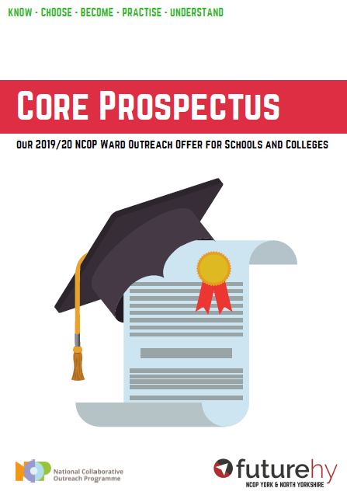
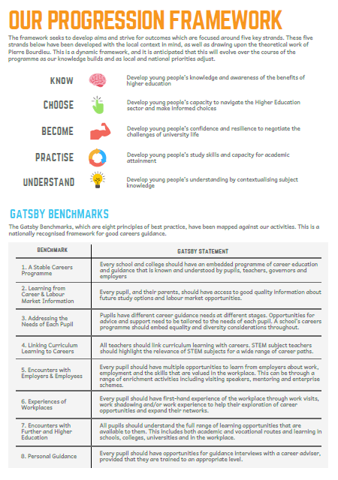
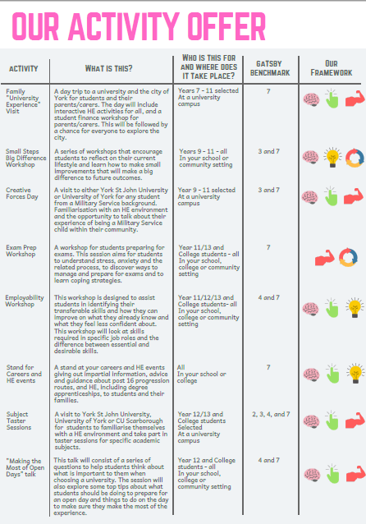
NCOP York & North Yorkshire (FutureHY)

Slide 5
The NERUPI Framework and Student Choice
“The process of choosing and applying to an undergraduate degree requires a highly sophisticated understanding between school subjects, undergraduate degrees, type of HEI and potential careers”.
(Hayton, 2018, p.44).
CHOOSE: Develop students' capacity to navigate higher education and graduate employment sectors and make informed choices
(NERUPI, 2019).

Slide 6
The NERUPI Framework and Student Choice
NERUPI ‘Choose’ at Level 3:
Enable students to…
Evaluate course, student finance and graduate opportunities and make informed choices that align with personal interests and career aspirations
Evaluate different types of higher education institution in terms of personal interests and career aspirations
Compare degree courses and study options across a range of universities
Engage effectively with the UCAS process and generate and submit a strong university application
Compare student finance, budgeting support and student employment opportunities across a range of universities

Slide 7

The Mock Open Day
Notes:
Online booking system to mirror Open Days
Transport – Rail tickets for students in rural areas/schools with lower sign-up rates

Slide 8
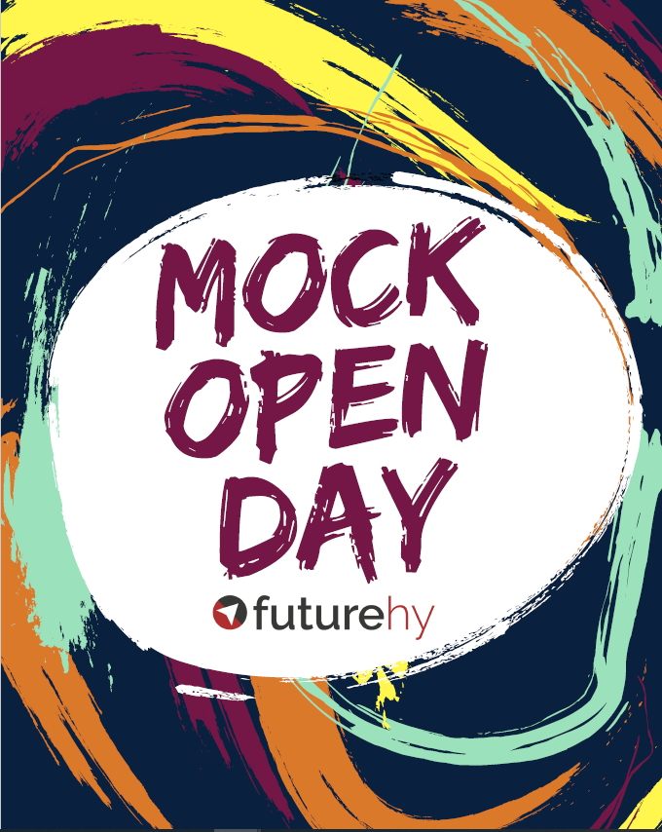
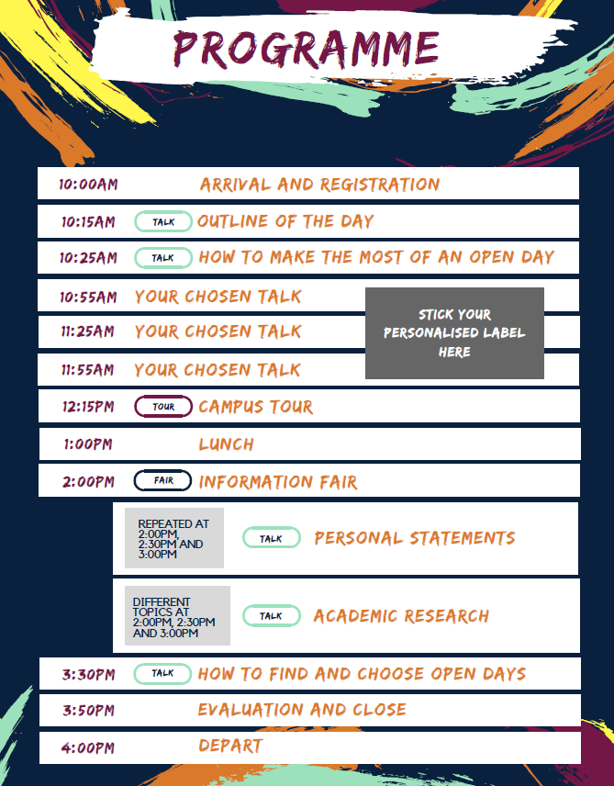
The Mock Open Day
Talk Options (choose 3 of 4):
What to Expect at Uni
Student Life
Student Finance and Budgeting
Accommodation
Notes:
Approx. 100 attendees from 10 institutions (FE colleges and school sixth forms)

Slide 9
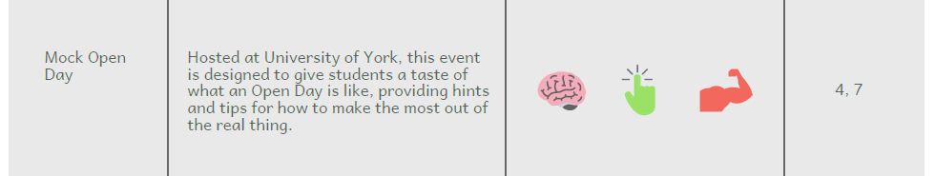

The Mock Open Day – NERUPI & Gatsby
KNOW
CHOOSE
BECOME
Gatsby 4: Linking curriculum learning to careers
Gatsby 7: Encounters with further and higher education

Slide 10
The Mock Open Day & Our Progression Framework
Notes:
HANDOUT

Slide 11

The Mock Open Day & Our Progression Framework
The FutureHY Progression Framework Level 3:
Know
Discover course and placement opportunities in Higher Education
Find out about research areas, expertise and facilities in Higher Education and new areas of development
Explore social and leisure, and extra-curricular opportunities in Higher Education
Find out about academic and information services, facilities and resources
Choose
Evaluate different types of Higher Education Institution in terms of personal interests and career aspirations
Compare degree courses and study options across a range of universities
Compare student finance, budgeting support and student employment opportunities across a range of universities
Become
Gain a positive first-hand experience of student life and a university environment
Become familiar with learning and teaching approaches in Higher Education
Engage with academic and personal support mechanisms
Interact with academic staff and other university employees
Interact with other students on programme, Student Ambassadors and current students
Access the information, advice & guidance they need to make a successful transition to HE

Slide 12
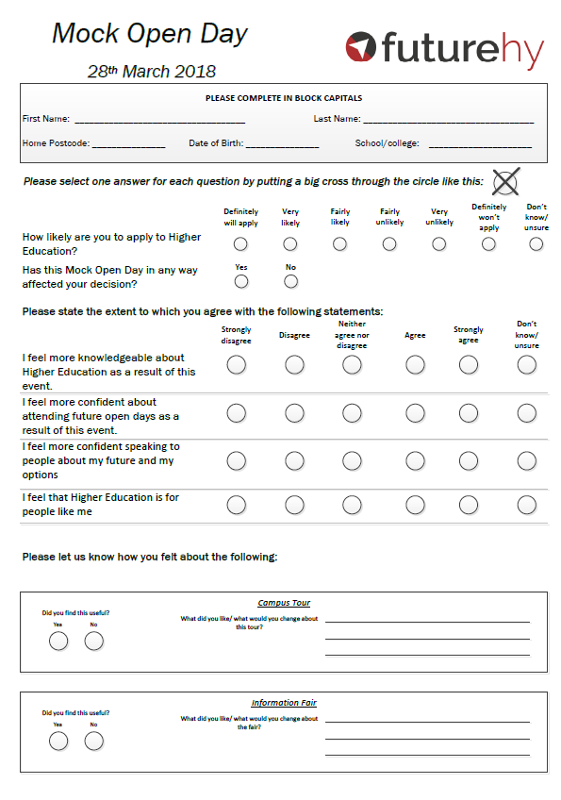
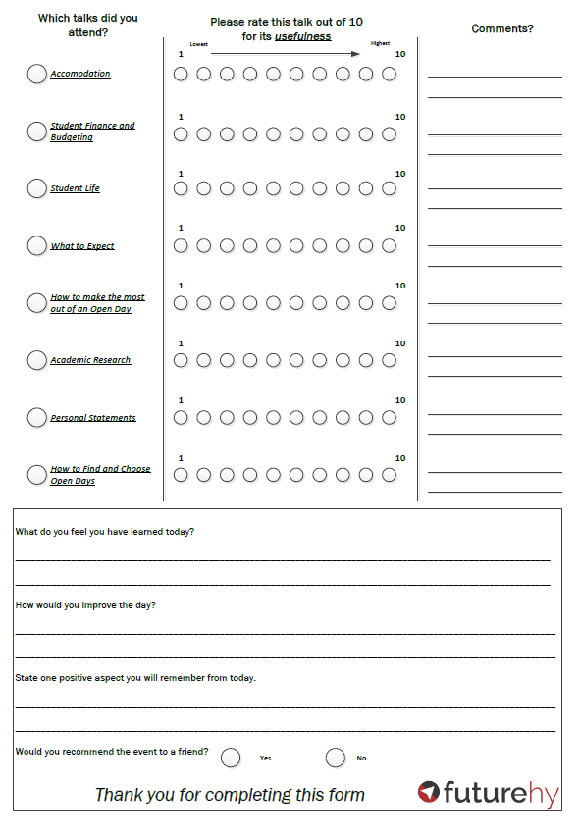
The Evaluation
Post-intervention form for participants and their teachers.

Slide 13
The Evaluation - Outcomes
Notes:
Just over 1/3 ‘Definitely will apply’
30% Very Likely
27% Fairly Likely
1.5% Definitely wont

Slide 14
The Evaluation - Outcomes
Notes:
9.5 Finance and Budgeting
9.25 How to find and choose an Open Day
9 Accommodation
9.3 How to make the most out of an Open Day

Slide 15
The Evaluation - Outcomes

Slide 16
Reflections on the Evaluation Process
Scope to better align the evaluation questions with the outcomes on the progression framework
Potential to add qualitative element to capture any unexpected outcomes and to add narrative to our reporting
Is it feasible to add a pre-intervention measure?

Slide 17
Any Questions?

Slide 18
Activity
Discuss in groups:
What interventions do or would you like your organisation to offer that enable students to build their capacity to make informed choices?
What challenges do you face in developing and delivering these types of activities? How do you overcome these challenges?
Notes:
Examples of challenges:
Institutional recruitment pressure
Our collaborative challenges – logistics and recruiting the students who would potentially benefit the most

Slide 19
References
FutureHY (2019) Our Evaluation Model [Online]. Available at: https://www.futurehy.co.uk/about/evaluation/ (Accessed 13 January 2020).
Hayton, A. (2018) NERUPI: A praxis-based framework. In Burke, P.J., Hayton, A. & Stevenson, J. (Eds.) Evaluating Equity and Widening Participation in Higher Education (pp.33-58). London: UCL Institute of Education Press.
NERUPI (2019) Framework: Version 20 (2019-20) [Online]. Available at: http://www.nerupi.co.uk/members/resources/nerupi-framework-for-levels-five-and-six-student-success-progression (Accessed 14 January 2020).

