Slide 1


IntoUniversity and the Geography of Need
Eilis O’Donnell
Director of Programmes and Delivery
June 2023
Registered Charity Number 1118525 (England and Wales) SC049776 (Scotland). Company Registration Number 6019150.

Slide 2
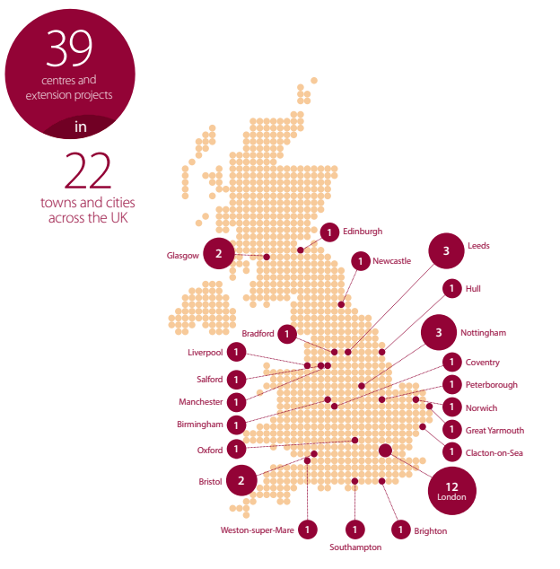
IntoUniversity
IntoUniversity provides local learning centres where young people are inspired to achieve.
2002
Piloted programmes in North Kensington.
2007
Launched as a registered charity, first scale-up plan to six centres.
2011
Secured first university partnerships, launching centres outside London.
2021
Launched in Scotland.
2023
Operating 39 local centres in 22 towns and cities.
DISCOVERING FOCUS | REALISING POTENTIAL | SHAPING THE FUTURE
TALENT | QUALITY | COMPASSION | ASPIRATION | TEAMWORK
Notes:
IntoUniversity, we provide local learning centres where young people are inspired to achieve. We provide crucial academic and pastoral support, where young people need it, close to home.
IntoUniversity initially began supporting young people in the North Kensington community with their schoolwork.
In 2007, we became a registered charity and started scaling up, rolling out new centres in high-need London communities.
In 2011 IntoUniversity set up our first university partnerships and launched our first centres outside London in Bristol and Nottingham.
In 2021, through a ground-breaking collaboration with the Universities of Edinburgh and Glasgow, we opened three centres in Scotland: two in Glasgow and one in Edinburgh.
We now operate 39 centres in 18 towns and cities across England and Scotland. Our next milestone is reaching 50 centres by 2026.
Phases that IU has been through – big jumps for the charity. Incubating idea, national network, national contribution particularly in very challenging areas in which to work. We’re now a major contributor to helping social mobility crisis in the UK.

Slide 3

What makes us distinctive
Neighbourhood-based centres at the heart of communities
All talents, all abilities: achieving a progression to HE rate of 68%
Scalable model to reach social mobility cold spots
Rigorous impact measurement
Early and sustained, long-term interventions; programmes for Primary and Secondary students
TALENT | QUALITY | COMPASSION | ASPIRATION | TEAMWORK
Notes:
Neighbourhood-based: Centres are based at the heart of communities, allowing us to forge strong relationships with families and create local traditions of success.
No academic criteria: We believe in the talent of every young person, and do not limit our support to those who have been labelled ‘bright’ or ‘gifted’.
Progression - 68% compared to 41% nationally and 26% FSM
Scalable model to reach social mobility cold spots: We can scale rapidly and effectively to address need in educational and social mobility cold spots.
Rigorous impact measurement: We have effective monitoring and evaluation systems with powerful evidence of impact.
Early and Sustained Intervention: Our programmes run from ages 7-18, supporting students over the long term and enabling them to engage positively with their education from a young age.

Slide 4

Who we support
To take part in our programmes, students must fit into one of the following criteria:
Eligible for Free School Meals (FSM)
Household income of £25,000 or less
Eligible for Pupil Premium Grant
A Care Experienced Young Person
Living in social housing
Receives Post-16 Bursary Support
Our referral criteria are good indicators of disadvantage and ensure we are working with students most in need of our support.
DISCOVERING FOCUS | REALISING POTENTIAL | SHAPING THE FUTURE
TALENT | QUALITY | COMPASSION | ASPIRATION | TEAMWORK

Slide 5







IntoUniversity’s Theory of Change
Model & Approach Outcomes Goals
Support improved attainment
Our young people are more likely to…
Make successful transitions
Succeed in public examinations
Have a positive post-school outcome
Enter Higher Education
Improve attainment
Home-from-home learning centres
Early intervention
Develop academic, social, emotional and employability skills
Develop a range of skills (including social, emotional and employability skills)
Excellent delivery
Belief in future success
Belief in future success
Place-based
Evidence-based
Pastoral care
Knowledge about HE and career options
Progression gap narrowed
Young people use their talents to benefit society
⭿⭾
Knowledge about HE and career options
Long-term
Multi-stranded
TALENT | QUALITY | COMPASSION | ASPIRATION | TEAMWORK
Notes:
Mention APPs

Slide 6
Setting up a new centre
Phase One:
Feasibility
Phase Two:
Set-up
Phase Three:
Operational
Feasibility assessment of the location (analysis of measures of deprivation, Higher Education progression rates, density of potential partner schools, practical considerations)
Desk-based site search
Location visits and site confirmation
Liaising with community groups
School meetings
Site refurbishment and preparation
Centre staff recruitment/training
Operational meetings to plan delivery schedule
Staff deployed to site
Delivery begins
Formal centre launch
First oversight board meeting
TALENT | QUALITY | COMPASSION | ASPIRATION | TEAMWORK

Slide 7
Phase One: Feasibility
IntoUniversity conducts a rigorous feasibility assessment in order to identify where we will have the greatest impact. The assessment has three stages – viability, suitability and practicality.
Is there a sufficient density of prospective partner primary schools in the area?
Is there both material and aspirational disadvantage in the area?
Viability
Suitability
Is the area safe and practical to operate in?
Are there critical on-the-ground insights that desk-based data won’t reveal?
Practicality
Notes:
IntoUniversity uses Free School Meals (FSM) as an identifier of disadvantage and Ever6 (students who have been eligible for FSM within the past 6 years) for longer-term disadvantage. Each IntoUniversity centre requires 8 classes per year group within 3.5 km of the centre. We work with Primary schools that have at least 30% of pupils eligible for FSM or at least 40% eligible for FSM over 6 years.
Once we are confident that an area is viable and suitable we will undertake an in-depth, on-the-ground assessment of the practical considerations of operating in that area. We consider if there are potential sites which will be compatible with our requirements for a local learning centre and identify any geographical or physical barriers which will limit young people from accessing the site.
To have the greatest impact we aim to work with the students who are least likely to progress to Higher Education by operating in areas that are primarily TUNDRA quintile 1 or 2. We also look at the Index of Multiple Deprivation (IMD) to determine the material deprivation levels of an area. IntoUniversity centres are predominately in IMD decile 1 and 2 areas.

Slide 8

The need for IntoUniversity in coastal areas
A large number of social mobility coldspots are formerly prosperous seaside resorts, built on a booming tourist trade, which has seen a decline in the last few decades.
Many of these areas perform badly on both educational measures and adulthood outcomes, giving young people from disadvantaged backgrounds limited post-16 opportunities, particularly once combined with weak labour markets.
Young people entering the job market in these areas are faced with a greater share of low-skilled, low-paid employment than elsewhere in the UK. Moreover, almost all of the neighbourhoods with the lowest rates of participation in Higher Education across England are in formerly industrial towns and cities across the north and midlands, or coastal towns.
These issues are compounded by poor connectivity by transport to England’s main urban centres, which restricts access to employment or education opportunities.
Notes:
https://www.officeforstudents.org.uk/news-blog-and-events/blog/white-students-who-are-left-behind-the-importance-of-place/
https://assets.publishing.service.gov.uk/government/uploads/system/uploads/attachment_data/file/496103/Social_Mobility_Index.pdf

Slide 9
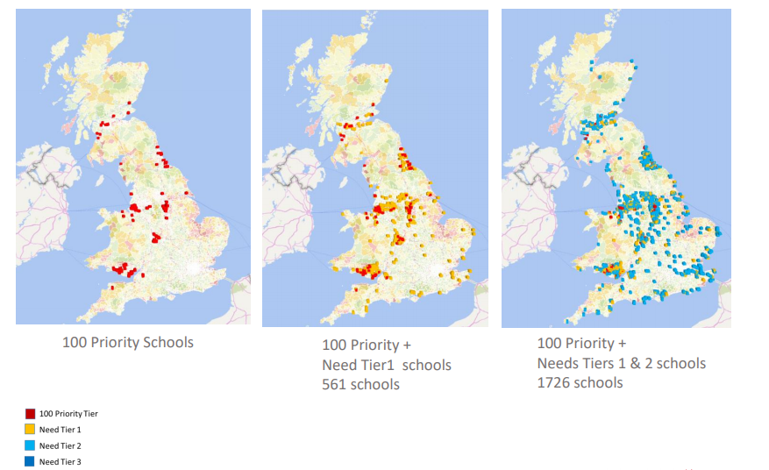
An overview of the UK looking at schools in the highest need segments reveals that although Norfolk does not have any of the 100 highest need schools, there are very significant concentrations of high need schools in Norwich, Great Yarmouth and Lowestoft.
Notes:
FSM density of schools and progression to uni data (IMD, IDACI, POLAR4, now using TUNDRA)

Slide 10
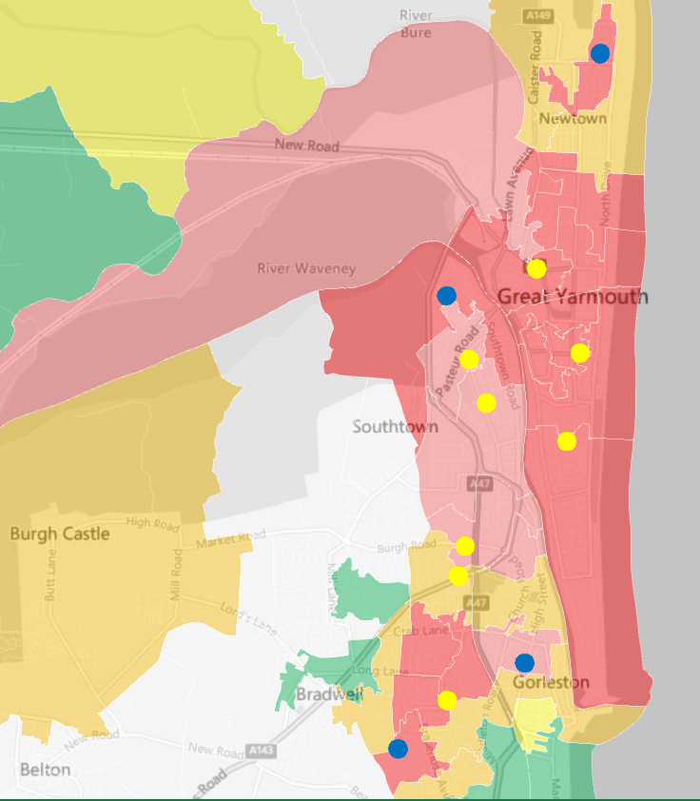
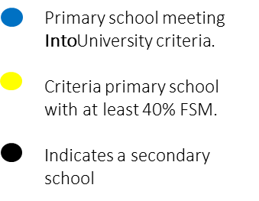
An example of the data mapping for Great Yarmouth
Almost a quarter of Great Yarmouth’s wards are within the most deprived 10% of the country.
Great Yarmouth’s Nelson ward, where several of the high-need schools are located is the most deprived ward in Norfolk.
The majority of Great Yarmouth’s neighbourhoods are in the bottom two deciles on the 2019 Index of Multiple Deprivation including neighbourhoods containing thirteen potential partner schools.
The Index of Multiple Deprivation (IMD) is the official measure of relative deprivation for small areas (or neighbourhoods) in England. These are referred to as Lower Super Output Areas, or LSOAs. IMD uses the same data sources combined in the same way for every LSOA allowing direct comparison.
1km
IMD
Decile 1
Decile 2
Decile 3
Decile 4
Decile 5
Deciles 6-10
Notes:
Can overlay lots of data - IMD, IDACI, TUNDRA. Keeps school while understanding different types of need. Can see change over time.

Slide 11
Great Yarmouth
To understand the need in the area, we considered:
Context of the local area: capital developments, migration patterns, age profile, car ownership
Deprivation - overall and localised (IMD)
Housing quality and distribution
Social mobility
School-aged demographics - English as an Additional Language, Free School Meals, ethnicity data and related educational attainment
Average level of qualifications achieved in different wards
Higher Education progression (POLAR4, now TUNDRA)
Attitudes to Higher Education
Schools mapping
DISCOVERING FOCUS | REALISING POTENTIAL | SHAPING THE FUTURE
TALENT | QUALITY | COMPASSION | ASPIRATION | TEAMWORK

Slide 12
Great Yarmouth
Insights that shaped where and how we set up:
Position of IU centre
  Located in the town centre
  Proximity to new university facility (The Place due to open in Sept)
Many languages spoken
  Ensure team are aware and trained
  Make use of local resource to translate
2 University partners (UEA and Trinity, Cambridge)
  Include both partners in student experience
DISCOVERING FOCUS | REALISING POTENTIAL | SHAPING THE FUTURE
TALENT | QUALITY | COMPASSION | ASPIRATION | TEAMWORK
Notes:
Due to geographical features of the town, many secondary school walk along the centre of the town.(Market Gates shopping centre).
The Place - uni hub, library, collab with UEA, Suffolk and other HEIs, across the road from the centre. Yet to open. East Coast College and the University of Suffolk are contributing £3.5m and Norfolk County Council £2m.
The presence of Norwich was important in making this decision to set up in Great Yarmouth

Slide 13
Working in coastal communities
Building relationships and trust are crucial - long-term commitment and funding help
Transfer the knowledge from feasibility and set-up to the delivery team on the ground
There is strength in clustering centres, though transport links can be a challenge in coastal areas
Operational considerations apply in coastal areas, e.g., transport, trips
Centrally-designed programmes need to be adapted locally
TALENT | QUALITY | COMPASSION | ASPIRATION | TEAMWORK

Slide 14
Any questions?
eilis.odonnell@intouniversity.org
Registered Charity Number 1118525 (England and Wales) SC049776 (Scotland). Company Registration Number 6019150.

