Slide 1
UoB: Closing the Awarding Gap
The Access & Participation Plan and the central role of co-creation
Abbi Bainton-James
Assistant Director, Student Diversity & Inclusion
Ife Grillo Student Inclusion Officer (Race and Ethnicity)
Notes:
ABJ & IG

Slide 2
2020-2024 APP Priorities
1.Narrowing of the gap in intake between Q1 and Q5 students from 10:1 to 6:1 by 2024-25;
2. Contributing to the national agenda of increasing the number of students from Q1 entering higher education;
3. Increasing the number of Black students enrolling at the University of Bristol significantly by 2024- 25;
4. Increasing the number of Asian students enrolling at the University of Bristol significantly by 2024- 25;
5. Increasing the number of mature students enrolling at the University of Bristol by 2024-25
6. Narrowing the gap in continuation rates between young and mature students from 9% to 5% by 2024-25;
7. Narrowing the gap in continuation rates between non-disabled students and those with mental health conditions from 7% to 3.5% by 2024-25;
8. Narrowing the attainment gap between BAME and White students from 7% to 1% by 2024-25;
9. Closing the gap in progression rates between disabled and non-disabled students by 2024/25.
Notes:
ABJ – Highlighting the ongoing priority of UoB. This target has not been met, carried forward and refined in our new APP and sits alongside wider institutional work – e.g. Anti racist action plan, reparative futures
Reparative Futures is a £10 million programme. It aims, through a series of targeted initiatives, to redress some of the systemic injustices arising from the transatlantic trafficking of enslaved African people.
The University acknowledges its historical ties with individuals linked to that activity and the significant work required to address this legacy and ongoing anti-black racism within the University and beyond.
The Reparative Futures Programme was announced in November 2023 and began in February 2024. It will run for 10 years with a view to creating a sustainable impact that can continue and be built on well after the formal programme has completed. It will be co-created with Bristol’s Black communities, students and staff.

Slide 3
2025-2029 APP Priorities
1 – Increase proportion of students from lower socio-economic groups
2 – Increase proportion of Black and Asian students
3 – Maintain the proportion of mature students
4 – Narrow gap in completion rates of students with declared MH vs. No disability
5 – Narrow gap in completion between mature vs. young students
6 – Narrow attainment gap mature vs. Young students
7 – Narrow attainment gap lower vs. Higher socioeconomic background
8 – Narrow attainment gap Global Majority vs. White students
9 – Narrow gap in progression rates between declared MH vs. No disability
Access and participation plan 2025 - 2026.pdf p.70-90 literature review
Notes:
ABJ – Metrics: 21-22 baseline = 8.3 PP, target for 28-29 = 5.6PP. Context of IMD gap 9.1PP target (13.6 current) and Mature 7.1PP target (10.6 currently)

Slide 4
New APP Activity
Full breakdown of all activity (incl. existing and expanded) in the APP
Strategy 7: Attainment for global majority students New activity – Build on belonging@Bristol outreach co-created with the Race Inclusion Advocates New activity – Staff training and development in inclusive pedagogies
Access and participation plan 2025 - 2026.pdf p.70-90 literature review
Notes:
ABJ – RIA expanded activity, new horizon’s transition program.

Slide 5
Staff Training
Ringfencing APP resource to employ a lecturer focused on inclusive pedagogy and upskilling the academic workforce – Based in Bristol Institute for Teaching and Learning (BILT).
Anti-Racism training for Professional Services and Academic staff teams, co delivered by Ife and our Assistant Director for Student EDI strategy.
Notes:
ABJ – Complementary to the transition and co-creation work

Slide 6
Scene Setting: The Awarding Gap to Date
92.2%
Gap = 16.4pp
75.8%
Source: OfS Access and Participation data dashboard
Notes:
Aggregated gap (white compared with all ethnicities except white) is 7.5pp, down from 8.1pp in the previous year – conceals a range of differential impacts
Black/white gap is up from 6.7pp in previous year (NB relatively small numbers lead to higher levels of volatility) - 4 year UoB average = 10.7pp

Slide 7
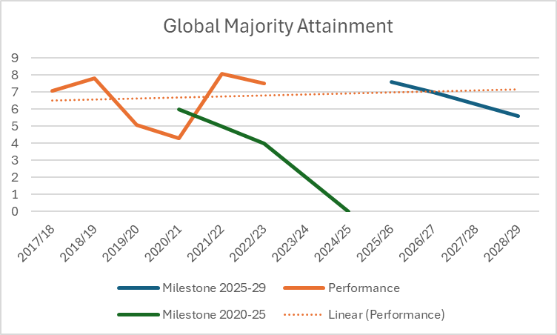
2025-29 To narrow the attainment gaps between global majority students and white students

Slide 8

Race Inclusion Advocates
Paid by the University to:
•Understand the lived experiences of Black, Asian, Arab, Latine, Mixed/Multiple Ethnic Students
•Use their skills and experience to consult staff on how to improve services
•Co-Create and develop inclusive activities that felt help foster a sense of belonging
•Challenge the University on the work it does to be anti-racist institution
Notes:
IG

Slide 9
What has been the focus of the RIA work
Developing skills associated with changemaking instead of just relying on lived experience
Less focus on 'How do we get more of group X to use service Y more?' and more focus on the broader issues
Advocates delivering less events and contributing more to the ‘less sexy work of EDI'
How we tackle Racism and Hate Crimes- Resolution
Understanding racialisation in mental health – Wellbeing
Supporting Students in their course – Economics
Improving students experience in halls – Student Communities Communities
Supporting LGBT Students of Colour– Inclusion

Slide 10
Impact of the RIA Programme
100% of students said they gained skills through being on the programme. There was a 45% increase in student's confidence in speaking in front of a crowd in a formal setting and a 34% increase in student's ability to use data-driven arguments.
92% of students said being an advocate helped improve their sense of belonging at university.
100% of students felt that being an RIA gave them tangible skills they could take forward post-university.
100% of staff said it improved their knowledge of the issues facing global majority students.
94% of Staff said were able to immediately make changes and improvements based on RIA feedback

Slide 11
Belonging Fund
The Belonging Fund is a funding opportunity open to all students from Global Majority backgrounds to support student-led, unique and innovative efforts to improve the sense of belonging and community among a specific cohort of students.
The purpose of the Belonging Fund is to recognise that students know better than the university regarding how to improve their sense of belonging.
While we should ensure all our events are more inclusive and not pass on the responsibility of building belonging to our students, it's important to recognise how nuanced their needs are and provide more targeted support.
We are currently funding seven BF Projects, decided by RIAs

Slide 12
New Horizons Belonging Programme
Access to inspiring role models and speakers
Events to develop social, living, academic, and professional networks
Skills workshops
Safe spaces to engage in meaningful conversations about race and racism and share experiences.
Building students relationship with the city
Black Specific Programme
Building Community
Building Connection
Improving Mattering.
Improving Psychological Safety
Notes:
IG

Slide 13
How do these interventions link together?
The RIA programme is for students looking to do strategic partnership work to improve the university for global majority students
The Horizons programme is for all global majority students looking to build connection, find community, and develop their skills
The Belonging Fund meets the nuanced needs of specific cohorts within the global majority group, recognising the uniqueness of their identities
The Antiracism in Practice Staff Training upskills services and ensure we take a whole institutional approach to antiracism

Slide 14
Questions

