Slide 1

The OfS Framework for Evaluating Outreach and NERUPI
Anna Mountford-Zimdars
University of Exeter

Slide 2

Project Background:
•funded by OFFA, now Office for Students
Builds on previous work from the University of Warwick (phase 1)
influence guidance to institutions on data collection and evaluation practice
• further the understanding of evaluation practices in outreach activities
Works with partner universities and third sector parties
Aim: Drive up quality of evaluation and evidence in the sector

Slide 3
Project Outputs
Part 1: The Standards of Evidence in Evaluation of Outreach
Part 2: A Good Practice Guide to Using the OfS Standards of Evaluation & Standards of Evidence in Outreach
Part 3: A Self-Assessment tool of the Standards of Evidence

Slide 4
Timeline
November: Road-testing self-assessment toolkit
December: steering group and SRHE conference event
January-February: Dissemination and possible inclusion in A & P plans
…please be mindful that this is still a live project…

Slide 5
Key Terms: Evaluation types
Type 1: Narrative The evaluation provides a narrative or a coherent theory of change to motivate its selection of outreach activities in the context of a coherent outreach strategy | Type 2: Empirical Enquiry The evaluation collects data on impact and reports evidence that those receiving an intervention have better outcomes, though this does not establish any direct causal effect | Type 3: Causality The evaluation methodology provides evidence of a causal effect of an intervention

Slide 6
Key Terms: Evidence for the different evaluation types
Type 1 Evaluation: Narrative Evidence: The HEI can refer to evidence of impact elsewhere and / or in the research literature on outreach effectiveness | Type 2 Evaluation: Empirical Enquiry Evidence: Quantitative and/or Qualitative evidence of a pre/post intervention change or a treatment/non-treatment difference | Type 3 Evaluation: Causality Evidence: Quantitative and/or Qualitative evidence of a pre/post intervention change on a treated group relative to a control or comparison group using an appropriate research design

Slide 7
What does this mean for my activities?
 | Standard of evaluation practice
Type of outreach activity | Type 1 | Type 2 | Type 3
Long-term or multi-activity intervention | A | A | B
Summer school or other HE-residential programme | A | A | C
Mentoring | A | A | C
Campus visit or open day (cross department) | A | B | n/a
One-off subject-specific taster session or masterclass | A | B | n/a
HE fair | A | B | n/a
Code: A = Expected; B = Commended; C = Highly Commended. n/a = not applicable.
Reference: Evaluation of Outreach Phase 1.

Slide 8
Handout: What does this mean for my practice?
Taken from draft document: Part 1 Annex 1: Guidance on outreach activity and evaluation type

Slide 9
Type 1: Creating a Theory of Change
Understanding the challenge
Why is your intervention necessary?
Defining your interventions
Who will you reach and how will you work with them?
Understanding the processes involved in bringing about the change
How will you benefit people and get the results you want?
Determining the impact of your work
What will be the short, medium and long-term impact?

Slide 10
NERUPI and THEORY Of CHANGE
NERUPI provides you with a theory of change
NERUPI allows you to plan activities and map them against the theory of Change – i.e. aims
NERUPI asks you to evaluate what you are doing, this moves you into Type 2 and Type 3 evaluation

Slide 11
Proposal: evaluation self-assessment tool
Why are we proposing this?
To improve quality of evaluation approaches
To improve how we assess evaluation through the A&P plan process
There is evidence that self-assessments can drive continuous improvement in organisations
Notes:
A new self assessment tool for evaluation of A&P activities
Why are we proposing?
Main aim is to support improvements in evaluation practice – helping providers to identify where they need to make improvements in their evaluation.
Where lack of evaluation skill/capability/expertise – its difficult for people to know where they are
WE want to up the game - we needed to make our expectations more clear to the sector
Systematic way of people understanding where they are
Moving beyond providers comparing themselves with others (this is a slow route to improve!)
Clear transparent framework to say this is what a robust, well developed approach to evaluation looks like and for YOU to be able to assess yourselves against that
Good examples of how self-assessment and reflective practice can be positive mechanisms for driving organisational continuous improvement.

Slide 12
Proposal: evaluation self-assessment tool
What will the tool do?
Enable providers to assess their performance and set a baseline from which to make improvements
Enable providers to identify where improvements are needed
Enable OfS to benchmark different types of providers and identify where and how we can target support
Enable OfS to set out expectations on evaluation practice in a transparent way
Notes:
How it will work – what is it designed to do?
All providers complete a self-assessment of their evaluation approach and this will become part of each provider’s access and participation plan.
For use by all types of provider, and will take account of contextual factors such as size and capacity – not dictating approach.
Basically like a survey completed by providers to assess your current evaluation approach and practice
Set out clear and transparent criteria that providers can assess themselves against
To help providers to review whether their evaluation plans and methodologies go far enough to generate high-quality evidence about the impact of their activities in APPs.
In order to measure current performance and identify where to make improvements to improve the strength and quality of the evaluation plans.
Sets a baseline to measure against going forward.
Being developed by a team at Exeter as part of ongoing research project (also including clear standards around different types of evidence)
More support from OfS
It also allows us to benchmark types of providers so we can identify who needs more support. (individually and cross sector trends)
The self-assessment tool will link to a wider set of guidance that will support providers to identify how they can improve.
- Good practice guide
- Clarity around types of evidence and what they can tell you about causality and impact
Why aren’t we giving the tool out now?
Not provided the self-assessment tool because it’s in development - piloted throughout November Ready for APP February.
Not helpful to give you something that looks different and will change.
Not all of you will work on evaluation so just give a summary of the main areas at this stage

Slide 13
Proposal: evaluation self-assessment tool
How will it work?
Self-assessment
Identify where and how to improve
Action plan
Implement activities
Impact report
Notes:
So how will it work in practice?
The self assessment will be included in the A&P Plan and follows the same process (also corresponding timeline)
First an assessment of performance - and identification of where improvements are needed
Action plan with the A&P Plan setting out the activities and interventions used to address the issues.
The A&P plans are implemented
Impact report is produced to understand the progress made
This feeds into the next self-assessment.

Slide 14
Proposal: evaluation self-assessment tool
What does it look like?
Four dimensions of self-assessment:
Evaluation Design / Evaluation Implementation / Learning / Strategic Context
Providers score themselves against a set of criteria
Providers receive a score based on completion of tool
Space for self-reflection
Action plan
Notes:
What will the tool cover – what does it look like?
Each area has set of questions with a simple ratings scale for each section
Clear and tangible indicators of what the ratings mean (important for consistency)
Inputs to scoring system - LOW SCORE NOT NECESSARILY BAD!
Space for self reflection – should be easy to identify where improvement needed - then put action plan in place
Dimension: 1: Evaluation design – strategically aligned with activity – appropriate approach
No single right answer about which evaluation design is most appropriate in different contexts and interventions
Your evaluation activities should be aligned to the underlying aims.
Informed and conscious choice about the type of evaluation approach
Understanding the type of evidence you will be able to collect (e.g. what level of causality – what claims will you be able to make)
Dimension 2: Evaluation Implementation
Methods, measures and tools you use
Reliability of data collection mechanisms
Appropriate SKILLS CAPABILITIES RESOURCES to support evaluation research which is methodologically sound.
Dimension 3: Learning from Evaluation – converting findings into continuous improvement in A&P PRACTICE
How evaluation findings and results are used to inform practice
Reflection, sharing, dissemination, translation into adjustments or innovation in practice.
Involvement of WP practitioners
Dimension 4: Strategic context
How evaluation culture is supported and prioritised at organisational level
Coherent programme of evaluation across different activities
Opportunities for staff to enhance their evaluation skills and understanding.

Slide 15
Towards a self-assessment toolkit
Design
Implementation
Learning
Strategic context
Standard of evidence achieved
Research design factors
Support for evaluation
Institutional culture
Skills and expertise
Interpretation of findings
Use of results
Resources
Data strategy

Slide 16
Self-assessment and NERUPI
There is strong overlap in what is required to enact NERUPI and what is required in the self-assessment toolkit

Slide 17
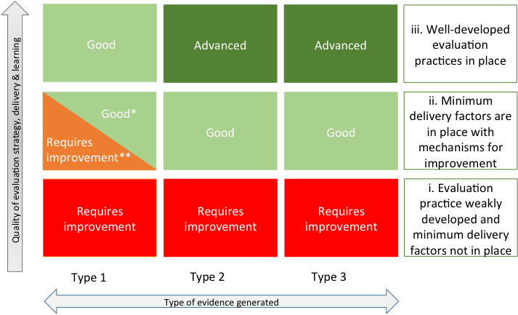
Standards of Evidence Matrix

Slide 18
Discussion

Slide 19


Possible slides, perhaps not needed

