Slide 1
Using ‘Science Capital’ to understand what teachers want from Science Outreach
14/11/18
A case-study at the Wohl Reach Out Lab (WROL)
Roberts Zivtins
@RobertsZivtins

Slide 2
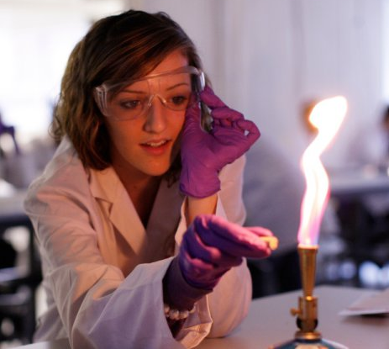
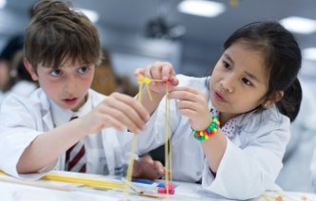
Research Context- Wohl Reach Out Lab
Imperial College London’s dedicated outreach space.
Founded in 2010 by Professor Robert Winston
16,126 pupils attended 1,227 activities since the WROL opened
Focus on practicals for students who otherwise would not have access to ‘hands on’ science.
Notes:
National FSM average= 14.4%

Slide 3
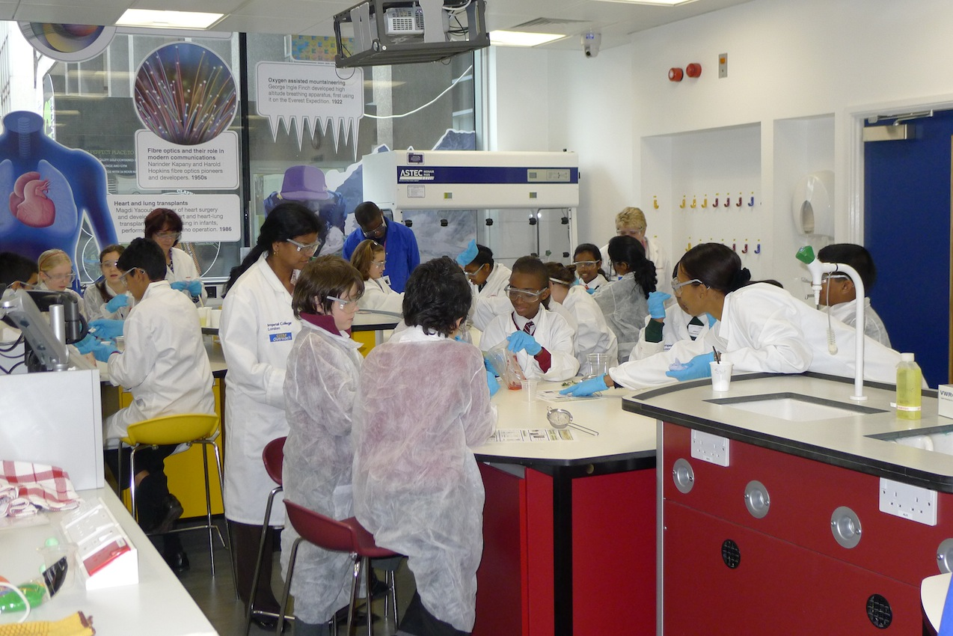
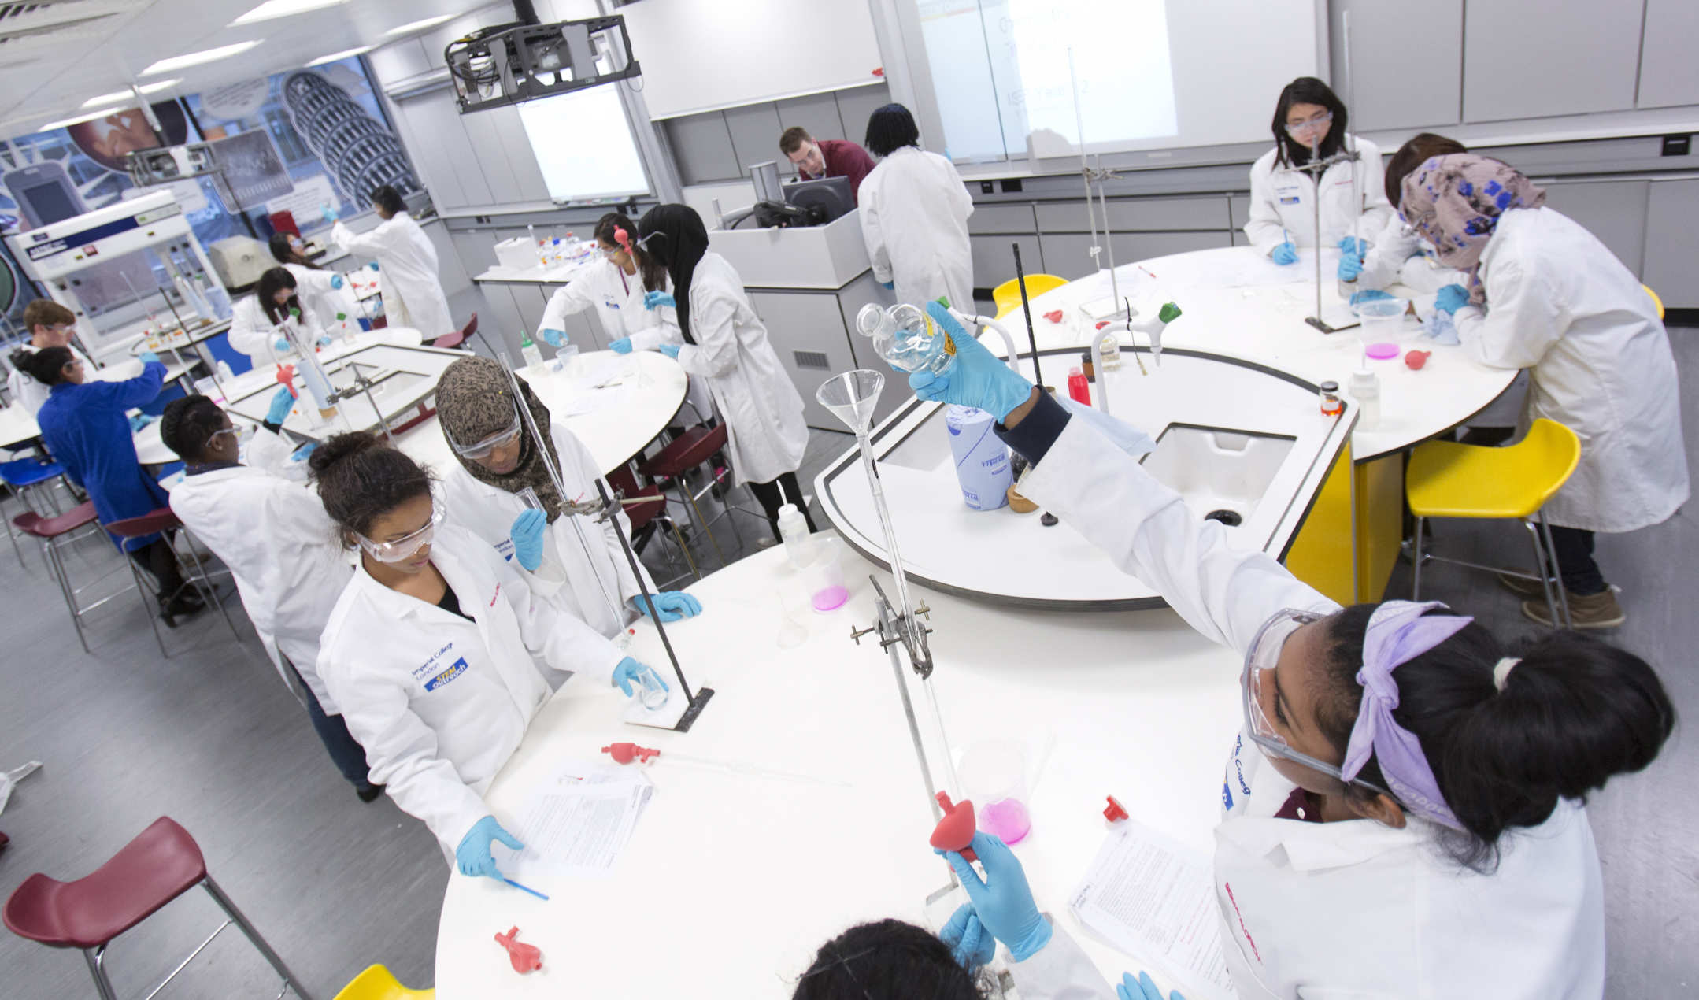
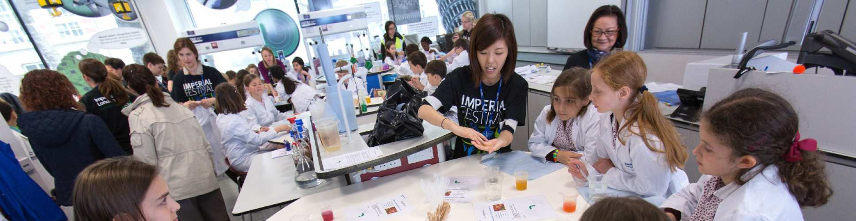

Slide 4
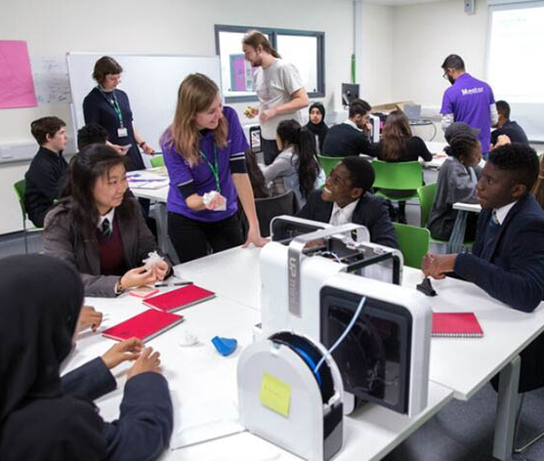
Outreach Programmes at Imperial
Programmes that Imperial run through the Outreach team:
Schools partnerships
Ad hoc school visits
Summer schools
Imperial Sutton Scholars
Pimlico Connection
STEM Potential
Spectroscopy in a Suitcase
Pathways to Medicine
School’s Challenge Programme
Maker Challenge Programme
INSPIRE PGCE teacher training

Slide 5
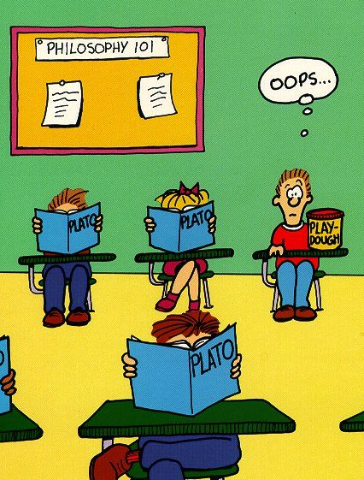
Teachers’ perspectives
Teachers are the ‘vanguards of school-university/ industry partnerships’ (Aslam et al. 2018)
Semi-structured interviews conducted with nine visiting teachers during the 2017/18 academic year
All teachers from, long-term, London school partner (FSM= 30.3%)
Interviews transcribed and coded in NVivo 11
Codes chosen a priori from science capital literature
Notes:
Rationale & methods
National FSM average= 14.4%

Slide 6
Key findings #1
Rejection of curricular outcomes
“…to come into a university and see the process of experimenting to actually find a relationship and then testing it … I think that really gets to the heart of science, so it's not really content, it's more ‘how is scientific knowledge generated'”- T7
Given the importance of curricular knowledge for gaining institutional capital (i.e. qualifications), these results were somewhat surprising.
Teachers’ opinions were often grounded in criticism of ‘school science’ and the pressures of formal qualifications
Notes:
- Teachers do not use outreach for curricular outcomes

Slide 7
Key findings #2
Importance of access to science equipment
“… we don't have the equipment, so we couldn't do it [PCR and electrophoresis] and that's something cool for them to do, which they would only get to do once they got to university.”- T2
There is not enough funding to warrant buying a class sets of some specialist equipment.
However, these science artefacts are valuable objectified science capital in the scientific community.
Outreach helps increase students’ contact to objects which have scientific cultural value.
Notes:
Teachers use outreach to develop students’ access of objectified science capital

Slide 8
Key findings #3
Exposure to the everyday scientific practices of the science community
“…you want to give them a chance to see and understand a relatively normal day, like how going in to do a lab with your biology cohort might be if you are on a day at uni. and you are in the labs”- T8
Science in novel environments has been found to be disorientating or exclusionary to newcomers (Archer et al. 2016)
School/university outreach provides a less-threatening environment, where school social norms mediate extent of unknown social expectations
Students are passively exposed to the tacit scientific attitudes and values so they can develop their stock of embodied science capital.
Notes:
Teachers use outreach to develop students’ stock of embodied science capital

Slide 9
Summary
Teachers want students to have an authentic experience.
Outreach should not try to replicate school- qualifications are important, but formal institutions specialise in developing students’ stock of institutional capital.
Teachers value when outreach is situated within socio-cultural context (both university and specific domains)
An authentic context allows students to access valuable forms of objectified capital.
Finally, teachers value the access to tacit forms of knowledge which allows the development of students’ embodied cultural capital

