Slide 1



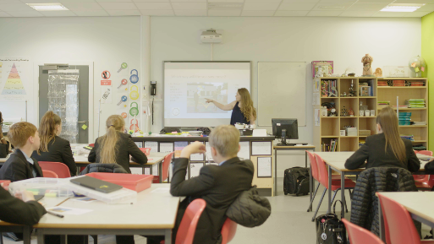

Decolonising STEM Education
Dr Meghna Nag Chowdhuri
Research Fellow
IOE, University College London

Slide 2




STEM participation and social justice
www.ucl.ac.uk/ioe-sciencecapital
Our projects | Details
ASPIRES @ASPIRESscience | Longitudinal study that tracks children and their STEM trajectories in UK
YESTEM @yestem_UK | International research-practice partnership focused on understanding and supporting equitable practice in informal STEM learning.
Making Spaces @M4kingSpaces | International collaboration to understand and develop equitable practices in maker spaces
Primary Science Capital @PrimarySciCap @Science_capital | Collaborative research to develop justice-oriented science teaching pedagogies for primary and secondary schools in UK

Slide 3
Science education, colonialism and social injustice
Educational injustices are not new
Yet, there is more urgency – not only brought about by COVID but also as foregrounded by BLM, environmental emergency, and many others
Important opportunity for re/imagining decolonial (science) education for sustainability and justice

Slide 4
What is (colonial) Science and science education?
What we ‘know’ as science (Euro-centred science has become the ‘canon’; ‘other’ knowledge/s viewed as ‘ethno’ knowledge)
How we ‘know’ (colonial research practices have contributed to the production of scientific knowledge)
How we teach what we know (methods of teaching and learning are themselves developed to safeguard the power of this ‘science’)

Slide 5
What is (decolonial) Science and science education?
What: Exposing and visibilising the colonial nature of currently powerful science
How: Challenges and broadening the ways science is ‘produced’ and ‘reproduced’
Teaching: Challenging and reimagining how we teach and learn ‘science(s)’

Slide 6


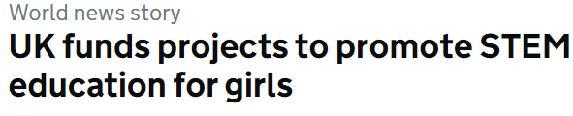



The mainstream STEM ‘participation problem’
Uneven participation in physics, maths and computing relative to other STEM subjects in higher education
Need to broaden the gender, ethnic and social class profile of STEM students post-16 (eg. Physics and Engineering)
Interventions have had little lasting impact
Key priority area for the UK government and other Western developed nations

Slide 7
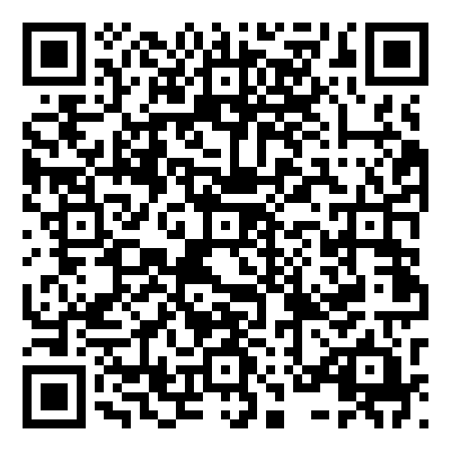
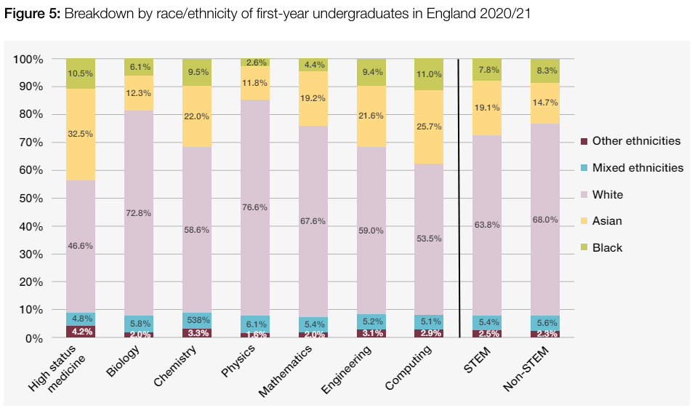
Racism and STEM participation
Racially minoritised students tend to record higher rates of non-completion than White students. In 2019/20, 5.1% of White students left their degree with no award, compared with 8.4% of Black students.
https://discovery.ucl.ac.uk/id/eprint/10181968/1/ASPIRES3%20Main%20Report.pdf

Slide 8
The challenge for STEM ‘participation’: blaming the student
Despite massive investments of time and resources to widen (and increase) participation, science/ STEM participation remains dominated by the privileged (e.g. White, male, middle-class, able-bodied, etc.)
Most efforts have focused on changing young people in some way, often through deficit models (e.g. to change/increase a perceived ‘lack’ of interest, motivation, awareness, knowledge)
But our research suggests that (i) lack of interest and motivation is not the main issue and (ii) schools and science education play a role in excluding and dissuading students from science

Slide 9
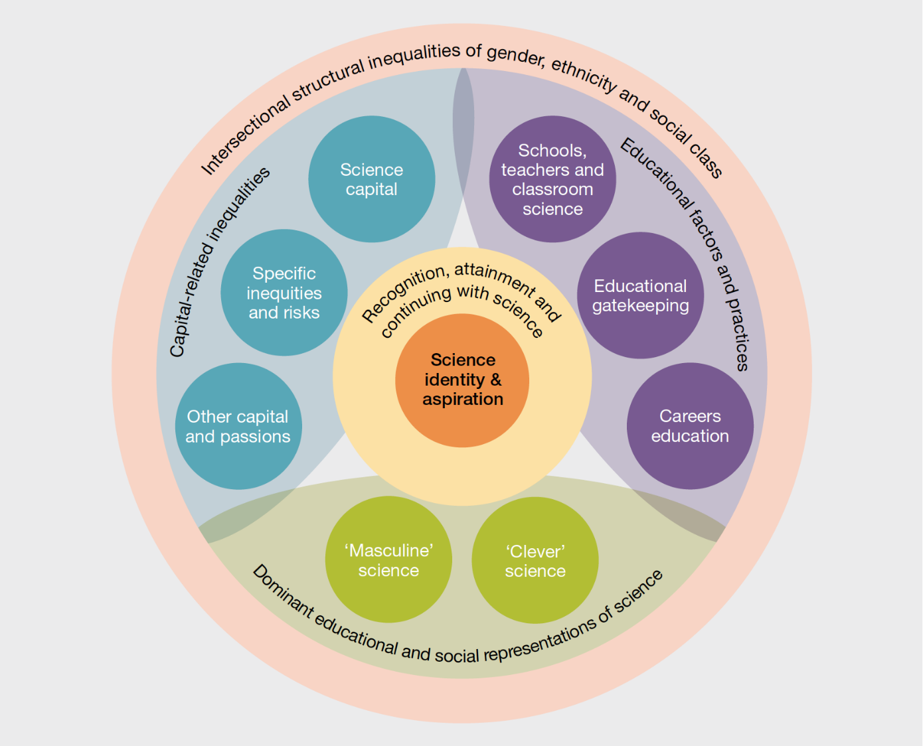
Structural (and intersectional) racism and inequalities impacting STEM participation
Intersectional structural inequalities of gender, race and social class:
Educational factors and practices
Capital-related inequalities
Dominant educational and social representations of science
Full (2019) report: https://discovery.ucl.ac.uk/id/eprint/10092041/15/Moote_9538%20UCL%20Aspires%202%20report%20full%20online%20version.pdf

Slide 10
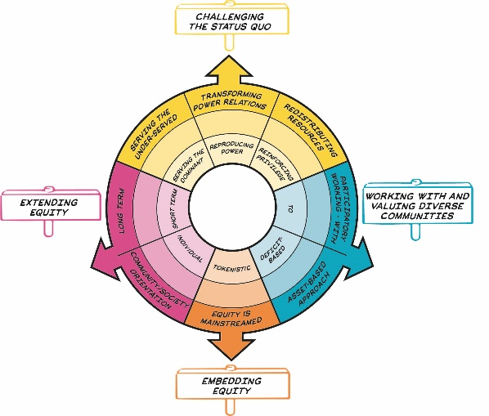
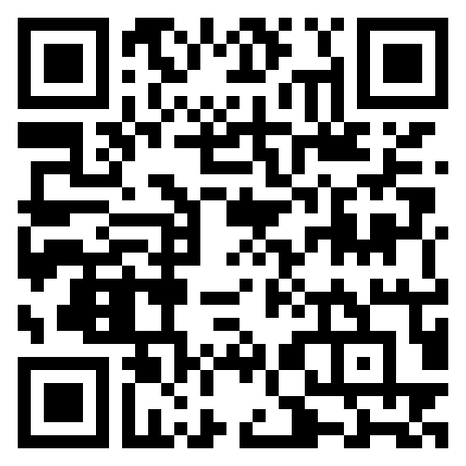
Tools for practice
Two tools: the Equity Compass and the Science Capital Teaching Approach (SCTA)
Both focus on changing practice (the field) not the young person
Its not (just) what you do - but the way that you do it!
Underpinning values and mind set will determine the equitable potential of your practice
@_ScienceCapital @PrimarySciCap @YESTEM_UK
Notes:
Field = practice, spaces and power relations through which science/STEM is constructed, represented and experienced. Field determines what and who gets valued.

Slide 11
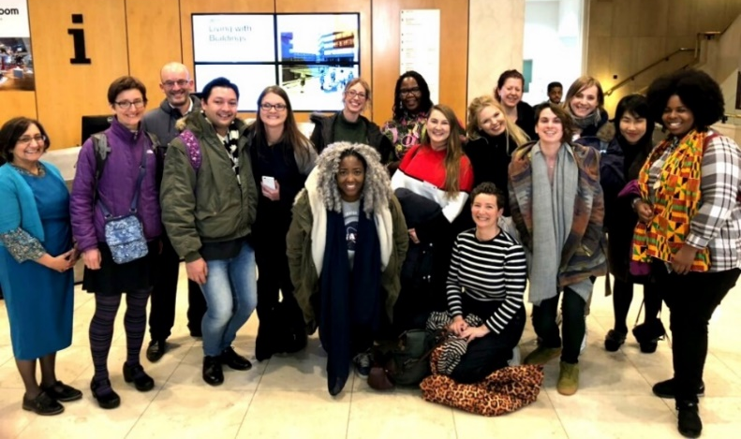
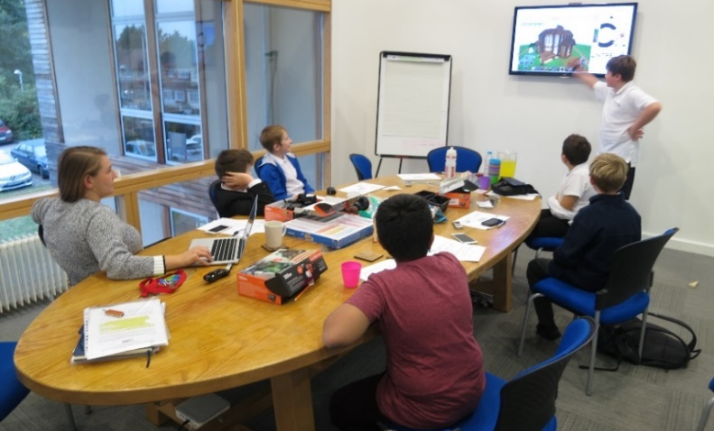
The Equity Compass: background
Developed in Youth Equity + STEM project (2017-2022), 5-year UK-US research-practice partnership
Collaboration with informal STEM learning organisations: Stemettes, Hanwell Zoo, We The Curious, Knowle West Media Centre
Academic research team, informal STEM learning practitioners and young people aged 11-14

Slide 12
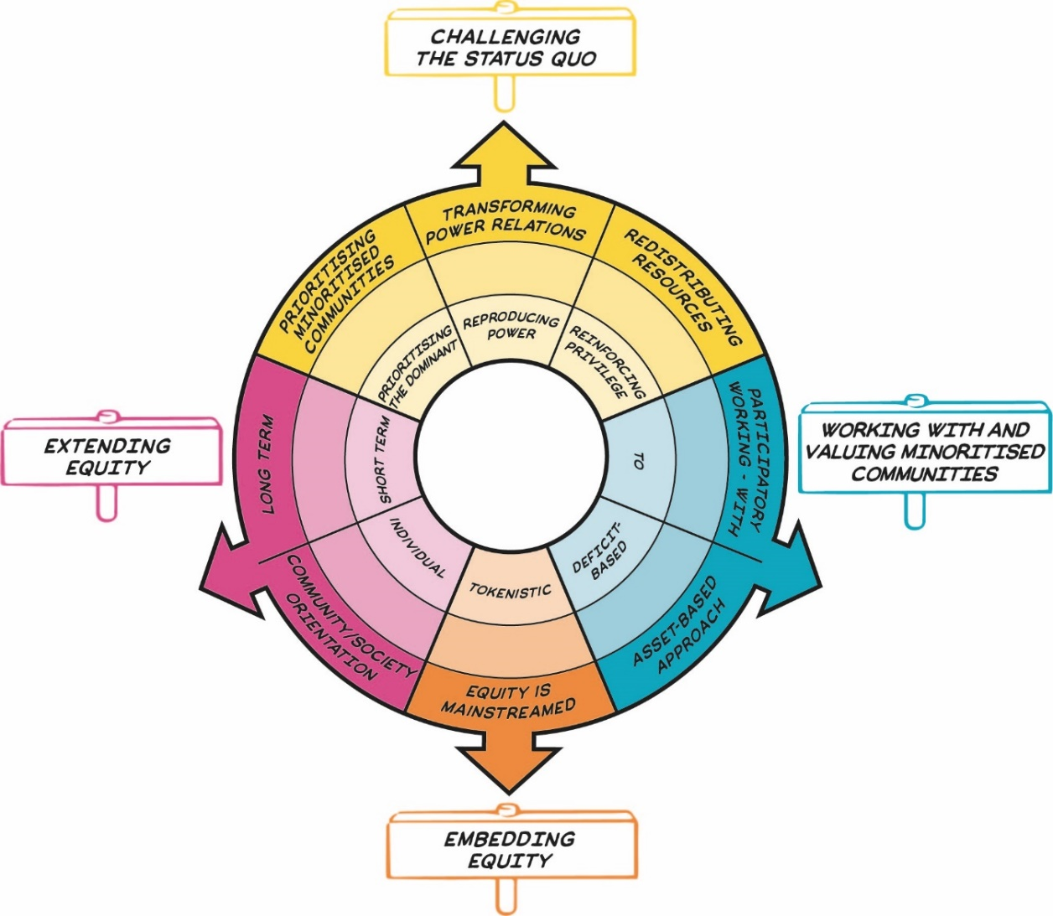
The Equity Compass
Equity Compass helps us to:
Recognise and think about key dimensions of equity/social justice
Use reflective questions to guide our thinking
Consider how equitable practices are
Map where we are – and map our progress (moving from inside outwards)
Twitter: @YESTEM_UK
#EquityCompass

Slide 13
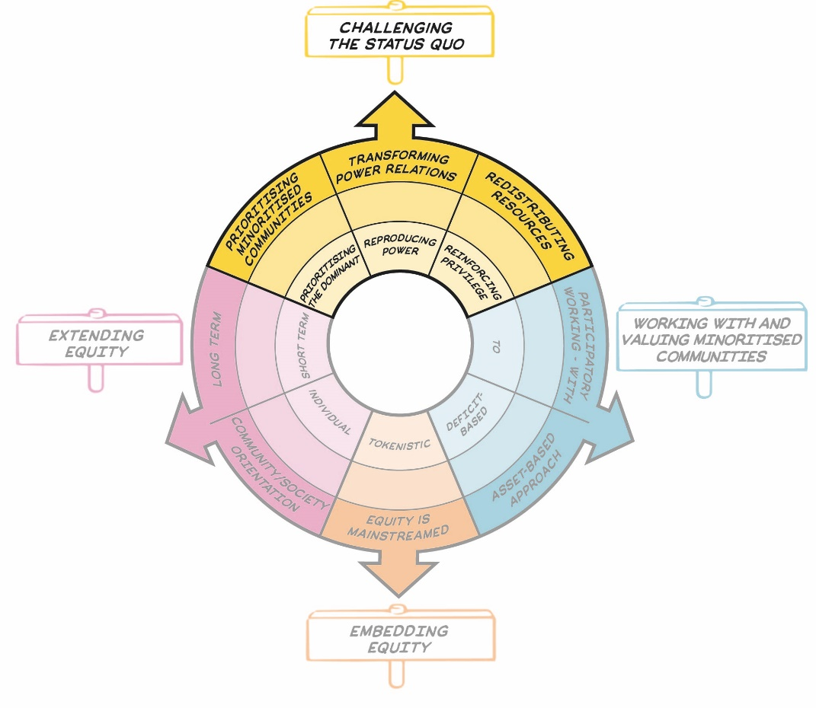
Challenging the status quo
Equity Dimension | Example questions
Transforming power relations | How do you challenge dominant ideas and representations in your session, e.g., scientists as clever, engineers as white men?
Prioritising minorities communities | Whose interests, values and needs drive what you do?
Redistributing resources | How is your practice supporting young people who tend to have fewer opportunities?
S

Slide 14
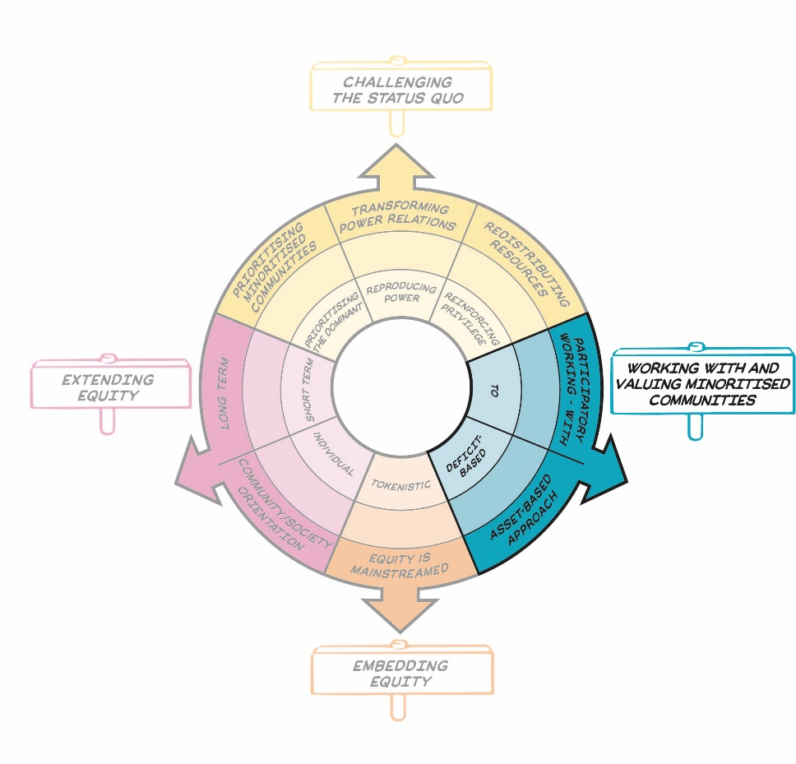
Working with and valuing minoritised communities
Equity Dimension | Example questions
Participatory working – with | How are young people involved in co-designing the sessions?
Assets-based approach | How are you valuing and recognising young people’s broad range of knowledge, skills and experience in your sessions?
S

Slide 15
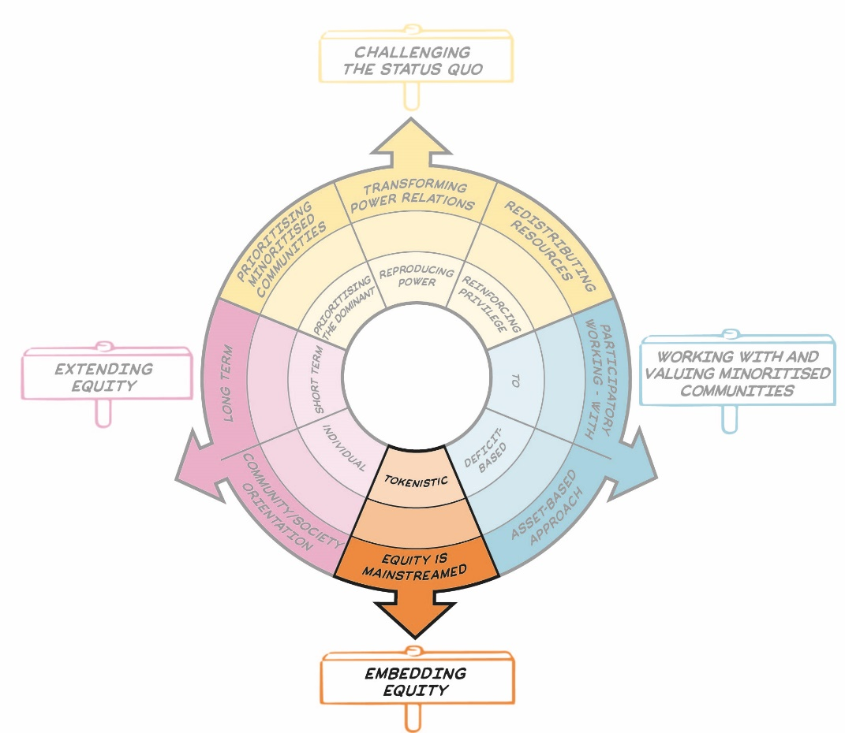
Embedding equity
Equity Dimension | Example questions
Equity is mainstreamed | How central, major, intentional and foregrounded are equity issues in your sessions?
S

Slide 16
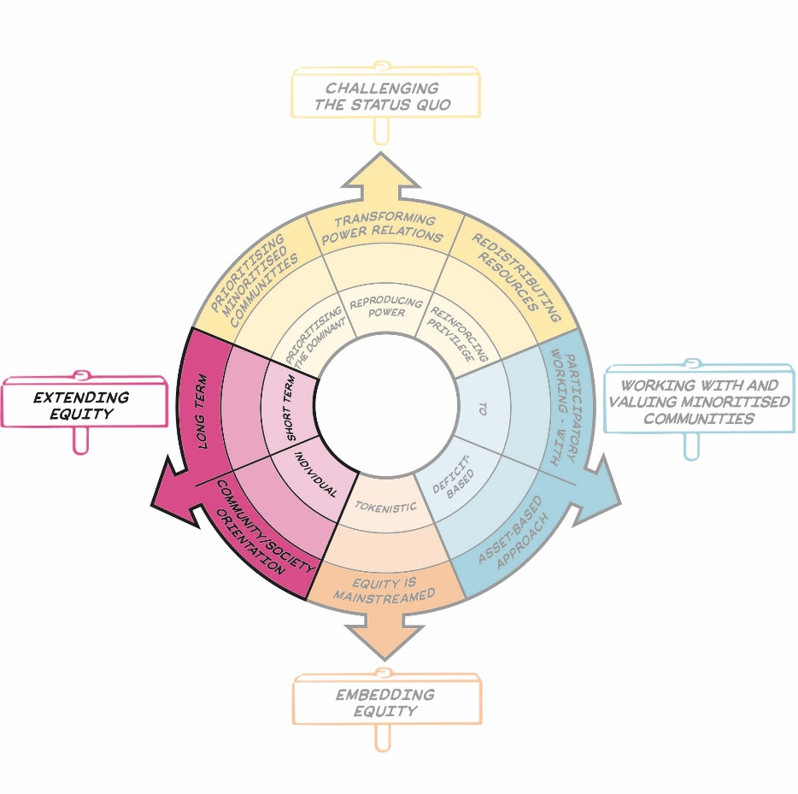
Extending equity
Equity Dimension | Example questions
Long term | How might you be able to support longer-term engagement – either through the sessions directly, or by linking with other opportunities?
Community/ society orientation | How do your sessions support wider outcomes, e.g., for young people’s families and community?
S

Slide 17
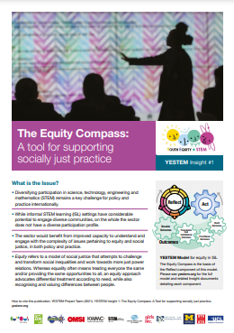
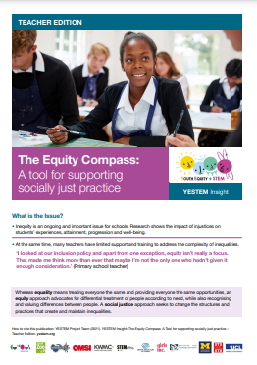
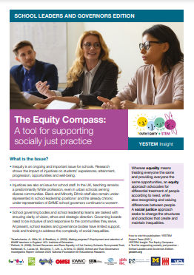
The Equity Compass: application to practice
Professional development material for informal STEM learning sector
Adapted for teachers and school leaders
Used also by funders, policy in the UK and internationally
Used by STEM Ambassadors

Slide 18
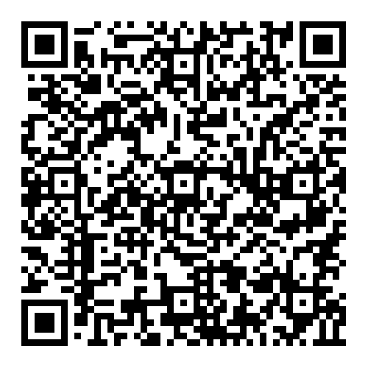
Key resources
Online free course
2-minute Equity Compass animation
Editable Equity Compass worksheet
Equity compass full collection of tools
https://www.futurelearn.com/courses/equity-informal-stem-learning-using-the-equity-compass

Slide 19

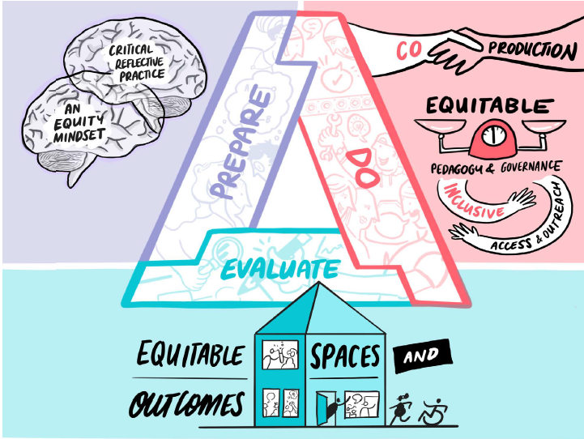
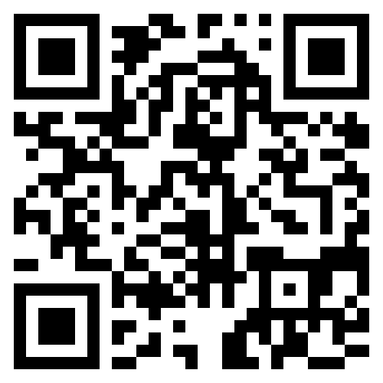
Coming soon…Making Spaces
Free online course for practitioner thinking about justice, equity in STEM
Guidebook with practical examples
Online Launch Event – 25th July
TWITTER:
@M4kingSpaces

Slide 20

Contact our projects | Twitter | Website
ASPIRES | @ASPIRESscience | https://www.ucl.ac.uk/ioe/departments-and-centres/departments/education-practice-and-society/aspires-research
YESTEM | @yestem_UK | www.ucl.ac.uk/ioe-yestem
Making Spaces | @M4kingSpaces | m4kingspaces.org
Primary Science Capital | @PrimarySciCap | https://www.ucl.ac.uk/ioe/departments-and-centres/departments/education-practice-and-society/science-capital-research/primary-science-capital-project

Slide 21



