Slide 1



Improving young people’s STEM engagement and participation: A science capital approach
Professor Louise Archer
Karl Mannheim Professor of Sociology of Education
UCL Institute of Education, UK

Slide 2
Why do we need to improve young people’s relationship with STEM?
The STEM participation ‘crisis’ – key issue for governments, employers and industry internationally
STEM skills ‘gap’ – important for national economic prosperity and social mobility
Social justice argument – currently participation is uneven (esp. in physical science, computing and engineering), we need to address inequalities by gender, social class and ethnicity
Importance of science literacy for active citizenship

Slide 3
Science aspirations
Lots of time and money has been invested in efforts designed to engage more young people with science …
… but little change in participation rates (and participation profile)
Most initiatives have focused in trying to increase interest in science (make it ‘fun’)
But our research suggests this is not the main issue …

Slide 4
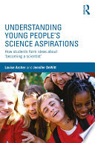
Aspires/ Aspires 2 study
Ten year study of children’s science and career aspirations
Phase 1 (age 10/11)
Survey of 9,319 Y6 students, 279 primary schools, England
Interviews with 92 children and 84 parents
Phase 2 (age 12/13)
Survey of 5,634 Y8 students (69 secondary schools)
Interviews with 85 children
Phase 3 (age 13/14)
Survey of 4,600 Y9 students
Interviews with 83 students and 73 parents
Phase 4 (age 15/16)
Survey of 13,421 Y11 students
Interviews with 70 students and 67 parents
Phase 5 (age 18/19)
Survey of 7,013 Y13 students
Interviews with 61 students and 65 parents

Slide 5
Science is interesting – but not for me
* Only asked of Y13 students studying at least one science A level
** Y13 data is weighted to national A level science entries
Notes:
Interest is not the whole story
Focus on understanding the ‘become a scientist’ gap

Slide 6
Aspirations age 10 -18
* Y13 data is weighted to national A level science entries
Notes:
Weighted for A level sciences
Over the years, aspirations getting more ‘realistic’
Moving away from celebrity
Business stays high
Poverty of aspirations that is often discussed in policy does not seem to be the case in our samples
Year 6 ‘be famous’ item was also high in year 6 and 8, and related to arts and sport
Business also related to people like Alan sugar and apprentice ie. famous and celebrity
These are agreement items so students can agree with multiples so not entirely representative

Slide 7
What careers do students aspire to?

Slide 8
What shapes these patterns?
Schools, teachers and education system
Careers education
Popular representations
‘Science capital’

Slide 9
Schools, teachers and education system
Differential expectations and stereotyping (e.g. ‘you need a boy brain to study physics’; see also Heidi Carlone’s research)
Teacher supply, retention and specialism
In England:
Stratification of science age 13 (‘Double’ and ‘Triple’ routes – school choice and channelling; inequalities in which schools can offer high status Triple);
Restrictive entry / gatekeeping to Advanced Level Physics;
Grade severity in Advanced Level Physics;
Culture of early specialisation

Slide 10
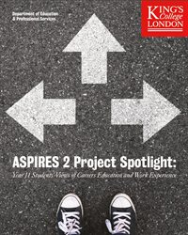
Careers Education – patchy and patterned
Cuts to provision in England
Not reaching all students (e.g. 63% of age 15/16 year olds report careers education)
Girls, minority ethnic, working-class students, those in the lower sets, and those planning on leaving education post-16 are all significantly less likely to report receiving careers education
‘Too little, too late’
Problem of self-referral model
Perceptions of generality and bias

Slide 11
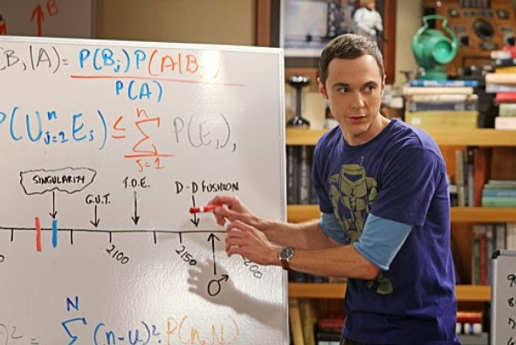
Popular representations
Alignment of physics and engineering with (white) middle-class masculinity
The ‘genius’ physicist (white, male, middle-class)
Also reinforced through the structures and practices of school science

Slide 12
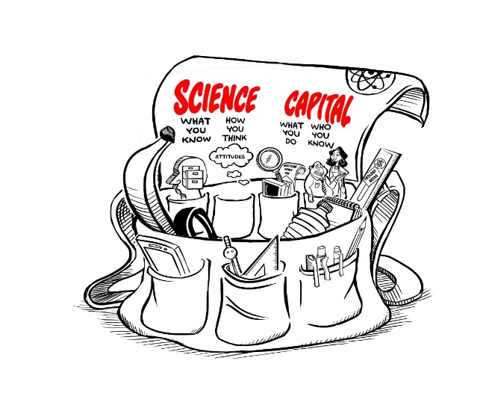
Science capital
Developed in Aspires project and extended in Enterprising Science project
‘Science capital’ is a ‘conceptual holdall’, combining habitus, cultural and social forms of capital
Nationally, about 5% of 11-15 year olds have high science capital and 27% low science capital
The more science capital a student has, the more (significantly) likely they are to aspire to post-16 science and have a ‘science identity’

Slide 13
Main dimensions of science capital
Science literacy (“what you know”)
Science-related attitudes and values (“how you think”)
Out of school science behaviours (“What you do”)
Science at home (“who you know”)

Slide 14
‘STEM capital’
The more science capital a student has, the more (significantly) likely they are to aspire to post-16 science and have a ‘science identity’
Emergent ASPIRES2 analyses of age 17/18 year old data set: Science capital relates particularly strongly to attitudes and aspirations in Science and Engineering, but also relates to attitudes/aspirations in technology and mathematics
Within ‘science’, science capital most strongly predictive of Physics participation. Also strong link with engineering
E.g. High science capital students are 10.5x more likely to intend to study physics at university and 4.4x more likely to study engineering
Students with high science capital had significantly higher cumulative maths, engineering, and technology perceptions than students with medium and low science capital

Slide 15
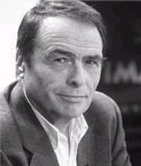
A sociological lens
Interactions of habitus, capital and field produce patterns in science engagement and participation:
Habitus - socialised, embodied dispositions shape whether science is ‘for me’, or not, formed through classed, gendered, racialized experiences: Gives a ‘feel for the game’
Capital – cultural, social economic and symbolic resources possessed and accrued, shaped by social axes: the ‘hand’ you can play in the game
Field – socio-spatial ‘space of positions and position-taking’: the ‘rules’ of the game
Extent of ‘fit’ between habitus, capital and field shapes whether students experience education as a ‘fish in water’, or not and produces differential trajectories

Slide 16
Habitus
Socialisation and inculcation over time - power of habitual practices and values (“what people like us do”)
Daily reinforcement of some career paths as more ‘natural’ or ‘thinkable’ for particular children. Eg. Girls and nurturing professions
Particularly shaped by home and school

Slide 17
Interaction of habitus + capital
Produces sense of whether science is for ‘people like me’, or not
Differences between high and low science capital families:
“The other day in the car we were laughing about chemical symbols and things, so I guess it does come into the discussion quite subliminally really” (Mother, white middle class).
“Science is just where it’s at in my family” (Davina, white, middle-class)
“I suppose in everyday life you don’t get that much to do with it [science]” (Mother, white, working class)
“They never talk about science” (Jack, Black, working-class)

Slide 18
Interaction with the ‘field’
Elitism and specialisation in the English education system makes it difficult to continue with science!
System advantages those with high science capital
‘Non-traditional’ students are both channelled and ‘self-select’ out of STEM

Slide 19

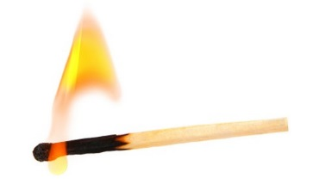
An analogy
Educator = heat
ENGAGEMENT = burning flame (produced at interface of habitus, capital and field)
FIELD = air and conditions around the candle (oxygen, wind, etc)
Influences if and how the candle burns (e.g. how bright, how long, flickering or steady)
HABITUS & CAPITAL = candle (‘fuel’): socialised dispositions, and (science-related) economic, social and cultural resources

Slide 20
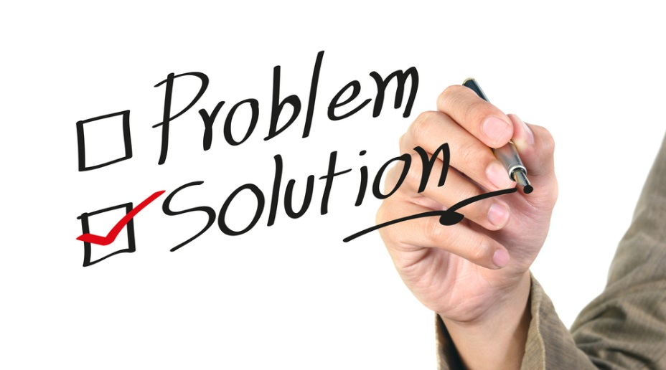
What can be done?

Slide 21
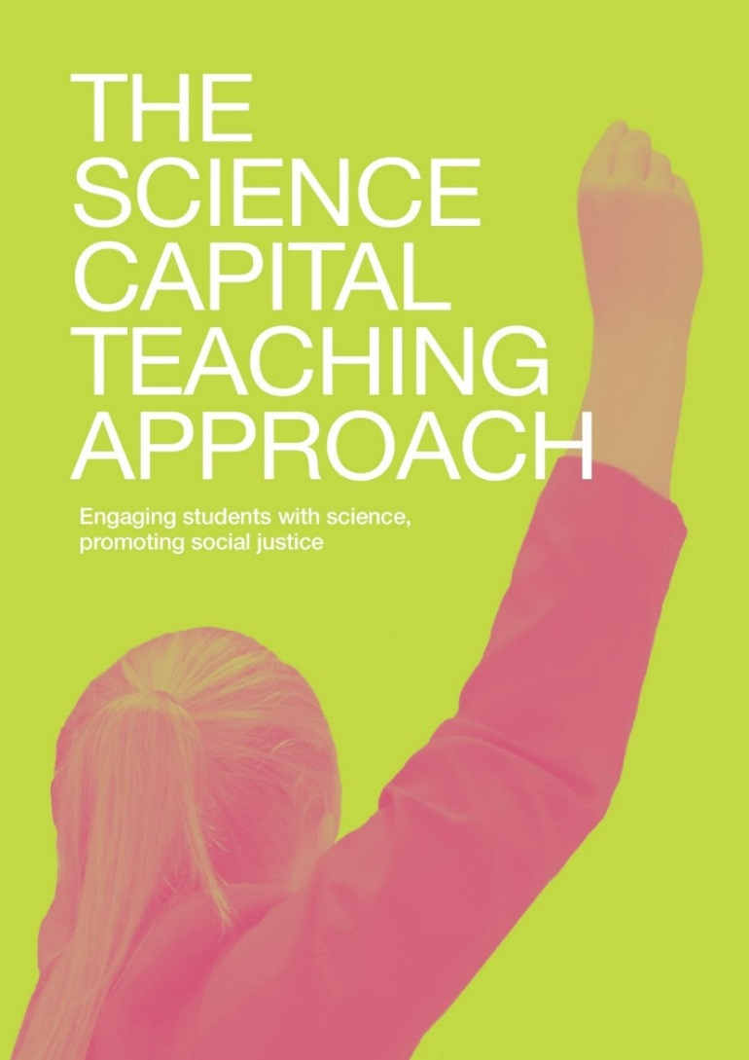
The Science Capital Teaching Approach

Slide 22
Enterprising Science project
Integrates existing good teaching practice with science capital theory and evidence
Worked 43 secondary science teachers over four years to co-develop a science capital teaching approach. Two year long trials:
2015/16 London data: 9 London secondary science teachers and their classes, c.200 students
2016/17 Northern schools data: 16 secondary science teachers and their classes, c. 480 students
Professional development model (2 x Saturday sessions plus regular support)
Data collection over 9 month academic year: teacher observations, student discussion groups, teacher and student individual interviews, student surveys (beginning and end of year)

Slide 23
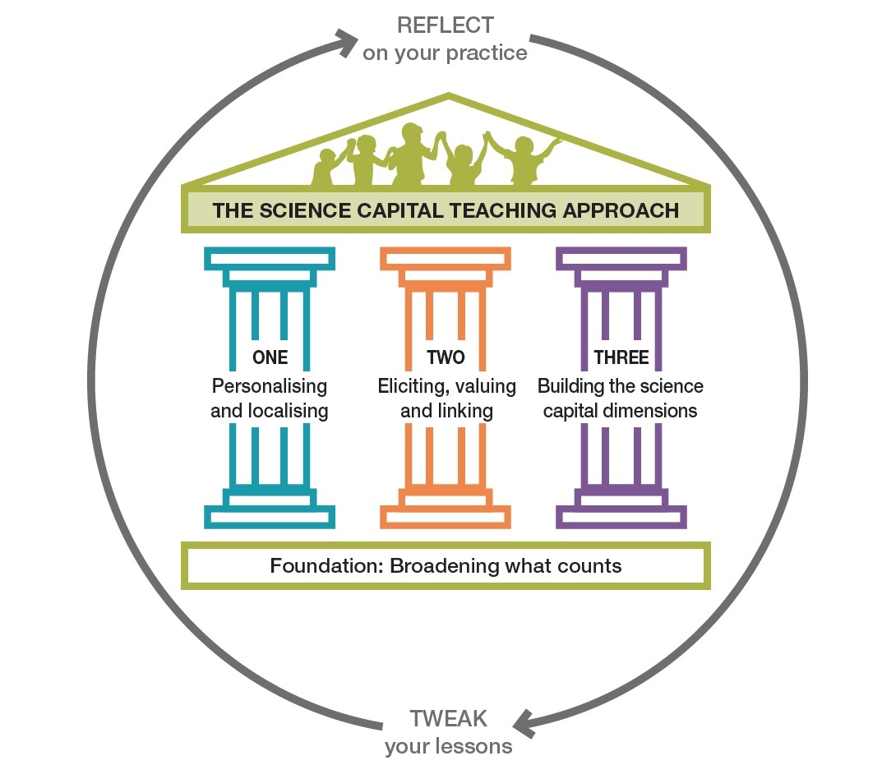

Slide 24
Foundation: Broadening what counts
Students do not just find science concepts difficult – some struggle to identify and engage with science, it feels alien to them
First step is to change the field, rather than the student
Recognise broader range of experiences, skills and behaviours as legitimate
Challenge stereotypes and dominant ideas and representations of science, such as ‘who does science’ and what constitutes ‘doing’ science.

Slide 25
Why broaden what counts? (Carlone et al.)
 | 4th Grade: Ms Wolfe | 6th Grade: Mr. Campbell
Teaching approach | Encouraging students to share their knowledge and ideas, ask questions, engage in collaborative, active inquiry | More traditional approach (teacher initiation, student response, teacher evaluation), emphasis on compliance, bookwork
Teacher role | Co-learner/facilitator | Authority/expert
Who is ‘scientific’? | Those who ask good questions | Well-behaved and articulate
Aaliyah (African-American girl) | Enthusiastic, engaged, active and creative questioning | Disengages from science, cannot ‘fit’ with celebrated subject positions
Amy (White, middle-class girl) | Top student, problem-solver | Near perfect performer – but less scientific behaviours (less questioning, creating experiments etc.), just ‘doing school’
William (Latino boy) | Conscientious, good student, tries to understand not just complete tasks | Studious and conscientious but not seen as ‘good at science’ by teacher because seen as too cautious and quiet
US-based study from Carlone, Scott and Lowder (2014)
Notes:
An overview of a paper that is really useful to think about how an individual teachers shape what is valued and who is able to participate. Paper on the reading list!
US-based study
Who tends to be value as good at science? who do you think the system values? Who do you try to value – and how do you do this?
THEN BREAK!

Slide 26
Pillar One: Personalise and Localise
Go beyond contextualising science - personalise and localise it to make relevant to students’ everyday lives
‘When a child’s worldview is left unvalued and expressionless in an educational setting, what should we expect in terms of engagement, investment and learning from that child?’ (Calabrese Barton et al., 2011, p.5)

Slide 27
Examples
Teachers facilitate examples that are meaningful to their particular students
E.g. Mr. Hobbes’ East London – ‘chicken and rice!”
Local area, football, beauty, etc – Newcastle
Farming/ rural – Leeds area
Family, self (e.g. personal health and experiences), leisure activities, things feel ‘good at’ in outside life – across all

Slide 28
Pillar Two: Elicit, Value and Link
A technique for helping to broaden what counts and personalise and localise
Way to support students to feel valued and connected to science
Teachers elicit student experiences, skills and home knowledge (what students ‘bring with them’) in relation to a topic, value (and legitimate) these, and highlight the science connections

Slide 29
Pillar Three: Building the science capital dimensions
Actively cultivate, develop and build science capital dimensions
E.g. build students’ understanding of how science is everywhere in life; build awareness of the transferability of science to any job

Slide 30
Examples of how teachers applied these ideas in their classes plus annotated lesson plans and resources are all available in the handbook
2 minute animation explaining the approach
Short film made with our teachers about their experience of applying the approach
All available on: http://www.ucl.ac.uk/ioe/departments-centres/departments/education-practice-and-society/science-capital-research/science-capital-teaching-approach-pack

Slide 31
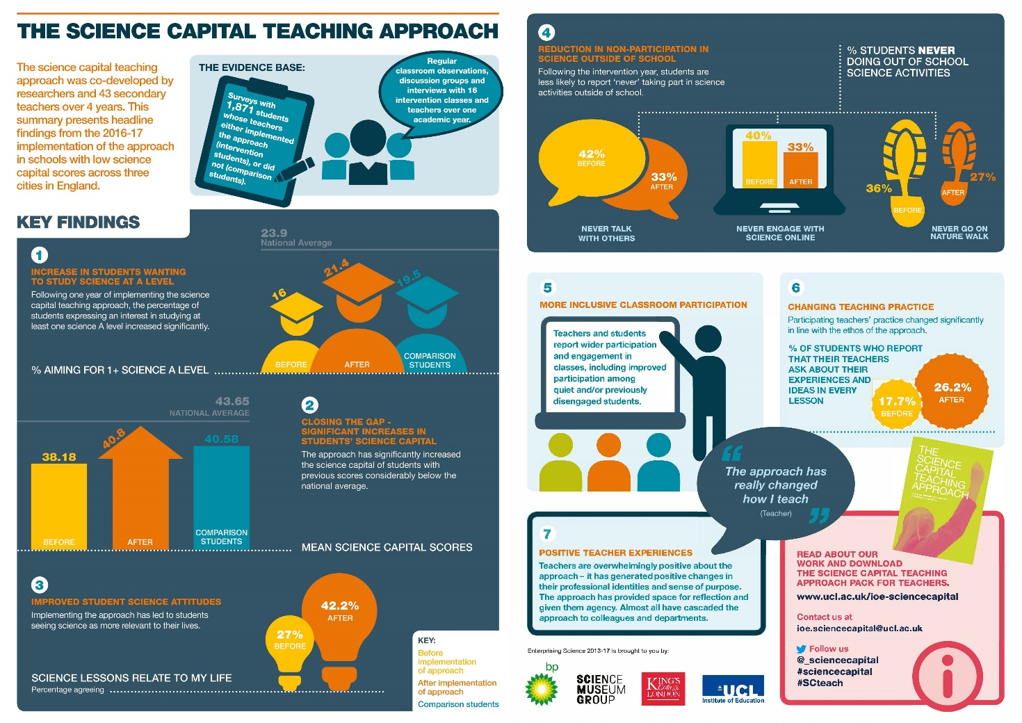
Outcomes

Slide 32
Teachers changed their practice (qualitative and quantitative evidence)
“That’s been a best part, you know - it really has changed how I teach” (Ms. Smith)
Students agree that also notice consistent changes in practice in line with the approach (“going off topic”)
“She teaches you based on what you know”
“Like she's linking it [science] to jobs that we can have, that was quite interesting”.

Slide 33
Student science capital significantly increased

Slide 34
Student aspirations to study A level science significantly increased

Slide 35
Students attitudes to science improved significantly – e.g. seeing the relevance of science to their lives

Slide 36
Students reported doing more out of school science activities – increase in those doing everyday and once or more a week, and a decrease in those never doing science outside school

Slide 37
Increased interest and enjoyment of lessons
Improved engagement:
“So [Y10 bottom set] are a very challenging group of students […] Through the year what I’ve noticed is when [I use the approach] I can see it their eyes … they kind of … like a meerkat, they pop up and you can see the engagement and you can see that they talk about it a bit more”.
Improved understanding: “Yeah, I feel like we get a better understanding because we can relate to what she's teaching us” (Alfie)
Improved behaviour
More inclusive classroom participation
Attainment: “Its been better than the target …. I’m really surprised” (Teacher)
‘Happier’ teachers and shared practice

Slide 38
Issues and limitations
Enactment of the approach was varied and takes time – still a developing process
Difficulty of balancing with demands of performativity, esp. at high stakes national test years (GCSE)
Two students were less keen/ sceptical
No change in % of students aspiring to be a scientist or science-related job and marginal decrease in % aspiring to medicine (13%-11%)
Only focused on secondary – whereas issues are evidence in primary

Slide 39

Messages for decision-makers
Support young people’s encounters with science (in and beyond the classroom) to be based on the science capital educational approach principles
Focus on changing institutional settings and systems – rather than young people
Take the long view: Move from one-off to more sustained approaches
Use science capital survey tools appropriately
Improve connectivity within and between settings: pathways, progression and partnerships

Slide 40
Conclusions and Implications
Our relationship to science is socially patterned and formed through complex interactions of multiple factors
It is particularly shaped by the interaction of our science capital, habitus and the ‘field’
If we want to improve people’s relationships with science, increasing interest is not enough – we need to build science capital
Building science capital does seem possible … but means making changes to the field, rather than just focusing on trying to change young people
More support for educators to engage with more complex & nuanced understandings of inequality and to have spaces and resources for professional reflection and taking ‘risks’
No simple or one-off intervention will change STEM participation – we need policy change and longer term initiatives and support. But we think it is possible!

Slide 41
10 further thoughts for applying SCTA principles in STEM outreach
DO share and apply SCTA principles to all forms of outreach and activity!
Do provide support, time and fora for staff to get to grips with the approach and reflect (individually and collectively)
DON’T just focus on ‘external’ and one-off STEM activities, interventions and opportunities (e.g. external visitor) – DO look at mainstreaming and everyday practice
DON’T just focus on the value of STEM for STEM destinations - DO emphasise the transferability of STEM for any job/ career
DO personalise, localise and link the STEM content to what matters most to these particular young people

Slide 42
6. DO take an assets-based approach (value what they bring with them – no ‘empty bags’)
7. DO use STEM as a vehicle for social justice – not an end in itself or a ‘civilising mission’
8. DO join up across primary/ secondary and informal sectors where possible
9. DO focus on diversity, representation and implicit messages that are conveyed within and by you, your activity and setting – how/are students experiencing a culture of science as ‘for all’?
10. DON’T forget – widening access will require reducing privilege (zero sum game)

Slide 43
More info/ resources
Science Capital Teaching Approach manual, films and infographic: http://www.ucl.ac.uk/ioe/departments-centres/departments/education-practice-and-society/science-capital-research/science-capital-teaching-approach-pack
2 minute animations:
What is science capital? buff.ly/1FmfXsi
A science capital approach to building engagement: https://www.youtube.com/watch?v=NDuEZFRt59M
The science capital teaching approach: www.ucl.ac.uk/ioe-sciencecapital
Teacher films:
Science capital teaching approach film:
https://www.youtube.com/watch?v=XDCekYVTkws
Science capital teaching approach trailer: https://www.youtube.com/embed/AxJP789Zu8U
Summaries, reports and papers:
Science Capital Made Clear: buff.ly/1XerGPE
Selection of research briefs, publications and short reports on our website
TedX talk: https://www.youtube.com/watch?v=g8D3fr-0aJ0

Slide 44
Thank you! Feel free to contact us:
Website: http://www.ucl.ac.uk/ioe/departments-centres/departments/education-practice-and-society/aspires
www.ucl.ac.uk/ioe-sciencecapital
Twitter: @ASPIRES2science
Email: ioe.aspires2@ucl.ac.uk

