Slide 1

Fostering Belonging and Community for Carers Lena Smith Together at Cardiff Manager
Notes:
Together at Cardiff is a service provided in Cardiff University and provides dedicated support to carers but also care experienced, estranged, military experienced and asylum seeking students.
This service is provided once a student has been made an offer at the university or attended an open day all the way through to graduation. This is for undergraduate, postgraduate and PhD students.
The current support covers carers of all ages.

Slide 2

Who are we supporting ?
Notes:
It is important to understand the student you are supporting. Through Together at Cardiff we have a one to one meeting with all students to ensure we are covering all the support they need.

Slide 3
A Tick Box
Disadvantaged socioeconomic background
Carer
First generation student
Estranged
Woman of colour
Neurodiverse
Asylum Seeker
Refugee
Queer /
LGBTQIA+
Disabled
Mature student
Notes:
This slide was created by a student who was explaining that she is more then the one box she ticked. This was about raising the importance about supporting the whole person and the intersectionality of that person.

Slide 4
But also...
Teacher/Tutor/ Educator
Neuroscientist
Writer
Mentor
Friend
Student
Maker
Entrepreneur
Fiancée
Colleague
Collector of hobbies
Notes:
This discussion looked at the hobbies and interests of that person and how this is important to support too.

Slide 5

Together at Cardiff
In 2021 Together at Cardiff was established to provide a space of belonging and community.
This means that regardless of how many priority groups they meet they just disclose once.
The students felt the wording gave them control and options on who knew the full story.
Together at Cardiff allows us to communicate the support available positively and improve disclosure. It also has helped us raise the profile of support available throughout the university improving staff knowledge and referrals.
Notes:
Student attend a meeting where we go through the support available and talk through what the student needs support with. We have a membership form which they complete at the beginning which includes a request of evidence. This covers them for their whole course, including the Together at Cardiff Bursary.

Slide 6
Carers Evidence
Some students can provide professional evidence of being a carer, but this is mainly for primary carers. However, there are students doing just as much but not classed as the primary carer.
We use our Caring Responsibility's Form to support gaining evidence for student carers. Here are some of the questions we ask to get a better understanding of their caring role:
Personal Care – This can include things like physically helping with washing, getting dressed, changing clothes, physically getting in/out of bed, laundry, cooking, cleaning and shopping.
Medication Support - This can include things like organising prescriptions, supporting with GP appointments/referrals, collecting prescriptions and supervising medication
Organisation and Financial Support - This can include things like organising and paying bills, support with claiming benefits and related applications, managing finances for the person(s) you care for.
Personal Safety Support - This can include things like managing risks within the house, minimising hazards, safe appliance use and using equipment for support.
Practical Support - This can include things like responsibility for shopping, attending appointments and meeting social needs of the person(s) you care for.
Emotional Support - This can include things like offering reassurance, being a point of contact and trusted person.
They also provide evidence of the condition of the person they care for. This can be a benefits statement, doctors letter of condition, charity organisation.
Notes:
This slide discussion was about recognising carers when the evidence is not always there but the need for support as a carer is clear.
It is important to recognise that once information is disclosed additional support can be looked into to support the student. An example of this could be counselling if they provide emotional support as this can affect the students wellbeing.

Slide 7
Together at Cardiff Support
Here are the areas of support we offer under Together at Cardiff:
One to one advice and guidance with the dedicated contact.
2 Together at Cardiff Cafes per week including out of term time
Together at Cardiff Dinners
Together at Cardiff Reading List
Together at Cardiff Bursary of £1000 per year paid in two installments
Car Parking Permits for commuting in carers
Library Extensions
Career Confident – Access to placements and work experience.
Notes:
This talked through the events, session and support provided by Together at Cardiff. These were all created by student voice and we keep developing the service based on there needs.

Slide 8
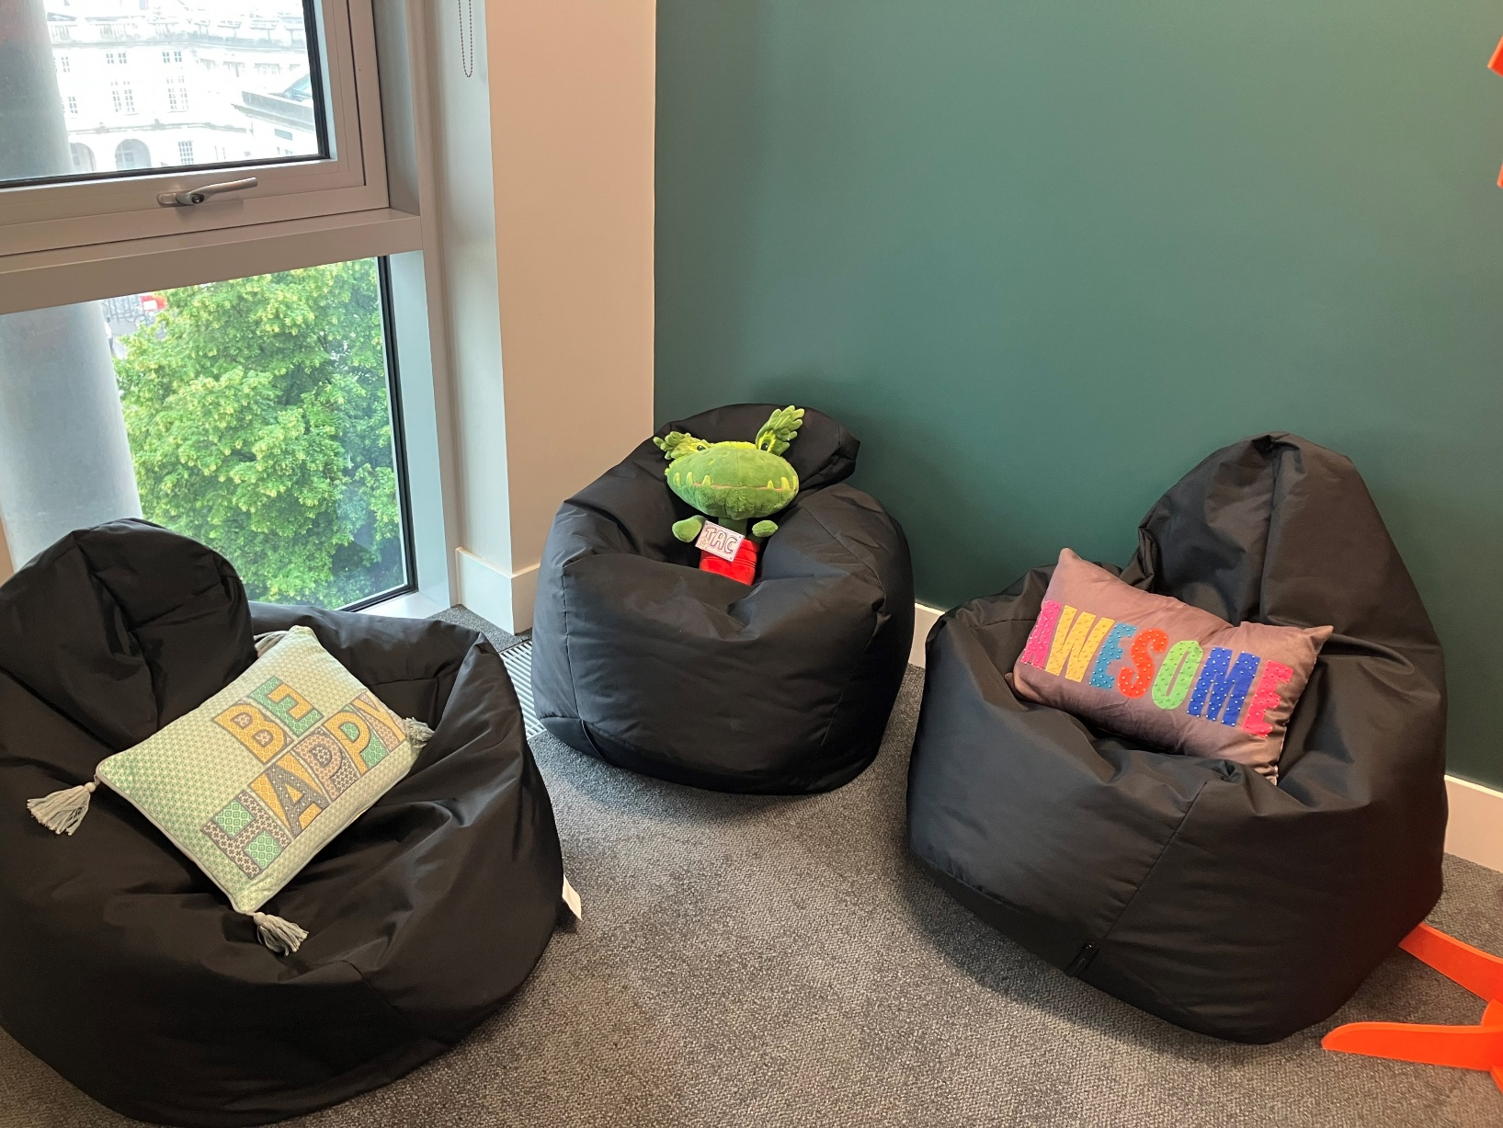
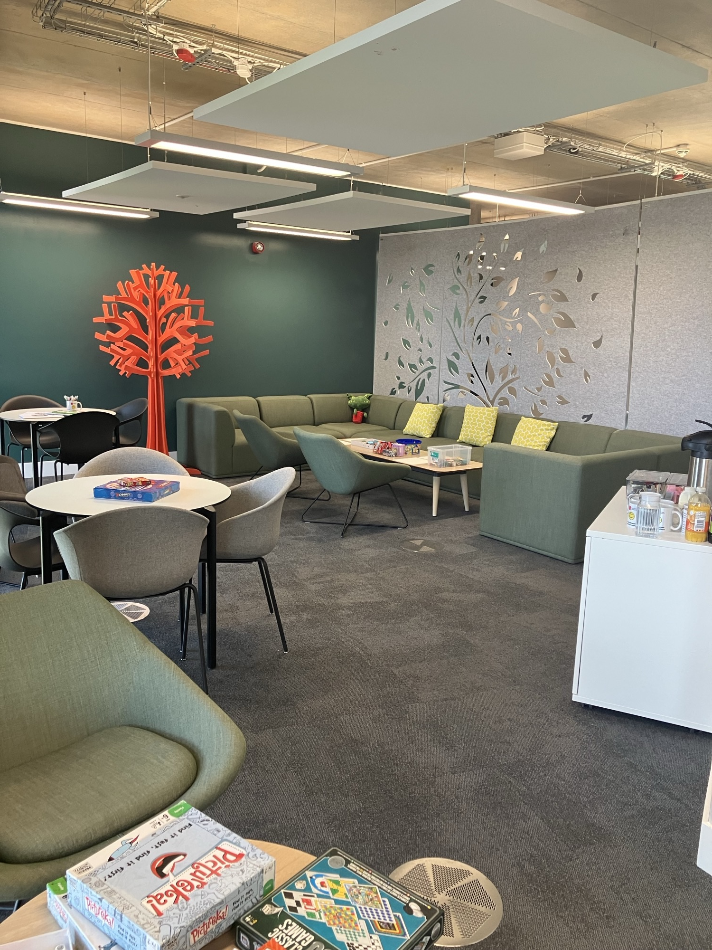
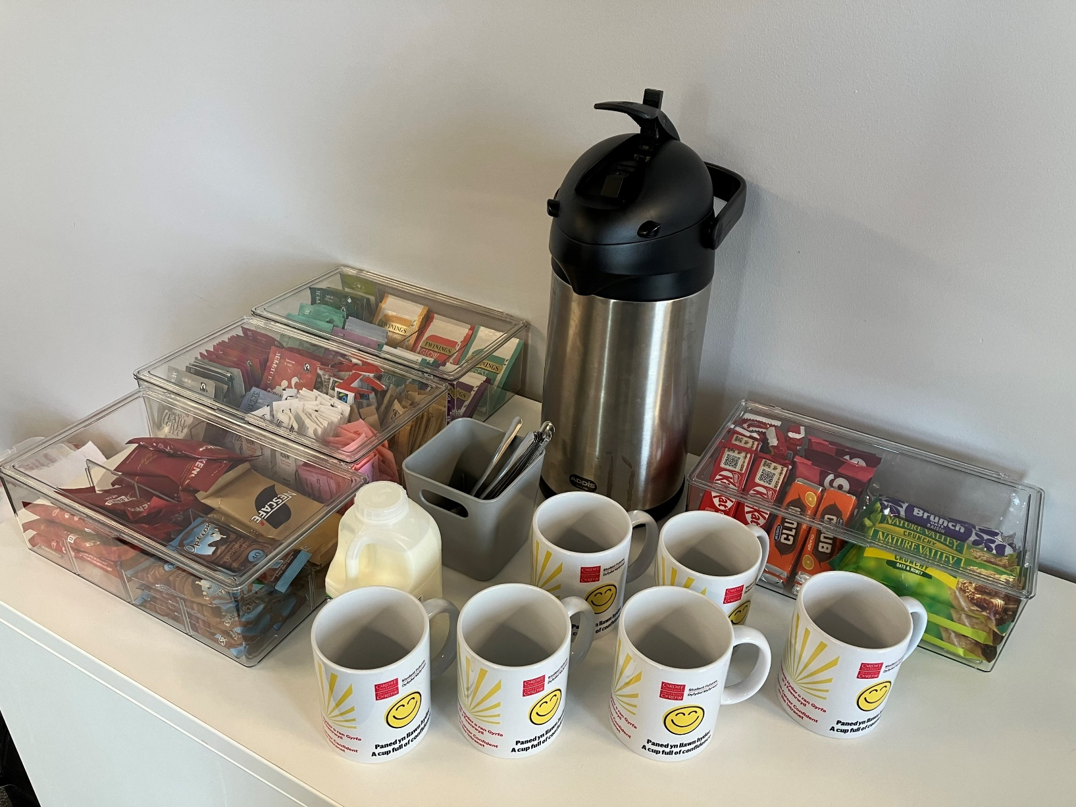
Together at Cardiff Cafes
Notes:
Our cafes are run twice a week and provide a social space for our Together at Cardiff members to join.
This is a low cost set up and having it in the same place each week and at the same time provides an ongoing space our students can join. It is important the space is not used for other things as you want to keep the space a place for respite.

Slide 9
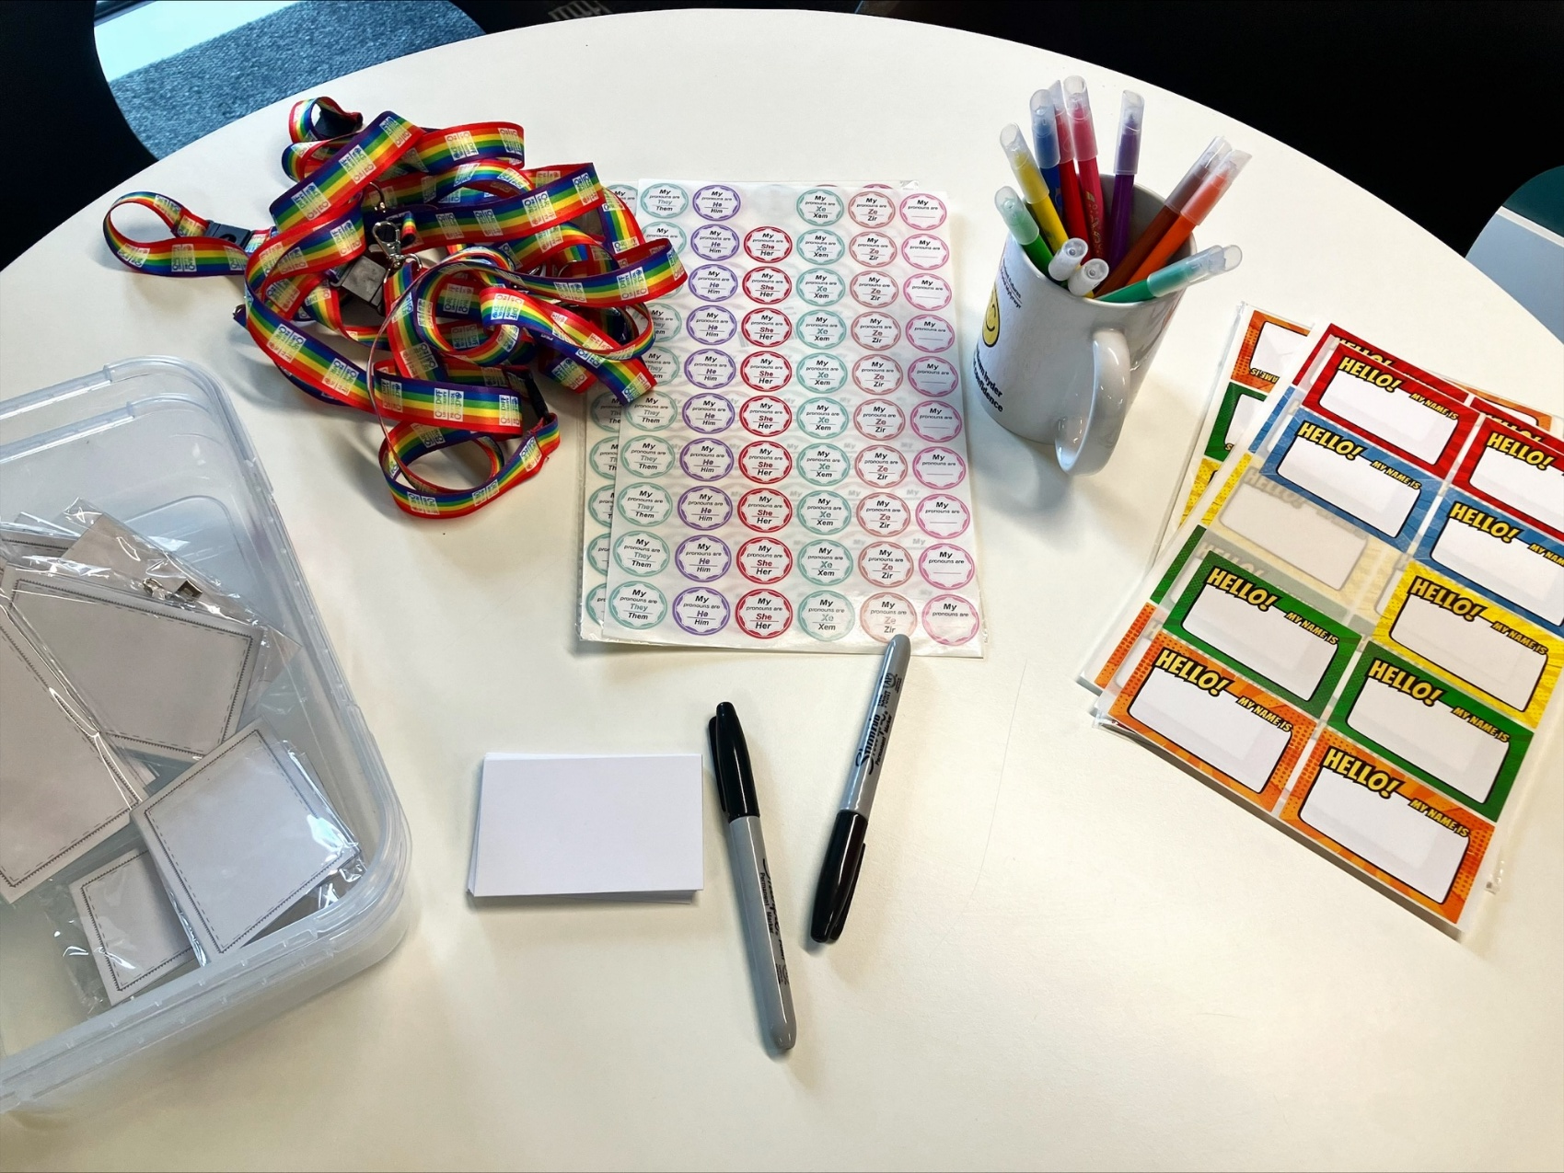
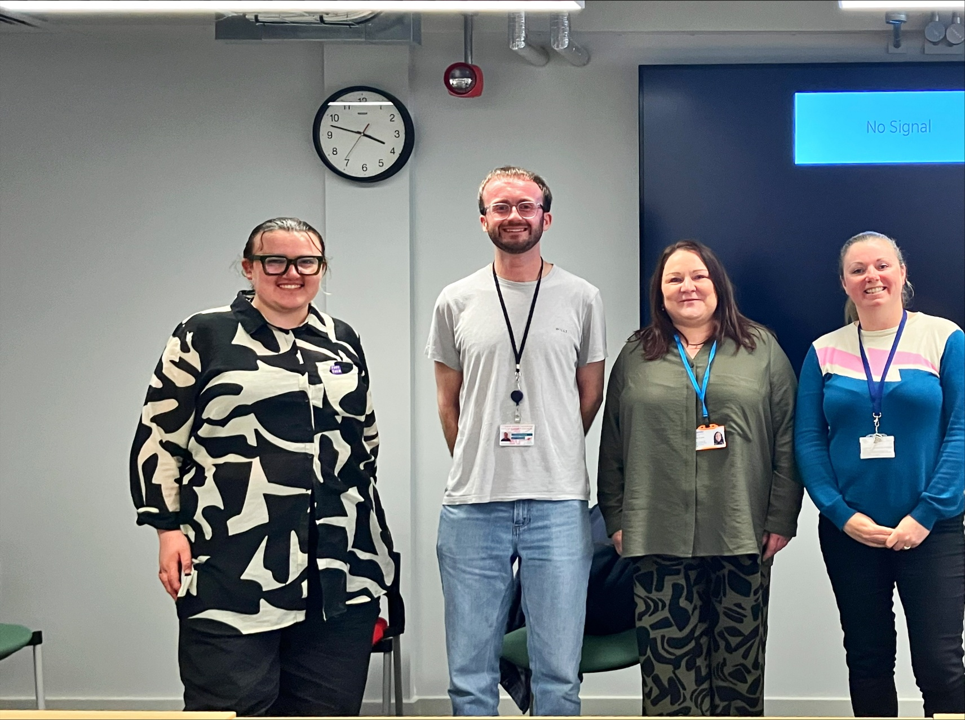


Together at Cardiff
Notes:
Through events, cafes and projects we focus on our student voice and what they would like to see. This can be celebrating Eid, name badges with pronouns as its hard to remember everyone's names, talks from expects locally and carers day events.

Slide 10
Together at Cardiff Reading List
Here are some books featured on our list for Carers:
Title: An extra pair of hands : a story of caring and everyday acts of love
Author: Mosse, Kate, 1961
Title: Reluctant carer: dispatches from the edge of life
Title: Poetic Persuasion: The Young Carer's Ink
Author: Mr Emmanuel Borges-Da-Silva,Michael Owusu-Kyereh
Title: You are not alone : a new way to grieve
Author: Lloyd, Cariad, 1982
Title: The Cracks that Let the Light In: A mother's story of raising her disabled son and the life-changing power of books
Author: Jessica Moxham
Title: The Cracks that Let the Light In: A mother's story of raising her disabled son and the life-changing power of books
Author: Jessica Moxham
Title: Day by Day: Emotional Wellbeing in parents of Disabled Children.
Author: Griffin, Joanna.
Title: Pulling through : help for families navigating life-changing illness
Author: Jessop, Catherine.
Notes:
We have a Together at Cardiff reading list which features books that support all our groups under Together at Cardiff. Here are books we feature for carers.

Slide 11
Embedding Support
To create true belonging we need the whole university to be responsive of the support needed. Here are some actions of support in Cardiff University:
Contextual Admissions for Carers of all ages.
Extenuating Circumstances for Carers – 1 week automatic extension on assignments given if unexpected caring responsibility has happened.
Car Parking permits for students commuting onto campus
Library Support – Books out for longer, Books posted out for free and free post envelope provided to return books, access to other university campuses.
EDI Impact Assessments – Carers included when create new or renewing services or projects.
Letters of support for placements closer to person they care for.
Support students on Interruption of Study to ensure link to the university
Notes:
This slide talked about the importance of embedding the support across the university and linking with other projects that match your goals too.
It is important to know that when creating community and belonging this needs to include the whole student experience.

Slide 12
“I just wanted to let you know that the university have agreed to allocate me closer to home for my final year placements !. I also wanted to mention that I really appreciate everything you have done for me this year and am incredibly grateful for the team at Together at Cardiff”
“thank you so much I’m honestly very emotional this is life changing for me in these circumstances and I really appreciate it so much :))”
“I also want to take this opportunity to say a final thank you. Thank you for making my life so much easier and bearable in final year, It really did make a difference. Thank you for standing in the gap and supporting the students who are having a particularly hard time but still choosing to carry on. What you do to support students is nothing short of exceptional. Keep doing what you're doing, you're great at it! I wish you all the best :)
“I wanted to take a moment to express my sincere gratitude for your unwavering support throughout my those darkest moments. Your guidance and encouragement have been invaluable to me, and I truly don’t know where I would be without you.”
“The meeting was wonderful and covered all the questions I had before starting university. And you were very encouraging and spoke with brimming positivity which makes me feel comfortable in seeking help when needed and looking forward to University”
Notes:
Feedback from some of our students who are part of Together at Cardiff.

Slide 13











Diolch am wrando Thank you for listening
Notes:
If you would like to chat about anything in the slides please email Lena Smith at Smithl77@cardiff.ac.uk

