Slide 1
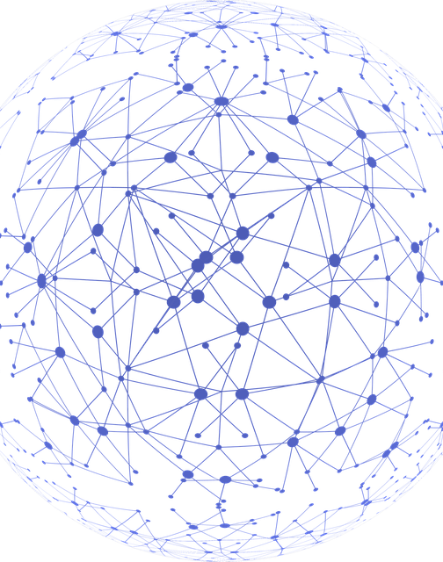
Online pedagogy, equity and engagement: a research-led approach
UCL Knowledge Lab
Diana Laurillard
UCL Knowledge Lab
Notes:
Online pedagogy is based on exactly the same theories about how we learn as all other kinds of face-to-face and remote pedagogies. But they are instantiated in very different ways from our conventional methods. Students’ learning processes still work the same way, but our ways of coaxing them to learn have to be very different.

Slide 2

Outline
How does online pedagogy achieve student engagement?
Building teaching community knowledge of how to manage equity and engagement online
Notes:
I will focus most on how to achieve student engagement in the online world.
I’ll address the first question by demonstrating the theory that underlies digital pedagogy.
Then I’ll look at how technology can also help us come together, to work out how to do it better.

Slide 3
How does online pedagogy achieve student engagement?
Notes:
Now, How does online pedagogy achieve student engagement?

Slide 4
What counts as high quality learning?
The Conversational Framework
Derived from theories and research on learning and teaching (Laurillard, 2002, 2012)
To represent the teaching-learning process as
a series of iterative exchanges
between the learner and a ‘teacher’ and
between a learner and their peers
at two levels of concepts and practices
Notes:
Some years ago I developed the Conversational Framework to address this question. The framework is a smple distillation of the main theories of teaching and learning, and is the simplest way to represent the teaching learning process as basically, a series of exchanges between a learner and a teacher, and between a learner and their peers, at two levels: of concepts and practices.
This representation of the teaching and learning process describes what it takes to learn. And educators can use it to test the pedagogic value of the new digital methods they’re now developing.
Laurillard, D. (2002). Rethinking University Teaching: A Conversational Framework for the Effective Use of Learning Technologies (2nd ed.). London: RoutledgeFalmer.
Laurillard, D. (2012). Teaching as a Design Science: Building Pedagogical Patterns for Learning and Technology. New York and London: Routledge.

Slide 5
What does it take to learn in formal education?
L
C
L
C
Learner concepts
L
P
L
P
Learner practice
Notes:
The heart of the framework is a simple way to think about how a learner is learning. They have some concepts, or knowledge, and they have some practices, or skills.
At the concept level, there are continual iterations of ideas, as they gradually develop a concept, and join it up with other concepts.
At the practice level as well, there are continual iterations of actions that gradually develop a skill, and then gradually more complex skills
Of course it’s also important that the concepts influence the learner’s practice, and v.v., in another continuous cycle. That’s how we’re all learning all the time, from day 1, for all kinds of language learning, sport, social interaction, and so on. But in formal education, we as teachers, have to make sure that these continual cycles are actually working, and the learner is indeed developing their concepts and practices together.

Slide 6
What does it take to learn in formal education?
Teacher communication cycle
Learner concepts
Peer communication cycle
Teacher concepts
L
C
L
C
Peer concepts
Teacher modelling
cycle
L
P
L
P
Peer
modelling
cycle
Decision-making game
Learner practice
Learning environment
Peer practice
Mock election
Notes:
The teacher does that by engaging the learner in thinking about concepts, and by setting up the learning environment for them to put those ideas into practice:
- if you teach them risk analysis, for example, you put the theory into a decision-making game;
- if you teach them about democracy, you run a mock election.
And their peers, the other learners, are important too – because they discuss and debate concepts, they practice skills together, and share their practical experience with each other. With this basic framework, we can now use it to represent all the main types of learning we use in education.

Slide 7
Types of learning mapped to the framework
Acquiring
Learner concepts
Teacher concepts
L
C
L
C
Peer concepts
L
P
L
P
Learning environment
Learner practice
Peer practice
Learning through ‘acquisition’
Notes:
We can link each type of learning to a specific part of the framework, beginning with learning through acquisition.
where the teacher is communicating concepts and ideas
that change some of the learner’s concept,
and then more presentation changes it some more – or so we hope!
But the learners do not need to generate any ideas themselves

Slide 8
Types of learning mapped to the framework
Learner concepts
Teacher concepts
Inquiring
L
C
L
C
Peer concepts
L
P
L
P
Learning environment
Learner practice
Peer practice
Learning through ‘inquiry’
Notes:
For ‘learning through inquiry, or investigation’ , it’s different
- the learner explores or questions the teachers’ concepts
- and from what they find generate ideas of what to look for next
- So these continued iterations produce more conceptual activity by the learner than learning through acquistion, because they are engaged in generating the questions and finding the answers in the teacher’s concepts (i.e. from the teacher, a book, or a website).
The more cycles there are, the more opportunities they have to change and develop their ideas.

Slide 9
Types of learning mapped to the framework
Learner concepts
Teacher concepts
L
C
L
C
Peer concepts
Practising
L
P
L
P
Learning environment
Learner practice
Peer practice
Learning through ‘practice’
Notes:
For ‘learning through practice’, the learner uses the learning environment set up by the teacher.
They are asked to achieve a goal
they generate an action
they receive feedback;
then respond with a revised action, with more feedback
And they may also be encouraged to use their practice to change their concept, and v.v, and so generate a better action.
All those iterations engage the student in developing both concepts and practices and the links between them - showing just how important this type of learning is.
From D. Laurillard (2012) Teaching as a Design Science, Routledge: New York.

Slide 10
Types of learning mapped to the framework
Learner concepts
Teacher concepts
L
C
L
C
Discussing
Peer concepts
L
P
L
P
Learning environment
Learner practice
Peer practice
Learning through ‘discussion’
Notes:
The same iterations happen with ‘learning through discussion’,
- where the social construction of ideas helps learners develop their concepts; then generate questions, they receive feedback from their peers, and respond with answers to their questions, and again these iterations engage them in the process of developing their concepts further.

Slide 11
Types of learning mapped to the framework
Learner concepts
Teacher concepts
L
C
L
C
Peer concepts
L
P
L
P
Collaborating
Learning environment
Learner practice
Peer practice
Learning through ‘collaboration’
Notes:
Similarly, for ‘learning through collaboration’,
- each learner is learning through practice by using the learning environment.
At the same time, they are discussing
and then sharing practice, and also linking the two.
Again, this type of learning helps them develop both concepts and practice, but in this case enriched by this social learning context. Collaboration takes them beyond discussion to having to negotiate what they do in practice, so it is more engaging than discussion alone, or practice alone. They have feedback both from the practice environment and from discussion and negotiation with their peers.

Slide 12
Types of learning mapped to the framework
Learner concepts
Teacher concepts
L
C
L
C
Peer concepts
Producing
L
P
L
P
Learning environment
Learner practice
Peer practice
Learning through ‘production’
Notes:
And finally, ‘learning through production’, is where
they reflect on and represent what they have learned, to communicate it to the teacher. Here they have to connect up concepts and practice, and then produce an essay, or performance, or presentation to show what they have learned.
- and then the feedback should enhance and consolidate their learning.
Learning through production is what we’re using in assessment. This where learners always have to produce evidence to demonstrate what they have learned. And if the learner has to produce something for the teacher, or for the class, it’s motivating - that’s why we use assessment to persuade students to focus on their learning process.

Slide 13
The Conversational Framework
Acquiring
Teacher communication cycle
Learner concepts
Teacher concepts
Inquiring
L
C
L
C
Discussion
Peer concepts
Producing
Teacher modelling
cycle
Peer
modelling
cycle
L
P
L
P
Collaborating
Learning environment
Practising
Learner practice
Peer practice
Bransford
Dewey
Hattie
Piaget
Marton
Seely Brown
Papert
Senge
Vygotsky
Notes:
This is the complete Conversational Framework, embracing all 6 learning types, which all work to complement and enhance each other, although each is distinctive from the others.
It derives from a wide range of research studies and teaching-learning theories,
here are a few of them. The work of each of these theorists can be located primarily in at least one part of the framework:
Ference Marton, who introduced the idea of the deep approach to learning, and his Variation Theory to explain how learning through acquisition could work
John Bransford, whose joint book on How People Learn covered everything, but especially learning through acquisition and inquiry.
John Dewey, who prefigured everything here a century ago, but is especially remembered for experiential learning
Seymour Papert who embedded the learning of concepts within the doing of practice
John Hattie, who focused our attention on the role of feedback in learning
Jean Piaget who showed how conceptual development was based on practical interaction with the world
Lev Vygostrky, who did so much to emphasise the importance of social learning
Peter Senge, who saw how collaborative learning led to knowledge creation
and John Seely Brown, who latterly focused so much on the importance of learning through making.
I hope you will find a place for your favourite theorist somewhere on the framework.
Of course, it is a simplification, but that’s what we need, as we design for learning - it has to be usable, not over-complex.

Slide 14
How does technology help? Conventional methods
Lectures
Acquiring
Teacher communication cycle
Learner concepts
Teacher concepts
L
C
L
C
Discussion
Peer concepts
Inquiring
Discussion groups
The library
Write a report
Producing
Teacher modelling
cycle
Peer
modelling
cycle
Group projects
Labs
L
P
L
P
Collaborating
Learning environment
Practising
Learner practice
Peer practice
These learning types are encouraged through a variety of conventional methods
Notes:
So for the teacher, the message of the Conversational Framework is that ideally we design learning sessions that use several of these types of learning to keep those cycles going.
There’s no special ordering to this. We should try to get all these cycles continually iterating as much as possible to promote learning, and for any one session they can start anywhere.
We’re familiar with the wide range of methods we use in conventional teaching and learning – the technologies of
Lectures,
The library,
Labs,
Discussion groups,
Group projects
And writing a report to show what has been learned.
So as teachers we try to encourage all these types of learning.

Slide 15


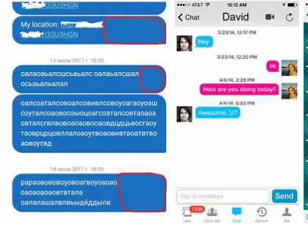



How does technology help online pedagogy? Digital methods
Digital images, videos
Acquiring
Learner concepts
Discussion
Teacher concepts
Explore the internet
L
C
L
C
Text chat
Menti
Peer concepts
Inquiring
Make website
Producing
Teacher modelling
cycle
Peer
modelling
cycle
Collaborating
Test a digital model
L
P
L
P
Draft a wiki
Learning environment
Practising
Learner practice
Peer practice
The same learning types are encouraged also through a variety of digital methods
Notes:
With online learning we have a much wider range of technologies we can use to design for learning. This is just a small selection:
For acquistion, Using digital images or videos
For inquiry, exploring the internet
For practice, testing a digital model - and here the digital environment itself is giving the students feedback on their actions, showing them the results of their actions, and how close they are to the goal.
For discussion, using text chat or Mentimetre
For collaboration, drafting a wiki
and for produciion, making a website
With digital and online technologies we have a huge new playbox of intriguing ways of supporting these different types of learning.

Slide 16
The Conversational Framework: Digital methods
Digital images, videos
Acquiring
Learner concepts
Discussion
Teacher concepts
Explore the internet
L
C
L
C
Text chat
Menti
Peer concepts
Inquiring
Make website
Producing
Teacher modelling
cycle
Peer
modelling
cycle
Collaborating
Test a digital model
L
P
L
P
Draft a wiki
Learning environment
Practising
Learner practice
Peer practice
Can you see how to map your students’ learning activities to the framework?
Notes:
Discussion: To what extent can you see how to map your students’ learning activities to the framework?

Slide 17
Building teaching community knowledge of how to manage equity and engagement online
Notes:
Now, we look at: Building teaching community knowledge of how to manage equity and engagement online

Slide 18
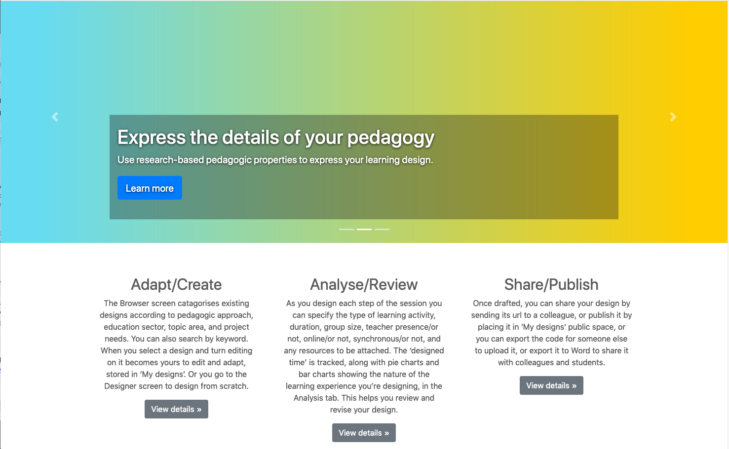
Bullding teaching community knowledg
https://www.ucl.ac.uk/learning-designer
The Learning Designer
A free open online design tool to help with moving your teaching online.
Based on the six learning types from the Conversational Framework – a model of what it takes to learn.
Supports teachers and educators to
design a sequence of blended and online teaching and learning activities
analyse their pedagogic design
share their learning designs with each other
Notes:
Teachers, educators and trainers in all sectors need support in moving to online learning, and there is very little help available.
So we developed the Learning Designer: a free online design tool, available to all. It turns the theory-based Conversational Framework into action.
It provides a structure for developing a sequence of learning activities to achieve the outcomes you define.
In the process you’re creating your design as a digital object, which you can then analyse, and export to Moodle, and also share with colleagues and your learners.
So lets go through what this could do for you.

Slide 19
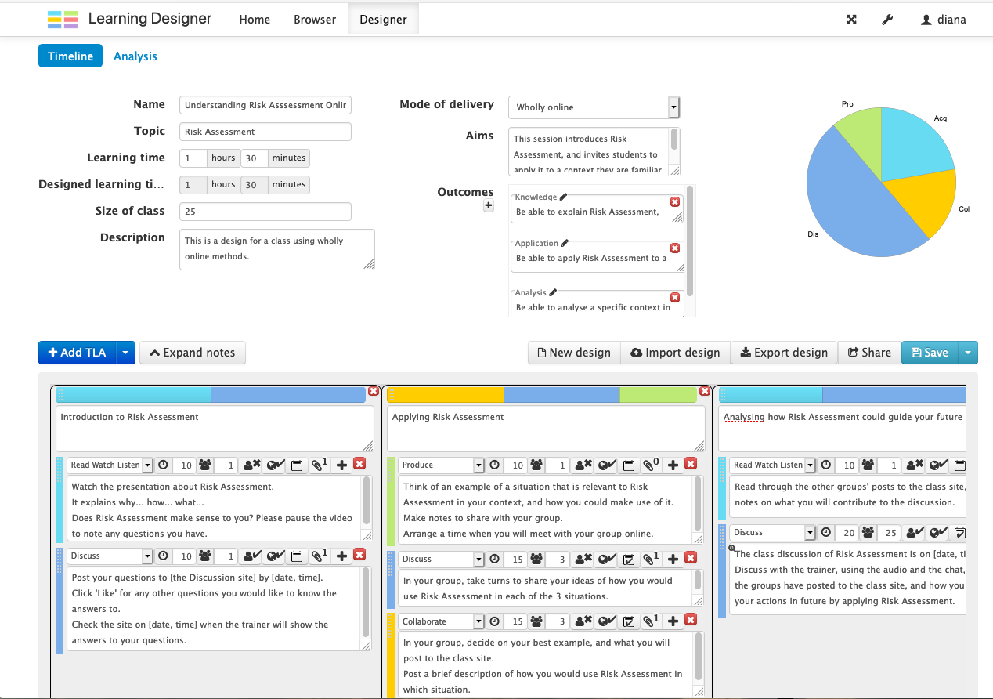
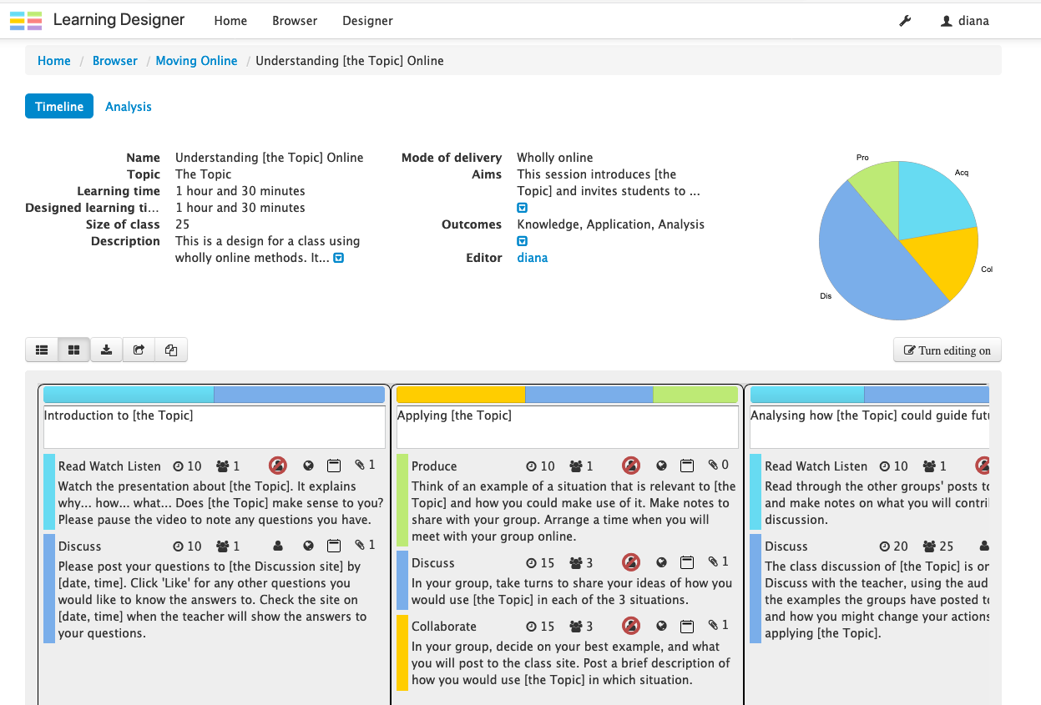
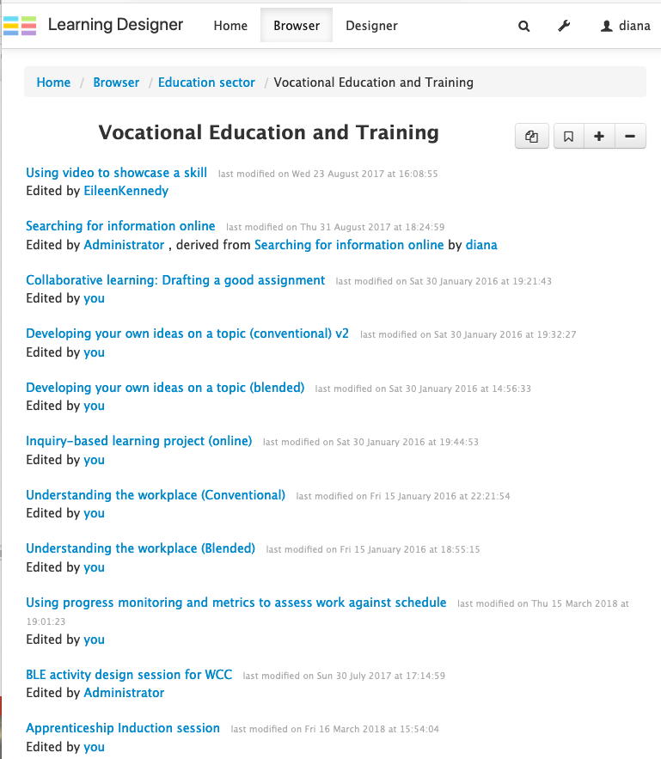
Adapting a learning design
Notes:
On the website you can go to the
- Browser screen to explore existing designs to see if any might be useful. Here I’ve chosen those categorised as Vocational Education
And from those I’ve selected one called ‘Understanding the Topic’, which has been derived from a learning design for understanding a specific topic. Looking at this on the Designer screen, I can see it might work for my topic, lets say Risk Assessment, so I hit Turn Editing On,
and now in edit mode I can edit everything in my own copy of the design. So I change all the Topic words to ‘Risk Assessment’.
I might decide, as I read through, to add a practice session, or change the length of an activity - everything is editable.
I might also decide to create a parallel learning process for students with disabilities - with links to different digital resources for example, or to a platform that embeds Google Translate for those with language difficulties.

Slide 20
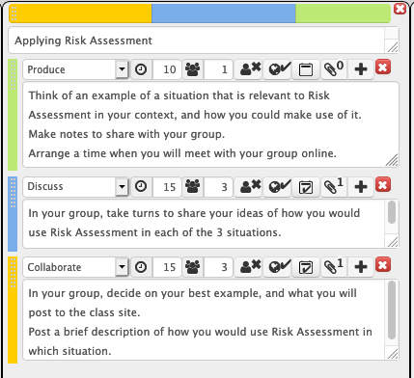
Adapting a learning design
Notes:
To get a better idea of how you generate your learning design, I’m going to expand the detail of this central Teaching-Learning Activity,
- on Applying Risk Assessment.
There are three different learning types here, which you can select using the dropdown menu – in this case Produce, Discuss and Collaborate.
And each activity has been assigned its unique set of pedagogical features, the duration in minutes, the size of the group – here an individual activity followed by two 3-person group activities, then whether the trainer is present or not, whether it’s online or not, whether it’s synchronous or asynchronous, and whether there is an attachment.
The colour coding of all the learning types matches those of the Conversational Framework. And because the software knows how much time you have assigned to each type of learning, it can provide the pie-chart as feedback on the overall distribution of learning types for this session. And this dynamically updates as you develop the design.
- as does the Designed Learning time.

Slide 21
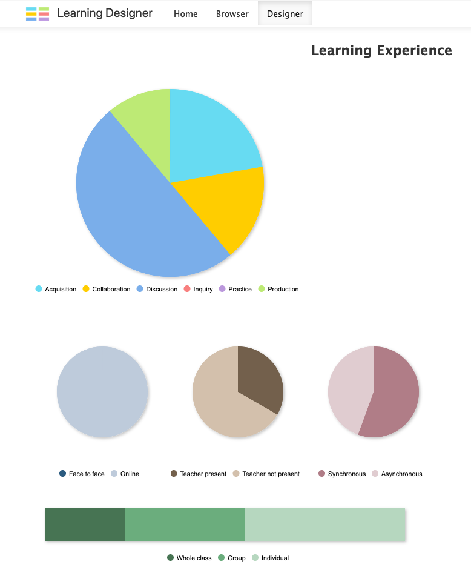
Analysing a learning design
The pie-chart analyses the distribution of types of learning in the design, in this case, acquisition, collaboration and production, but mostly discussion.
There are no rules about what it should be, but now you have the opportunity to consider if that looks appropriate
It is entirely online (pale blue), no f2f
There is some trainer presence (dark brown) to respond to questions, and conduct the plenary discussion
More than half is synchronous (dark pink) - with a group and with the trainer
There is mostly individual work (pale green), then groups, then whole class
Notes:
Now I’ve clicked on the Analysis tab to see what kind of learning experience I’ve designed for the learners. The Pie chart shows I have mostly used learning through discussion, both in groups and with the trainer, but there is a reasonable spread of other kinds of activity as well.
From the smaller pie charts I can see it is entirely online (pale blue), with the trainer present for about a third of the learning (the dark brown), and more than half is synchronous (the dark pink).
And from the bar chart I can see that it’s mostly individual work (pale green), then groupwork, then whole class.
There are no rules about what these distributions should be, but now, as designer, you have the opportunity to consider if that looks appropriate for what you’re trying to do.

Slide 22
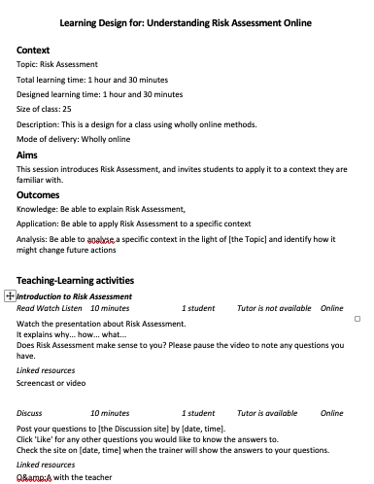
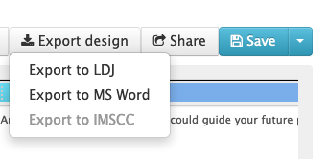

Sharing a learning design
On the Designer screen you can Export your design to Moodle (upcoming version)
Or Export to Word, to send to learners, or discuss with others
You can also Share it by creating a url to send to colleagues
https://www.ucl.ac.uk/learning-designer
Notes:
And for sharing and discussing your design with others you can Export the design to Moodle (that version is about to be launched).
and then send it to learners, or use it to discuss the design with others in your team. And you can also Share it by creating a url to send to colleagues.
Or you can export it to Word, and it produces a structured output of everything you have designed in so far.
Demo
At the same time, I can do a live demo, and you can request things to try, or ask questions about what it can do, as we go.
Link to https://www.ucl.ac.uk/learning-designer

Slide 23
A community of practice: innovating, testing, and
sharing new ideas for effective design
Browse
Adopt
Publish
Adapt
Create
Review
Test
Redesign
Building knowledge for science and scholarship
Notes:
Finally I want to consider what all this could mean for the future development of our knowledge and understanding about online learning.
This is a representation of how we build knowledge in the context of academic science and scholarship.
We begin by Browsing journals and adopting others’ ideas, then adapt them and create something new, which we test, redesign, and re-test, until we;re ready to have it reviewed and commente by others, and finally publish for other to browse and use.
That’s how we build scientific and scholarly knowledge. But we never do that in education. And now we really need to be doing that.
Wenger, E. (2011). Communities of practice: A brief introduction. http://hdl.handle.net/1794/11736

Slide 24
A community of practice: innovating, testing, and
sharing new ideas for effective online learning design
What is the pedagogic equivalent of the scholarly journal?
Browse
Adopt
Publish
Adapt
Create
An online collaborative community using digital tools to share testable
co-designed
peer-reviewed adaptable
learning designs
Review
Test
Redesign
Building knowledge of online learning design
Notes:
We need the same kind of knowledge building process for building knowledge of the new digital pedagogies.
Sharing ideas for effective online learning design.
- But what is the pedagogic equivalent of the scholarly journal?
- It’s got to be something like the LDer: An online collaborative community using digital tools to share testable co-designed peer-reviewed adaptable learning designs.
Then perhaps we’ll be able to rapidly develop the new knowledge we need about how to do high quality online learning.

Slide 25
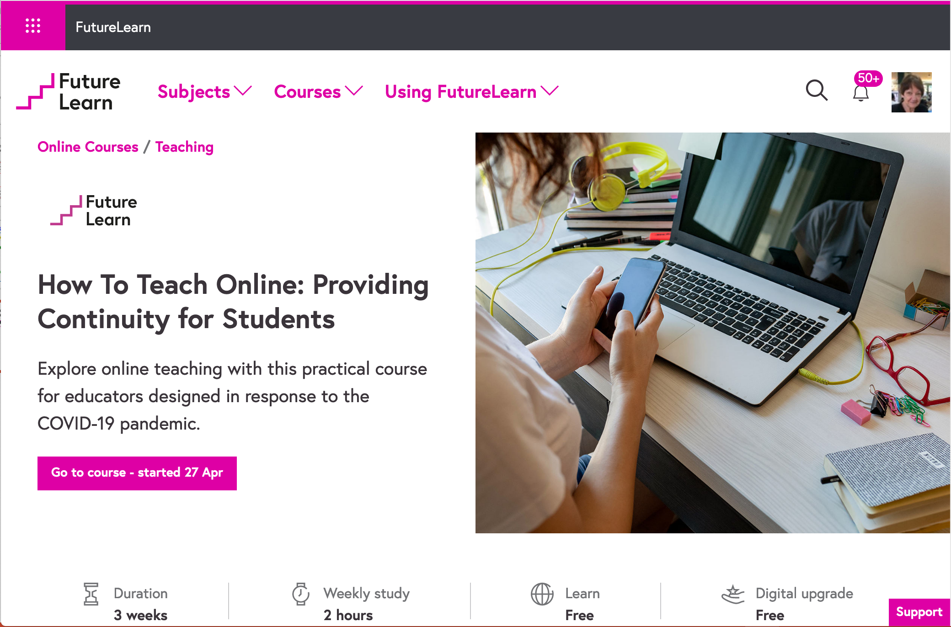
Large-scale online courses to orchestrate collaborative knowledge development by education professionals
Notes:
And we do now have the technology for this - the large-scale online course platforms for MOOCs such as Coursera or EdX, or the one UCL uses, FutureLearn.
We embed the Learning Designer in these courses for teachers in all sectors to collect their best designs and teaching solutions.

Slide 26
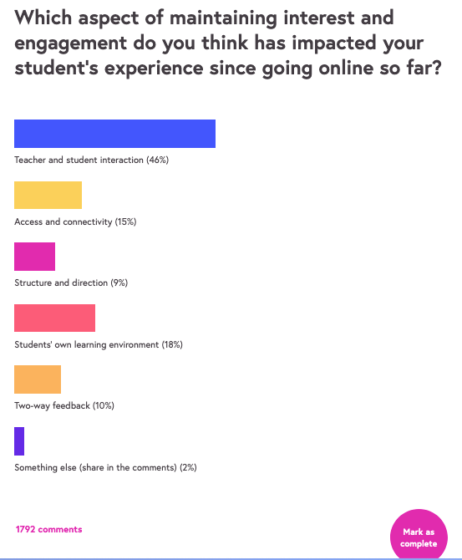
Poll to assess teachers’ sense of engagement issues
Teacher and student interaction (46%)
Access and connectivity (15%)
Structure and direction (9%)
Students’ own learning environment (18%)
Two-way peer-to-peer feedback (10%)
Something else (share in the comments) (2%)
Notes:
To design for engagement, we need to know what teachers think the issues are, and they will be many. The FL course tried to get a perspective on this by doing a poll of its 10,000s of participants, to find out what their impression was so far.
- For them it was far and away the nature of the interaction between teacher and students that made most impact, but the next most important was the nature of the student’s environment.
We need to work together on ways of addressing such issues, which is why not just discussion but also collaboration among teachers is important.

Slide 27
Education professionals sharing learning designs on Padlet
Notes:
One way to organise a collaborative approach to problem-solving, is to run a peer review activity. Here participants are sharing their designs on a Padlet wall, ready to review and build on each other’s work. This is part of how we build our community knowledge of the pedagogies for online engagement.

Slide 28
Online pedagogy, equity and engagement: a research-led approach
Online pedagogy achieves student engagement through
active participation by individuals and small groups
different types of feedback, from self, peer, computer, and teacher
We now have the technologies to build community knowledge of how to manage engagement and equity online
UCL Knowledge Lab
Notes:
To summarise these thoughts about online pedagogy, equity and engagement
We can achieve student engagement if they are actively participating in the learning process, whether as individuals or in small groups
and we can make use of the different types of feedback, from their own practice, from peers, or the computer, or the teacher
Finally, we now have have the technologies to build community knowledge of how to manage engagement, and certain types of equity online.
Our main problem with equity is student access to a laptop and connectivity, and teachers cannot solve that. But we can fight for it. Digital access is now as important to an educational institution as buildings. It is the sine qua non - nothing can happen without it. so if our students do have poor access we have to lobby the institution to create the means for them to gain access - through fund-raising if need be. The big tech corporates have done well out of the pandemic - they could contribute, for example. Then we can manage equity as well, on a much greater scale.
Thank you very much for your attention

