Slide 1

Decolonising the Academy: A Journey of Self-Reflection
Dr Deborah Husbands
University of Westminster

Slide 2

Decolonising
What is it?
Why is it done?
How is it done?
For whom is it done?
Can it ever be considered ‘done’?

Slide 3

Importance of exploring our cultural stories
Positionality
Storytelling
Critical race theory (trigger alert!)
Benefits
Risks

Slide 4
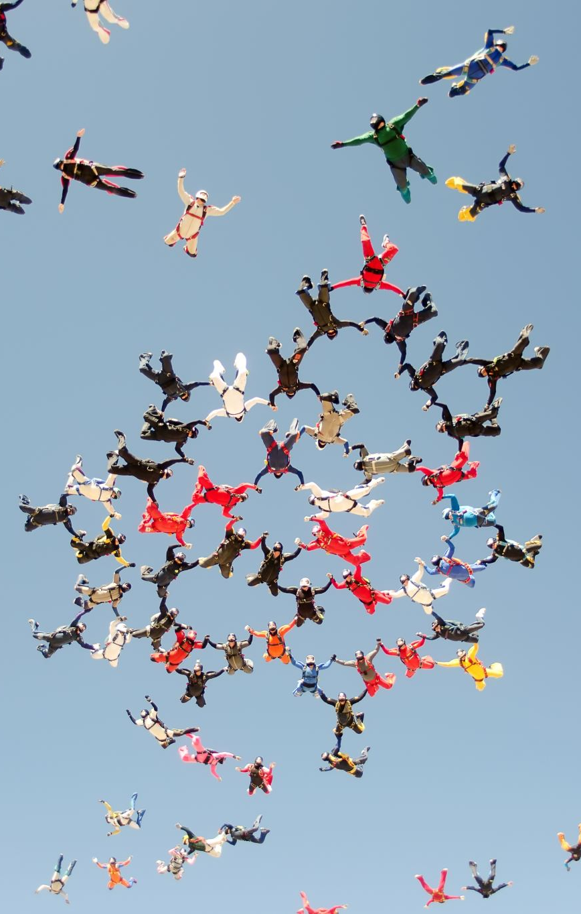
Decolonising is a process…
Purpose
Practice: reflective & reflexive
Knowing-in-action
Reflection-in-action
Reflection-on-action
(Gould, 2009)
Our conduct: being prepared, patient, perceptive, peaceable & positive

Slide 5

Storytelling moments
Get some refreshments
Form a pair
Use your ‘artefact’ as a conversation starting point
Aim for an ‘intimate’ chat about your journey, your culture, your background (each person to share your story for up to 10 minutes).
Ask (respectful) questions about anything you want to know more about or don’t understand
Come back into the lecture theatre by 11:20am
Share your reflections on the process as you feel comfortable

Slide 6

Feedback

Slide 7

Reflections
How do you/we feel about your/our stories?
How can you/we engage with culturally diverse students’/colleagues’ stories and experiences?
Does telling our stories feel ‘healing’ or ‘challenging’? What are the issues with either outcome?
How can you use your story to decolonise the curriculum/academy in your area of work?
What can you commit to do after this session to further your decolonising journey?

Slide 8
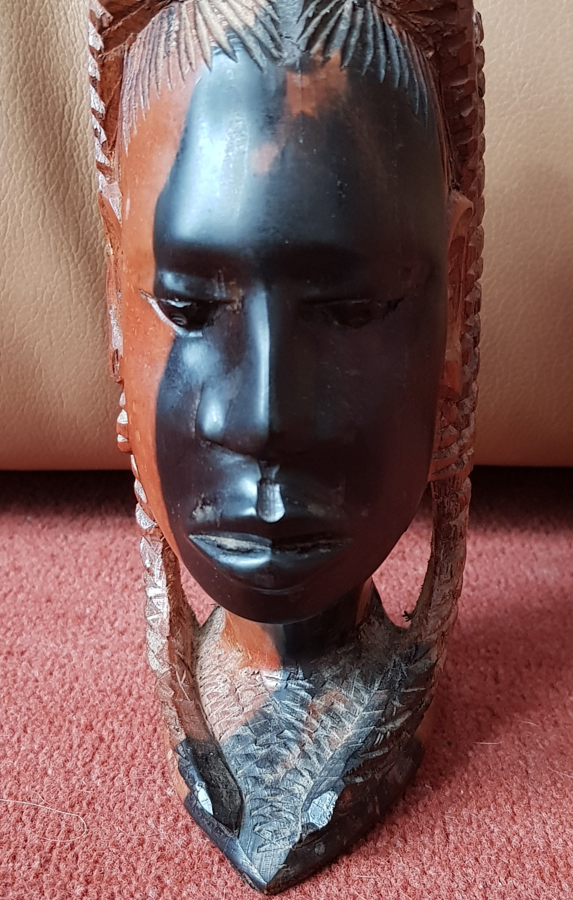
Storytelling my artefact: The experience of an ‘outsider-outsider’
Bought while on holiday in Jamaica, the land of my immediate ancestors
Shading reflects hypervisibility and hyperinvisibility of my experiences in the academy
The natural plaited hairstyle (cornrows down each side) signifies my resistance to adopting Eurocentric ways of being, fighting the urge to bodily ‘code-switch’ in order to feel a sense of belonging
Holding a visage of quiet strength and determination, declaring my Blackness and intersectional identity to a world that is not fully open to me

Slide 9

Thank you!
Deborah Husbands
LinkedIn
X: @DebbiHusbands
husband@westminster.ac.uk

