Slide 1

Uncovering partnership working’s hidden benefits – collaboration and co-creation with UCL Careers Extra students
Penny Longman,
Senior Careers Consultant
NERUPI conference, 13 September 2023

Slide 2
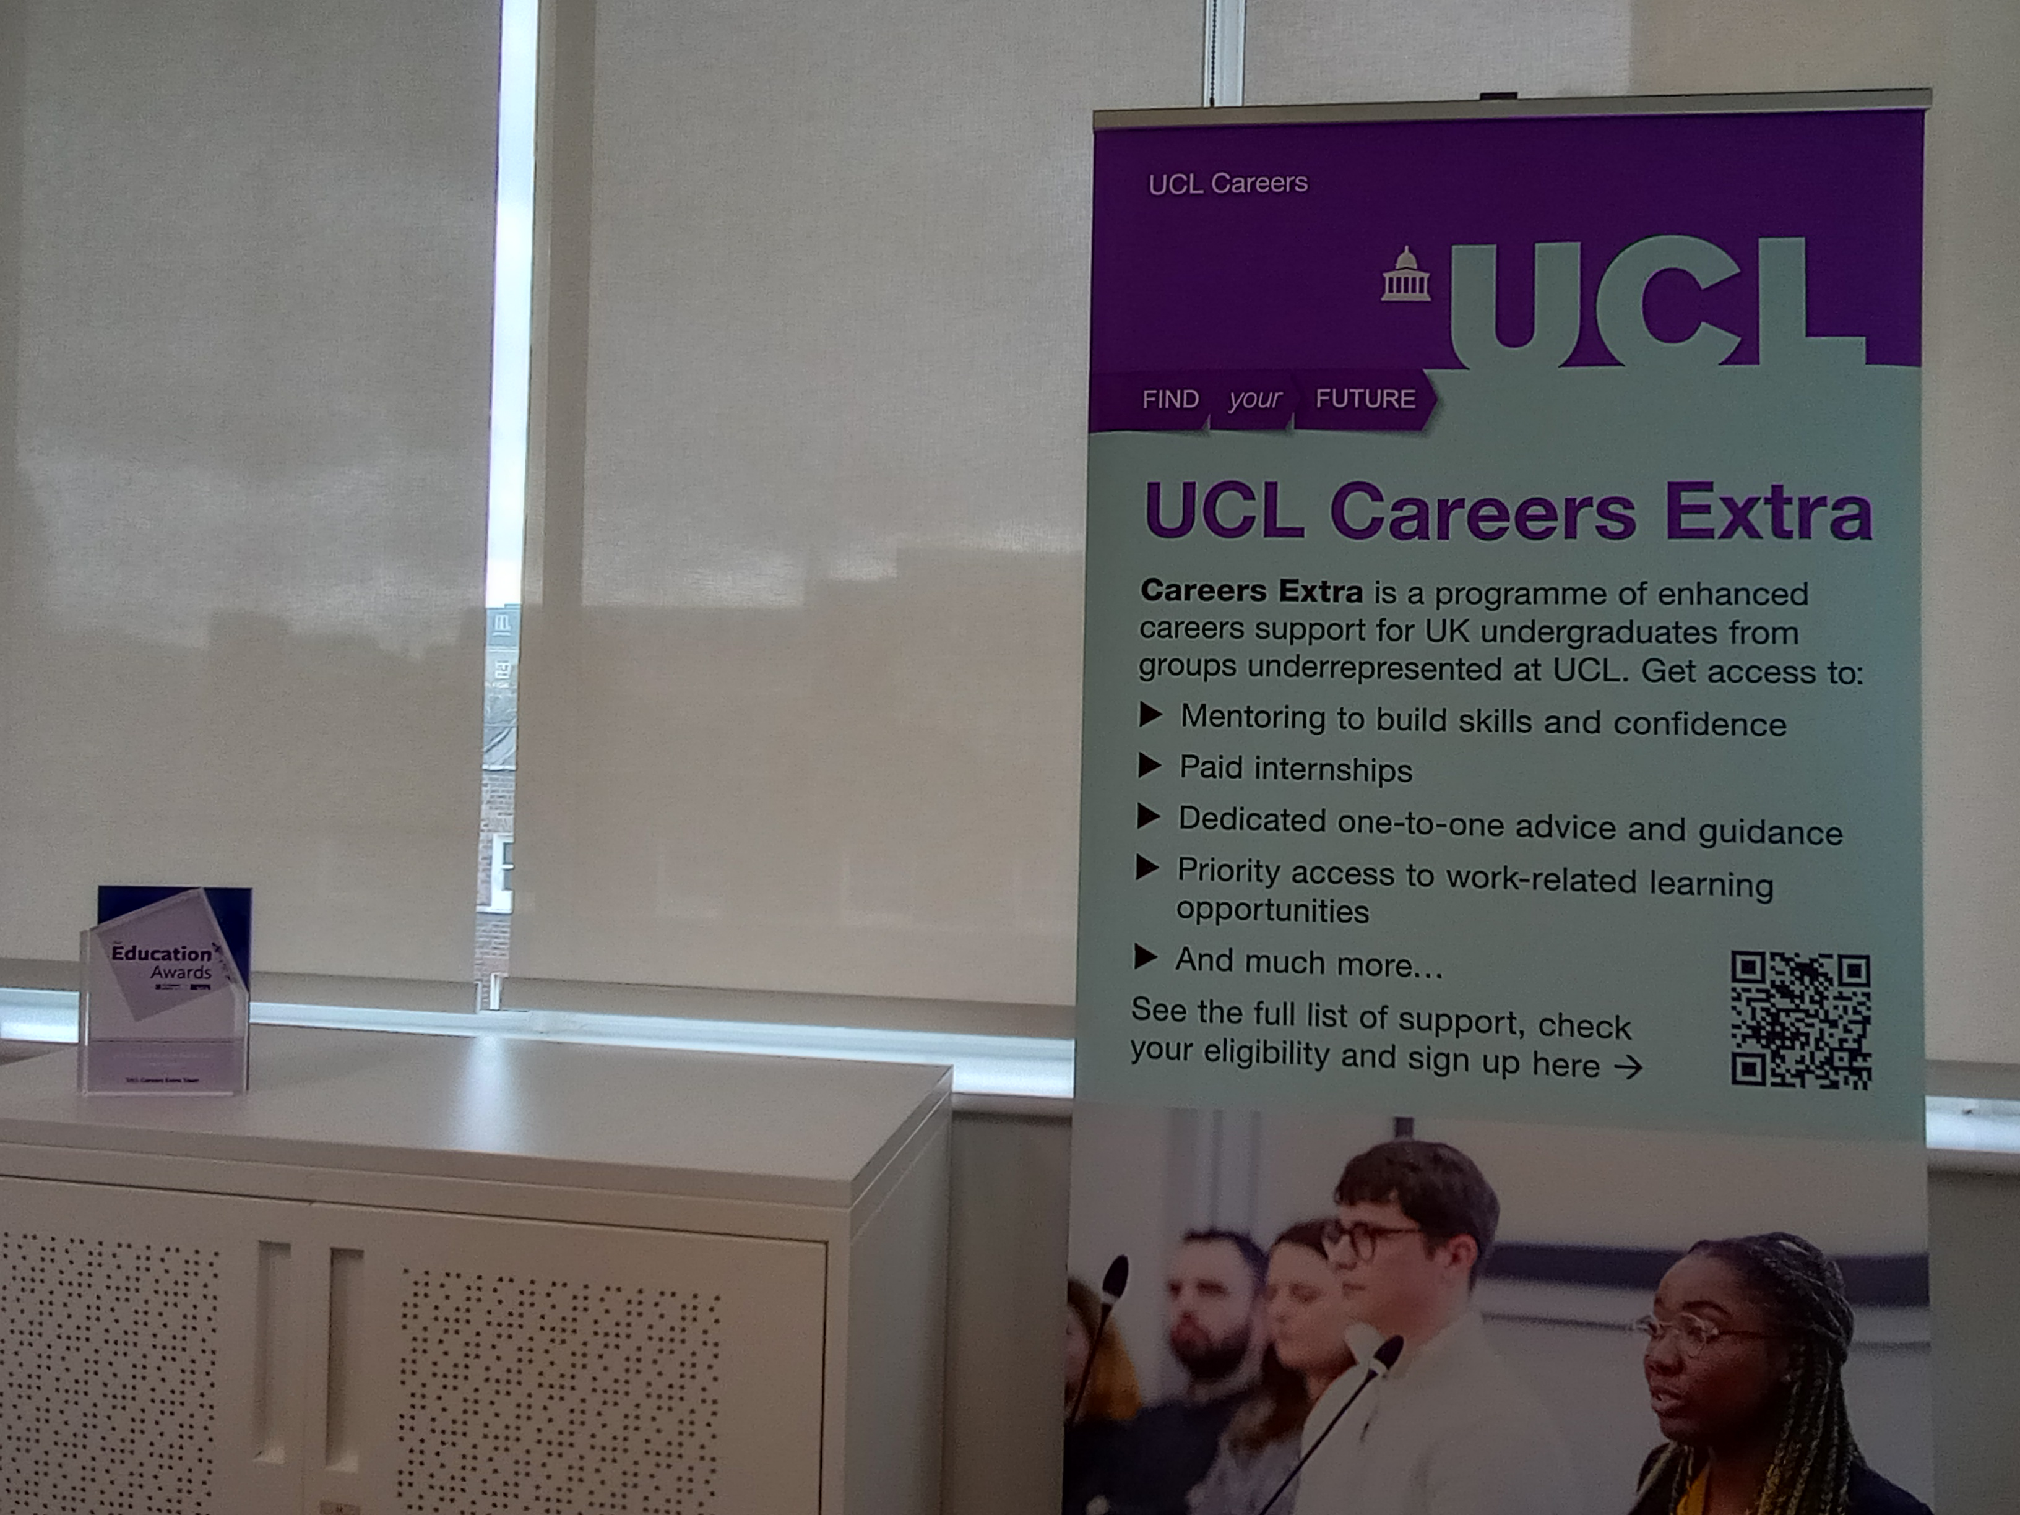
This session will cover:
Introduction to UCL Careers Extra;
The Champions scheme – why and how;
Hosting an intern;
ChangeMakers student leadership;
Outputs and developments;
Our learning;
Application elsewhere?

Slide 3
UCL Careers Extra
Enhanced careers support for UCL undergraduates from under-represented groups.
Eligible students opt in.
Approximately 1500 students (around 1250 current).

Slide 4
Why the Champions?
Aim of collaboration and co-creation.
Importance of lived experience – but every experience is individual.
Inspired by others (St Mary’s Be SMART, Lancaster GROW Your Future).
Careers Extra students wanting to give back.

Slide 5
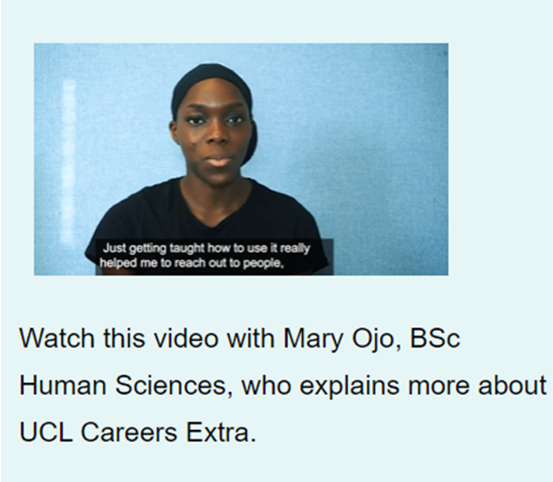
Champion role
Five steering groups per year + option of project work.
First team recruited March 2021.
Outputs – initiating buddy scheme, alumni network, student society connections, social media, resources.

Slide 6
Going deeper
Hosting intern (Summer 2022).
ChangeMakers Student/Staff partnership project – expanding buddy scheme pilot.

Slide 7

The challenges
Being more than ‘a glorified focus group’.
Building a team.
Challenges of occasional involvement/flexible projects.
Student leadership is not a magic wand.
Implementing ideas - takes more resource (who knew!) and significant support requires significant resource.

Slide 8
The highlights
The ‘hidden benefits’:
Ownership of project;
Mentorship to build skills – careers panel event;
Presenting to Education Conference;
Engagement with UCL Careers;
Successful job applications!

Slide 9
What’s next?
Where are they now?
Plans for this year.

Slide 10

Questions?

