Slide 1




NERUPI & the OfS
Evaluation Requirements & Self Assessment tool
Wednesday 15 May 2019
Annette Hayton, NERUPI Convenor

Slide 2
The NERUPI Framework
Designed to maximise the impact of Widening Participation interventions providing:
a robust theoretical and evidence-based rationale for the types of intervention that are designed and delivered
clear aims and learning outcomes for interventions, which enable more strategic and reflexive design and delivery
an integrated evaluation process across multiple interventions to improve data quality, effectiveness and impact

Slide 3
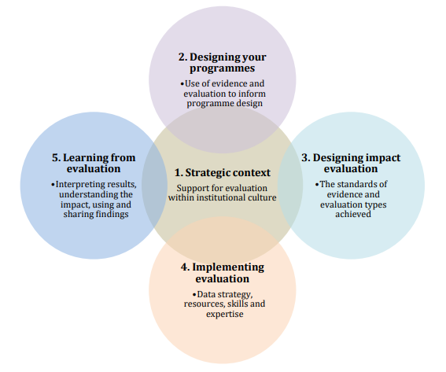
Five-point framework: evaluation self assessment tool

Slide 4

Theories of change
Important for the sector to move beyond descriptive research to action
BUT
Understanding the challenge
Understanding the processes involved in bringing about the change
Theories of change currently being presented too simplistic
and linear
Defining your interventions
Determining the impact of your work
Notes:
Page 9 of Using Standards

Slide 5
Effective theory of change
Iterative, repeating cycle
Aims for interventions informed by theory, research and practice
Interventions reflect the aims
Appropriate methods used to generate useful data
Evidence to demonstrate impact and inform practice and theory

Slide 6
Action research reflective cycle for WP
ANALYSIS
theory - OfS policy -
local context - practitioner expertise - data -
PLANNING
aims - targeting - interventions - evaluation strategy- logistics
COLLECT DATA
Monitoring – tracking – related stats – process - impact
ACTION
Deliver interventions & undertake evaluation
ANALYSIS
Cycle repeats
Notes:
Learn adn reflect page 45

Slide 7
OfS: Using standards of evidence
Review
and reflect
Evaluate
Plan
Implement
Project Planning Cycle page 45
Notes:
Evaluation is an integral part of the outreach planning and management

Slide 8
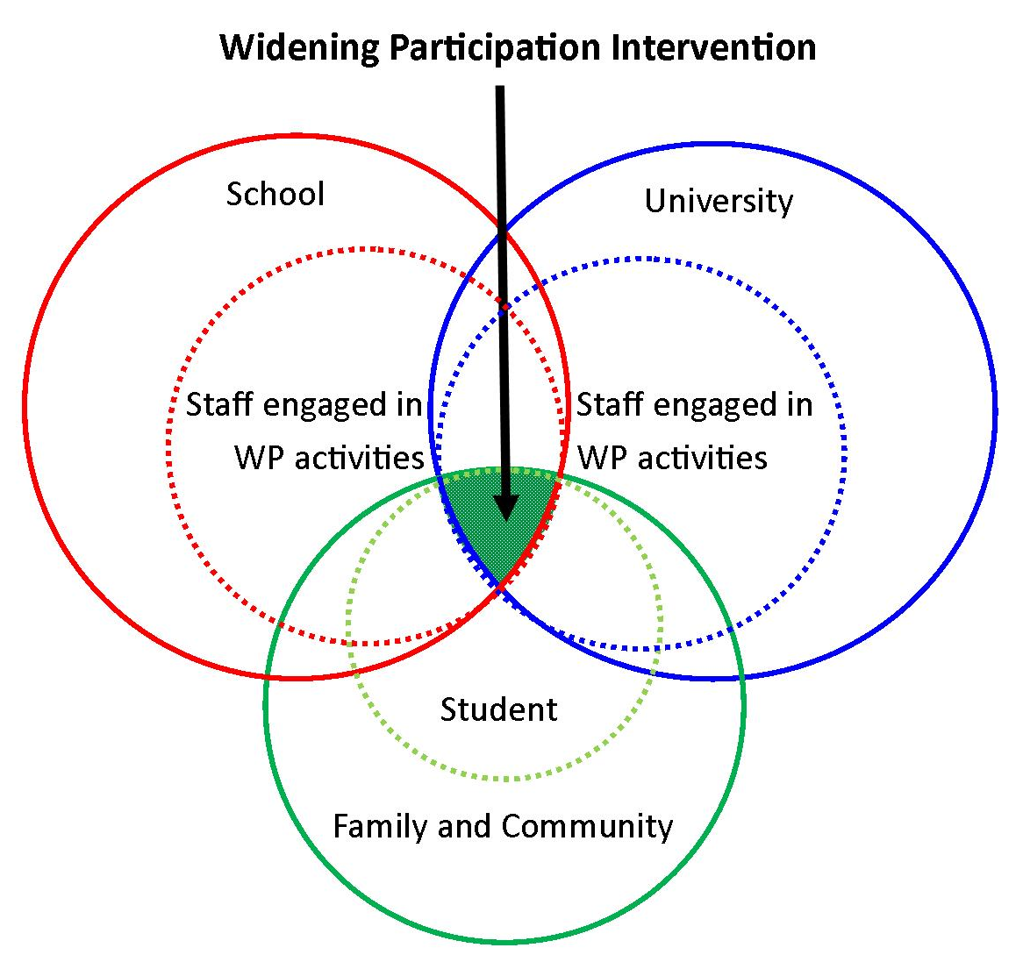
Strategic Context & field of HE progression
Notes:
Where do you draw the line? Or how do you define the field?

Slide 9

1: Strategic Context
The HEI
- National or local recruiter? Over-under-subscribed? High levels of drop-out? Large attainment gaps?
The local area
- Culture of HE progression? Rural? Urban? Transport?
Employment
- Graduate? Semi-skilled? High unemployment?
Schools
Community
Agree Strategy and Priorities
Notes:
How and when do you involve wider communities (i.e) stake holders

Slide 10
1: Strategic Context
Dimension 1: Strategic Context
Are there opportunities for your widening participation team(s) t have conversations about evaluation on a regular basis? | Evaluation is an integral part of planning and review of interventions. The NERUPI Framework provides a common language and a set of Aims and Objectives to underpin discussions e.g. at outreach team meetings, staff development and planning and at the University's APP Advisory Group.
Is there a mechanism for strategic overview of evaluation of access and participation programmes? | All interventions are aligned to the NERUPI Framework providing a firm foundation for the ????Group/Forum/ Academic Advisory Board to consider and advise on the choice of evaluation method and assess the impact of interventions.
Are access and participation delivery staff and partners aware of the importance of evaluation? | The NERUPI Framework underpins the design and planning of interventions, ensuring that clear aims and objectives are embedded into planning process along with appropriate evaluation methods. Planning meetings / debriefs/discussions reviews etc et etc take place ???

Slide 11
1: Strategic Context
Dimension 1: Strategic Context
Are access and participation delivery staff and partners committed to facilitating robust data collection processes? | The NERUPI Framework provides a firm foundation for ensuring that staff and partners are aware of our key aims and objectives and our expectations regarding data collection which are integral to our programme. FOR EXAMPLE We embed this into practice by e.g. using NERUPI as a basis for setting objectives when planning interventions, presentations at partner school conferences
Is there a whole institutional approach to widening participation? | The 6 flexible Levels within the NERUPI Framework extend across the student lifecycle setting out clear expectations for interventions, providing the basis for planning and delivery across the institution and clear aims and objectives to underpin evaluation. FOR EXAMPLE
Have you identified a skills base or expertise among professional service staff for undertaking or commissioning evaluation of widening participation initiatives | FOR EXAMPLE A skills mapping process/recruitment process/commissioning process/CPD workshops/ have been developed based on the NERUPI Framework utilising both the theoretical and practical it provides to inform the above

Slide 12
1: Strategic Context
Dimension 1: Strategic Context
Have you identified a skills base or expertise among academic staff for undertaking or commissioning evaluation of widening participation initiatives | The NERUPI Framework provides a clear set of theoretically grounded aims that enable academic staff to deploy their research expertise to meet national and institutional priorities
Do you encourage access and participation staff members to engage in reflective practice? | The NERUPI Framework is used as a basis for reflection on interventions allows staff to assess how far aims and objectives have been met and providing a starting point for exploration of the related theory enabling staff to develop as reflective practitioners.
Are there opportunities for access and participation staff members to enhance their evaluation skills and practice? | NERUPI provides opportunities for staff to attend NERUPI seminars engage with key theoretical concepts and relevant literature

Slide 13
2: Programme Design
SOCIAL AND ACADEMIC CAPITAL |  | HABITUS | SKILLS CAPITAL | INTELLECTUAL & SUBJECT CAPITAL
PROGRESSION CURRICULUM |  | STUDENT IDENTITIES | SKILLS CURRICULUM | KNOWLEDGE CURRICULUM
KNOW | CHOOSE | BECOME | PRACTISE | UNDERSTAND
Develop students' knowledge and awareness of the benefits of higher education | Develop students' capacity to navigate Higher Education sector and make informed choices | Develop students' confidence and resilience to negotiate the challenges of university life | Develop students' study skills and capacity for academic attainment | Develop students' understanding by contextualising subject knowledge
Notes:
Programmes are underpinned by evidence
Evidence is used to inform decisions on the course of action
You are clear and specific about what change you want to bring about
You are clear on the rationale for chosen activities and how you deliver them
You have developed a coherent description of what you are doing and why
Your programme design has developed through developing your strategic thinking and depth of understanding (how the theory is
presented externally is less important)
Develop a logic chain that describes your investment, activities, planned outputs and desired outcomes and impact
Undertake a theory of change process to map your outcomes and challenge your assumptions
Ensure you understand what the existing evidence says about the likely results of different approaches and the implications for your programme design
Test the evidence you are drawing on to shape your decisions – is it rigorous, is it trustworthy?
Remember it’s an iterative process: as you consider the existing evidence you should refine your ideas about the intervention you want to test, and as the programme design is developed you may need to search for more evidence relevant to the specific design features.
You might need to work differently, change courses of action, let things go

Slide 14

NERUPI Key theoretical influences
Sen and Walker’s concepts of capability
Bourdieu – capitals, habitus & field
Paulo Freire on Praxis
Nancy Fraser on social justice
Yosso cultural wealths
Identities and possible/future selves
Young and Maton’s concepts of knowledge
Critical pedagogies

Slide 15
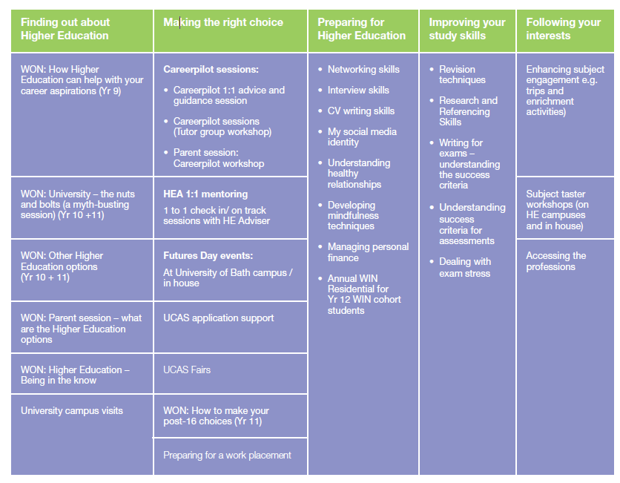
2: Programme Design

Slide 16
2: Programme Design
Dimension 2: Designing your programmes
Are your programmes underpinned by clear objectives for what you want to achieve? | The NERUPI Framework sets out clear Aims and Objectives/Learning Outcomes that provide the basis for additional learning outcomes tailored to specific interventions while retaining overall programme coherence.
Is your programme design informed by evidence? | The theoretically grounded, context specific aims and objectives in the NERUPI Framework provide a firm foundation for programme design.
Is there a clear and detailed specification of the specific activities your programmes will deliver and why you are delivering them in this way in order to best meet your objectives? | Our programmes and activities have been mapped/developed against the aims objectives in the NERUPI Framework which prides a coherent basis for assessing impact of individual activities and the programme as a whole

Slide 17
2: Programme Design
Dimension 2: Designing your programmes
Are you clear on how you will measure all the outcomes and impact of your programmes? | The NERUPI Framework offers the flexibility to use a range of impact and outcomes and measures as appropriate for the intervention while providing overall programme coherence.
Is evaluation specified at the planning stage of your interventions? | The NERUPI Framework underpins the design of activities and the identification of appropriate data collection and outcome measures.
Notes:
Dimension 2: Designing your programmes
Are your programmes underpinned by clear objectives for what you want to achieve?
The NERUPI Framework sets out clear Aims and Objectives/Learning Outcomes that provide the basis for additional learning outcomes tailored to specific interventions while retaining overall programme coherence.
Is your programme design informed by evidence?
The theoretically grounded, context specific aims and objectives in the NERUPI Framework provide a firm foundation for programme design.
Is there a clear and detailed specification of thespecifc activities yur programmes will deliver and why you are delivering them in this way in order to best meet your objectives?
Our programmes and activities have been mapped/developed against the aism and objectives in the NERUPI Framework which prides a coherent basis for assessing impact of individual activities and the programme as a whole
Are you clear on how you will measure all the outcomes and impact of your programmes?
The NERUPI Framework offers the flexibility to use a range of impact and outcomes and measures as appropriate for the intervention while providing overall programme coherence.
Is evaluation specified at the planning stage of your interventions?
The NERUPI Framework underpins the design of activities and the identification of appropriate data collection and outcome measures.

Slide 18
2: Programme Design
Dimension 3: Designing your interventions
 | By defining a set of capabiliities required at 6 levels for successful progression to and through higher education the NERUPI Framework incorporates a theory of change that is most closely aligned to an action research approach to continuous improvement.
Is evaluation specified at the planning stage of your interventions? | The NERUPI Framework underpins the design of activities and the identification of appropriate data collection and outcome measures.
Notes:
Dimension 2: Designing your programmes
Are your programmes underpinned by clear objectives for what you want to achieve?
The NERUPI Framework sets out clear Aims and Objectives/Learning Outcomes that provide the basis for additional learning outcomes tailored to specific interventions while retaining overall programme coherence.
Is your programme design informed by evidence?
The theoretically grounded, context specific aims and objectives in the NERUPI Framework provide a firm foundation for programme design.
Is there a clear and detailed specification of thespecifc activities yur programmes will deliver and why you are delivering them in this way in order to best meet your objectives?
Our programmes and activities have been mapped/developed against the aism and objectives in the NERUPI Framework which prides a coherent basis for assessing impact of individual activities and the programme as a whole
Are you clear on how you will measure all the outcomes and impact of your programmes?
The NERUPI Framework offers the flexibility to use a range of impact and outcomes and measures as appropriate for the intervention while providing overall programme coherence.
Is evaluation specified at the planning stage of your interventions?
The NERUPI Framework underpins the design of activities and the identification of appropriate data collection and outcome measures.

Slide 19
3: Designing Impact Evaluation – mixed methods
Targeting &
Monitoring
Tracking & Statistical data
Impact of interventions
Process Evaluation

Slide 20
3: Designing Impact Evaluation
Aim 1 | Develop students' knowledge and awareness of the benefits of higher education and graduate employment |  | Intervention | Evaluation method
Level 2 (age 14–16) | Top-level objective | Explore academic, social, economic and personal benefits of progressing to higher education | Year 10 university visit linked to wider Gatsby-based careers programme | Identify targeting criteria & characteristics of school/students Pre-event quiz?
 | Objectives or learning outcomes | Understand economic benefits of higher education and career opportunities for graduates | Graduate ‘job search’ activity to identify qualification required and average salary – web-based group work | Observation, quality of presentation of results and quiz results, capacity to undertake own job search
 |  | Explore benefits of higher education in terms of personal development and cultural enrichment | Student ambassador presentations on student life Individual or pair work reflecting on interests in worksheet/online form | Observation Results of worksheet/ online form Innovative feedback e.g. Poster/Aims of another student
 |  | Discover study and research opportunities at the HEI/in the area | Introduction to courses at the HEI and related career opportunities | Link to ‘job search’ activity and use quiz to identify knowledge gains

Slide 21
3: Designing Impact Evaluation
Type of intervention | A/P | Monitor | Track | Process | Impact
Long-term or multi-activity outreach | A
Residential (outreach) | A
Mentoring, tutoring, PAL | A/P
Campus visits | A
One-off HE info, UCAS, taster | A
HE Fair, Open day; School Assembly | A
Subject specific support | A/P
Academic Skills provision | P
Support for specific groups e.g BAME, women in STEM, WWC | A/P
Employment & progression provision | P
Residential (pre-sessional/undergrad) | P
Third sector provider | A/P
Notes:
Making judgements:
Proportionality of evaluation to spend
Existing evidence base
Utility of findings (e.g. what you want to prove from your evaluation)

Slide 22
5:Learning – what might you do: sharing results
Internal mechanisms for sharing the results of evaluations could include cross-institutional networks or steering groups.
A wide range of opportunities can be used to share the results of evaluation externally in order to contribute to knowledge on effective practices, such as publication of reports and briefings, presentations at conferences/events, publication in widening participation newsfeeds, and articles in journals.
Audience | Content | Format
Policy makers | Quantifiable results that enable comparisons with other interventions and providers | Summary report, information included in monitoring reports
Widening participation practitioners | Information on the evaluation and lessons learnt | Workshop presentation, newsletter articles, blog post
Partner stakeholders | Evaluation results and emerging recommendations for developments or changes to the intervention | Detailed written report

Slide 23
5: Learning
Can you attribute impact - or lack thereof – to your programmes | The NERUPI Framework is designed to facilitate a range of evaluation approaches. The overarching aims and objectives provide the flexibility to deploy the appropriate methodology while retaining overall coherence
Does your evaluation triangulate findings from different sources? | The coherence provided by the overarching aims and objectives of the NERUPI Framework makes it particularly suited to a mixed methods approach
Does your reporting demonstrate engagement with the key scholarly literature? | The NERUPI Framework is based on key theoretical concepts and literature in the field.
Are mechanisms in place to enable evaluation results to influence practice across the sector? | Membership of NERUPI provides opportunities to share evaluation case studies through the members’ website, NERUPI seminars and the annual Convention.

Slide 24
Action research reflective cycle for WP
ANALYSIS
theory - OfS policy -
local context - practitioner expertise - data -
PLANNING
aims - targeting - interventions - evaluation strategy- logistics
COLLECT DATA
Monitoring – tracking – related stats – process - impact
ACTION
Deliver interventions & undertake evaluation
ANALYSIS
Cycle repeats

Slide 25
NERUPI Framework
A set of Aims and Objectives for interventions informed by theory, research and practice
Can encompass specific intervention-based aims
A common language for planning and reporting
Choice of appropriate methods according to context of intervention
Evidence to demonstrate impact and inform practice and theory

Slide 26

Find out more: www.nerupi.co.uk
NERUPI Open Event
Introduction to the NERUPI Framework
14 June 2019
NERUPI Annual
Convention
Making Spaces in HE: Exploring Possible Selves
2-3 July 2019
Keynote Speakers
Prof Jacqueline Stevenson
Sheffield Hallam
Richard Shiner
Office for Students
NERUPI Members Event
Widening Participation and Graduate Progression
15 May 2019

