Slide 1

NERUPI
Network for Evaluating and Researching University Participation Interventions
Monday 14 January 2019
Annette Hayton, NERUPI Convenor

Slide 2
Accountability, context & impact
Research has increased understanding of reasons for low participation and attainment of under-represented groups but:
Research insights haven’t informed evaluation and monitoring
Findings not disseminated to practitioners or policy makers
Monitoring for OfS, SMTs and Government focussed on:
value for money
demonstrating the effectiveness of WP interventions
Practitioner research/evaluation focussed on:
the successful delivery of activities
reporting to OfS, funders and SMT

Slide 3
Multiple data sources
Targetting &
Monitoring
Tracking & Statisttical data
Impact of interventions
Process Evaluation

Slide 4
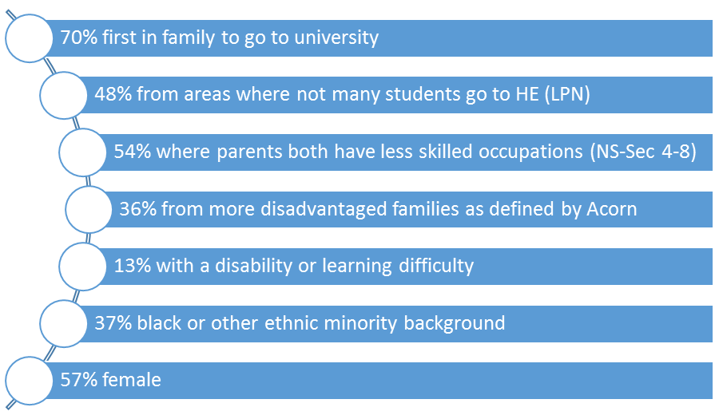
Targetting & Monitoring
Participant characteristics are monitored to assess and demonstrate success in attracting students who fulfil the targeting criteria.

Slide 5
Tracking and statistical sources
Tracking services such as HEAT (Higher Education Tracker) provide information about engagement with activities and destinations
National, local and institutional data such as admissions are provide valuable information that can inrom strategy and priorities

Slide 6

Process Evaluation
Did they have a good time?
Were they safe?
Can organisation be improved?
Did they like the lunch?
Was the session engaging?
How was it for the staff and ambassadors?

Slide 7
Theories of change
Important for the sector to move beyond descriptive research to action
BUT
Understanding the challenge
Understanding the processes involved in bringing about the change
Theories of change currently being presented too simplistic
and linear
Defining your interventions
Determining the impact of your work

Slide 8
Praxis
Freire’s notion of ‘praxis’ fundamental
activities taking place within a field or context
Practitioners & Policy makers often unaware of theory & research
misrecognition
simplistic solutions
deficit models
Researchers ofen unaware of:
Nuances of policy
Monitoring requirements
Nature of activities & interventions

Slide 9
Action research reflective cycle for WP
ANALYSIS
theory - OfS policy – local context - data - knowledge
PLANNING
aims - targeting - interventions - evaluation strategy- logisitics
COLLECT DATA
Monitoring – tracking – related stats – process - impact
ACTION
Deliver the interventions
ANALYSIS
Cycle repeats

Slide 10
Effective theory of change
Iterative, repeating cycle
Aims for interventions informed by theory, research and practice
Interventions reflect the aims
Appropriate methods used to generate useful data
Evidence to demonstrate impact and inform practice and theory

Slide 11
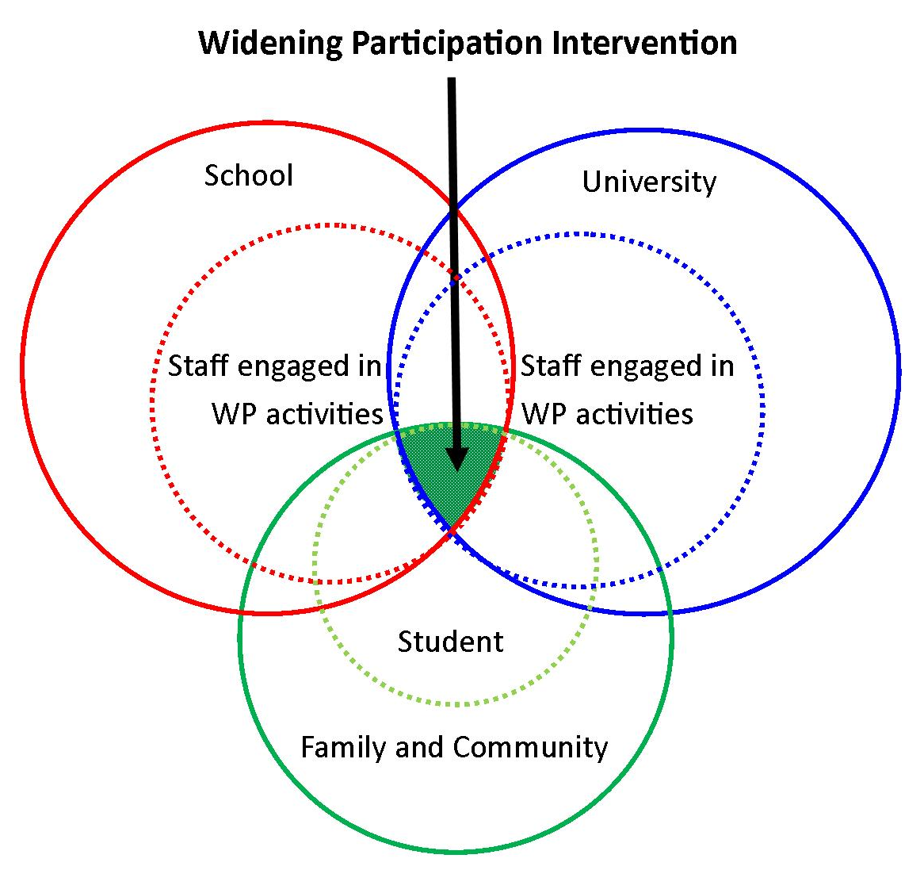
Context & the field of HE progression

Slide 12
Reflexivity & key actors
Framework enables us to develop understandings and interventions with key actors in the field
Participants
Parents
School teachers
WP outreach workers
University academic and professional support staff
Regulators and SMTs

Slide 13
ANALYSIS: Considering the context
NERUPI: PRAXIS
Understanding the challenge
Research
Insights from Practice
National Policy
HEI’s Mission & APP targets
Local economy & communities
Local Education
Understanding the processes involved in bringing about the change
Evaluators & researchers
Organisers of interventions
HE staff & students

Slide 14
The NERUPI Framework
Designed to maximise the impact of Widening Participation interventions providing:
a robust theoretical and evidence-based rationale for the types of intervention that are designed and delivered
clear aims and learning outcomes for interventions, which enable more strategic and reflexive design and delivery
an integrated evaluation process across multiple interventions to improve data quality, effectiveness and impact

Slide 15
PLANNING: implement intervention
Target group characteristics
Defining your interventions
Aims
Understanding the processes involved in bringing about the change
Pedagogy
Curriculum
Organisation & logistics
Embed research and evaluation

Slide 16
ACTION: implement intervention
Target group characteristics
Defining your interventions
Curriculum
Embed research and evaluation
Understanding the processes involved in bringing about the change
Pedagogy
Organisation & logistics
Communities (stakeholders)

Slide 17
ANALYSIS: evaluation and impact
Aims
Intervention
Feedback
Methods
Analysis
Results

Slide 18
Action research reflective cycle for WP
ANALYSIS
theory - OfS policy – local context - data - knowledge
PLANNING
aims - targeting - interventions - evaluation strategy- logisitics
COLLECT DATA
Monitoring – tracking – related stats – process - impact
ACTION
Deliver the interventions
ANALYSIS
Cycle repeats

Slide 19
Evaluating Equity & WP
Picciotto (2012) ‘Experimental black boxes are poorly suited to the evaluation of complicated or complex programmes in unstable environments’
Fendler (2016) translational science has been invented to concentrate on bridging laboratory finding with clinical experience.
Morrison (2017) its assumed that interventions are context neutral: the reality is ‘that “what works” is a matter of judgement
Gale (2017 ) notes causal evaluation often ‘premised on students having a problem or “symptoms” that require treatment …
(Clegg et al., 2016) 'what really matters is to know why something works'.

Slide 20
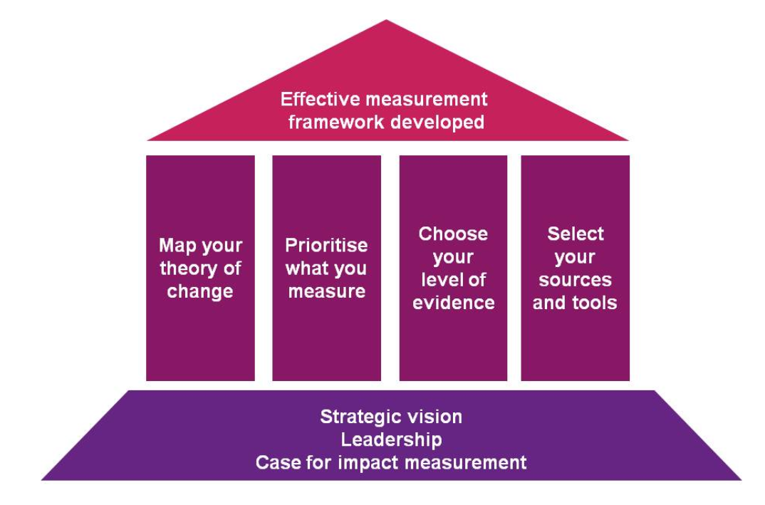

Slide 21
Type of intervention | A/P | Monitor | Track | Process | Impact
Long-term or multi-activity outreach | A
Residential (outreach) | A
Mentoring, tutoring, PAL | A/P
Campus visits | A
One-off HE info, UCAS, taster | A
HE Fair, Open day; School Assembly | A
Subject specific support | A/P
Academic Skills provision | P
Support for specific groups e.g BAME, women in STEM, WWC | A/P
Employment & progression provision | P
Residential (pre-sessional/undergrad) | P
Third sector provider | A/P

Slide 22
Design an in-depth evaluation
Identify an intervention to evaluate in depth:
Why? Strategic importance? Resource required? Previous success of event? Future planning?
Identify Aims - NERUPI & wider concerns
    Propose possible intervention(s)
Agree ideal methods – interviews, focus groups, PARS, authentic tasks e.g. academic, creative, group work,
Identify Resource Required – evaluator? assistant? external & develop delivery plan
Agree how and to whom evaluation will be reported
Notes:
Picciotto warnsNot possible, desirable or necessary to use complex methods for all interventions.

Slide 23
Goldsmiths Fine Art Case Study
Issues
70 places 1400 applicants
Students white, middle class, female
No successful applicants from local colleges
Colleges discouraging students from applying
WP students not doing well on the course
Department not engaging with WP initiatives

Slide 24
Goldsmiths Fine Art Case Study
Mixed Methods Action research project
Theory & research including ‘Art for a Few’
Analysis of application and admission figures
SARS project with Lewisham College
Surveys, focus groups and interviews with staff and students in local colleges
Survey and interviews with Goldsmiths students
Interventions developed, evaluated and adapted

Slide 25
Goldsmiths: Making it happen
Recognition by University that there was an issue
Issue clearly defined through initial data analysis
Clear theoretical base
Commitment to change from Fine Art Department
WPO links with local schools and colleges
WPO experience of developing interventions
Support from academic in education department
Funding for a research assistant

